Slide 1

Tom C. Rawlings
Director

Slide 2
Fiscal & Administration
2019 Fiscal Summit
Presented By:
Renita Jeffries, Fiscal Program Director
Cathy Phillips, RBWO Manager
Karen Hardy, Field Fiscal Services Unit Manager

Slide 3

What will we learn today?
Pre-Bill Submission, Provider Responsibilities, and Items reimbursed on Pre-Bills
Clothing Allowances
Contracts and Rate Schedules/Annexes
Waiver Letters
Respite Care
Concurrent Care/Bed Holds
Payment Processing
Standard Operating Procedures for Outstanding payments
Items that may be reimbursed by the child’s county of custody
Items that are Not billable
This Photo by Unknown Author is licensed under CC BY-NC-ND

Slide 4
What will we learn today?
Miscellaneous DFCS Policies
Q&A
This Photo by Unknown Author is licensed under CC BY-NC-ND

Slide 5
Pre-Bills
Beginning November 1st, 2018 we stopped faxing and/or mailing the pre-bills to providers. All RBWO providers must download your pre-bills on the SMILE website: https://smileonline.us/smile/wa/r/AppLogin. You must be registered on the SMILE website to download the pre-bills using your vendor number(s). If you have a problem registering or downloading the document, please call 1-800-553-5911.
The Pre-Bill is your first step in being reimbursed.
The Pre-Bills are released into the SMILE Web Portal on the last day of the month and are accessible to the providers on the first day of the following month.
They are no longer mailed to the vendors, so you must retrieve them from the SMILE Web Portal.
There is a column on the pre bills that the waiver expiration date must be entered. This is to alert the vendor to apply for another waiver.

Slide 6
Providers Responsibilities
Verify all children on your roster matches the pre-bill. Verify placement dates for the prior month and that the information for these children are correct (name, per diem, # of days, waiver amount, sibling incentive).
  Please note: Any inconsistencies should be discussed and communicated to the DFCS Case Manager who will need to ensure proper correction and/or entry in GA SHINES.
Add any new children admitted to agency using New Admit forms
Any other miscellaneous charges (clothing, medical) you must submit the original receipts.
Provider’s are required to mail Pre-bills back to their assigned payment center by the 10th day of the month with total owed. Included with the pre-bills should be the new admit forms, and if applicable a copy of any waivers for your new admits or any changes for your current children, and the receipts for any miscellaneous charges. No Fax or Scan copies will be accepted.

Slide 7
Items Reimbursed On Pre-Bill
The following items are listed on the pre-bill for payment:
Per Diem
Regular
Respite
Sibling Incentive ($3.44 per day per child each month for sibling group of 3 or more placed together in the same foster home)
ADM/WVR Cost (i.e. Foster Care/Parent Supplement) - requires signed RBWO Program Designation Waiver Letter issued by CCTU)

Slide 8
Items Reimbursed On Pre-Bill (cont)
Other
Clothing (Initial and annual clothing allowance amounts)
Car Seat (Maximum reimbursement of up to $125.00 per child up to age 8)
Medical (must be prescription drugs, not over the counter)
Supplemental Supervision (No Waiver is required for the first two weeks while CAPS is being approved)
NOTE: If supplemental supervision goes beyond two weeks, then a State waiver along with the day care receipts will be required and the payment will be made directly to the vendor
Safety Helmets ($30 per child)
NOTE: Original receipts must be attached for clothing, car seats, safety helmets, supplemental supervision and medical. Providers should retain copies of all receipts submitted in case they are lost in mailing.

Slide 9
Clothing Allowances
Initial and annual clothing allowances are available to all youth placed with a Child Placement Agency (CPA) or Child Caring Institution (CCI).
Per RBWO Minimum Standards, 11.33, to be reimbursed for clothing it must be submitted within 90 days. The 90 days starts on the first day following the month the purchases were incurred.
DFCS reimbursements must be issued to the legal entity providing services to the child, not the CPA foster home.
Beyond the six-month placement period, clothing replacement costs are limited to the amount covered in the per diem and the annual clothing allowance, if applicable.

Slide 10
RBWO Clothing (cont)
Initial Clothing – all new children entering a foster care placement or returning after break in DFCS custody are entitled to initial clothing.
Initial clothing must be utilized within the first 6 months of placement(increments or at one time)
$311 for children birth through age 12 and $415 for children 13 and over.
Annual Clothing
All children are eligible for annual clothing and can be spent in increments or at one time.
Cannot be utilized in the same calendar year a child enters care.
$415 for all age children
DFCS reimbursements must be issued to the legal entity providing services to the child, not the CPA foster home.
Beyond the six-month placement period, clothing replacement costs are limited to the amount covered in the per diem and the annual clothing allowance, if applicable.

Slide 11
RBWO Clothing (continued)
In order to be reimbursed, please follow these procedures.
Original receipts must be attached to the Pre-bill for reimbursement-please note the child’s name, the CCI or CPA and Subcontractor’s name, written on the receipt, and the names must be legible.
Name of store and date purchased must be visible on all receipts.
Receipts need to identify the articles of clothing purchased.
Separate receipts for each child are preferred. If separate receipts are not provided, please do not use high-lighters as they tend to make the amounts fade and it is hard to review the receipt.
Federal regulations do not allow DFCS to directly pay a retail vendor for clothing.
DFCS county directors do have the authority to grant an additional initial clothing entitlement for children in “dire need” of additional clothing: however the need must be documented. Providers must obtain approval prior to incurring the cost. This is entered as a waiver amount.

Slide 12
***County clothing is NOT paid through the RBWO Pre-Bill system. These charges must be listed on a foster
care invoice and sent to the appropriate county for reimbursement.

Slide 13
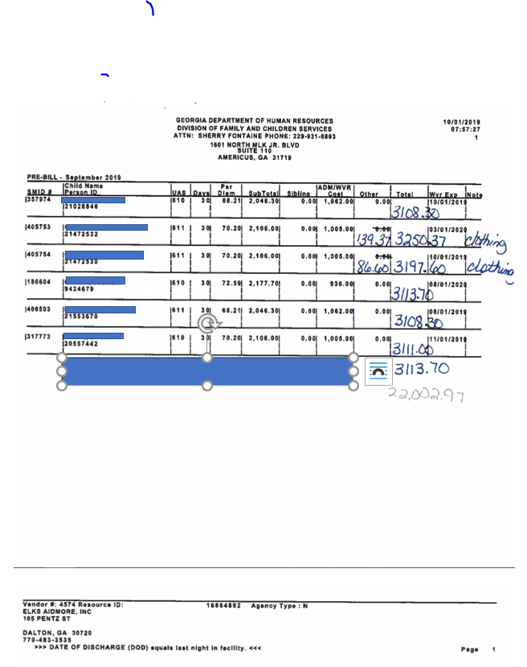
Prebill

Slide 14
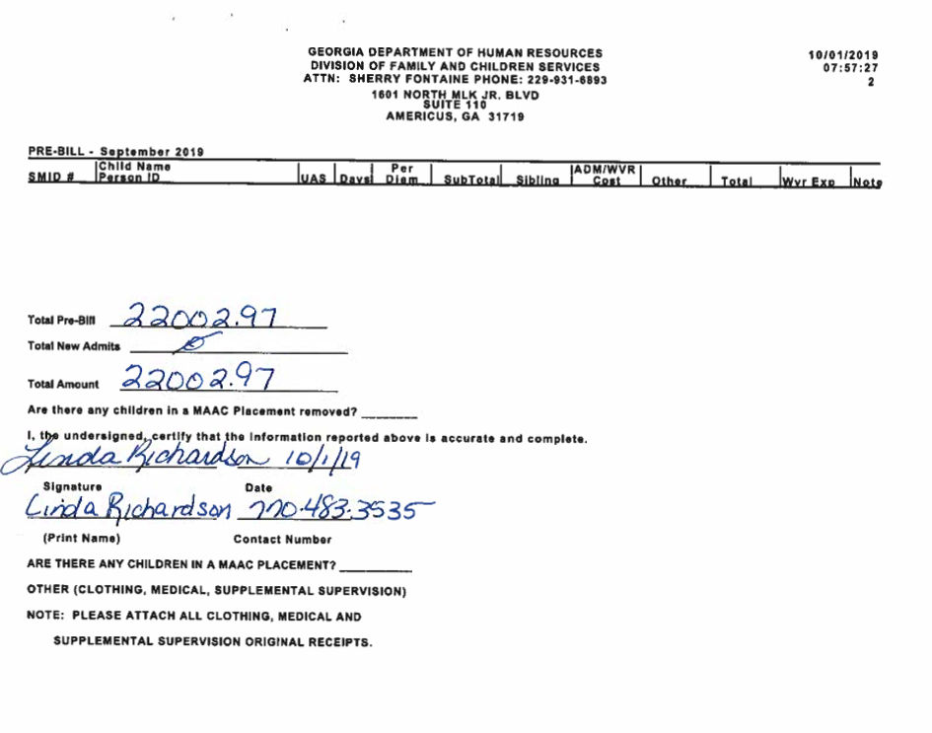
Signature Page
of
Prebill

Slide 15
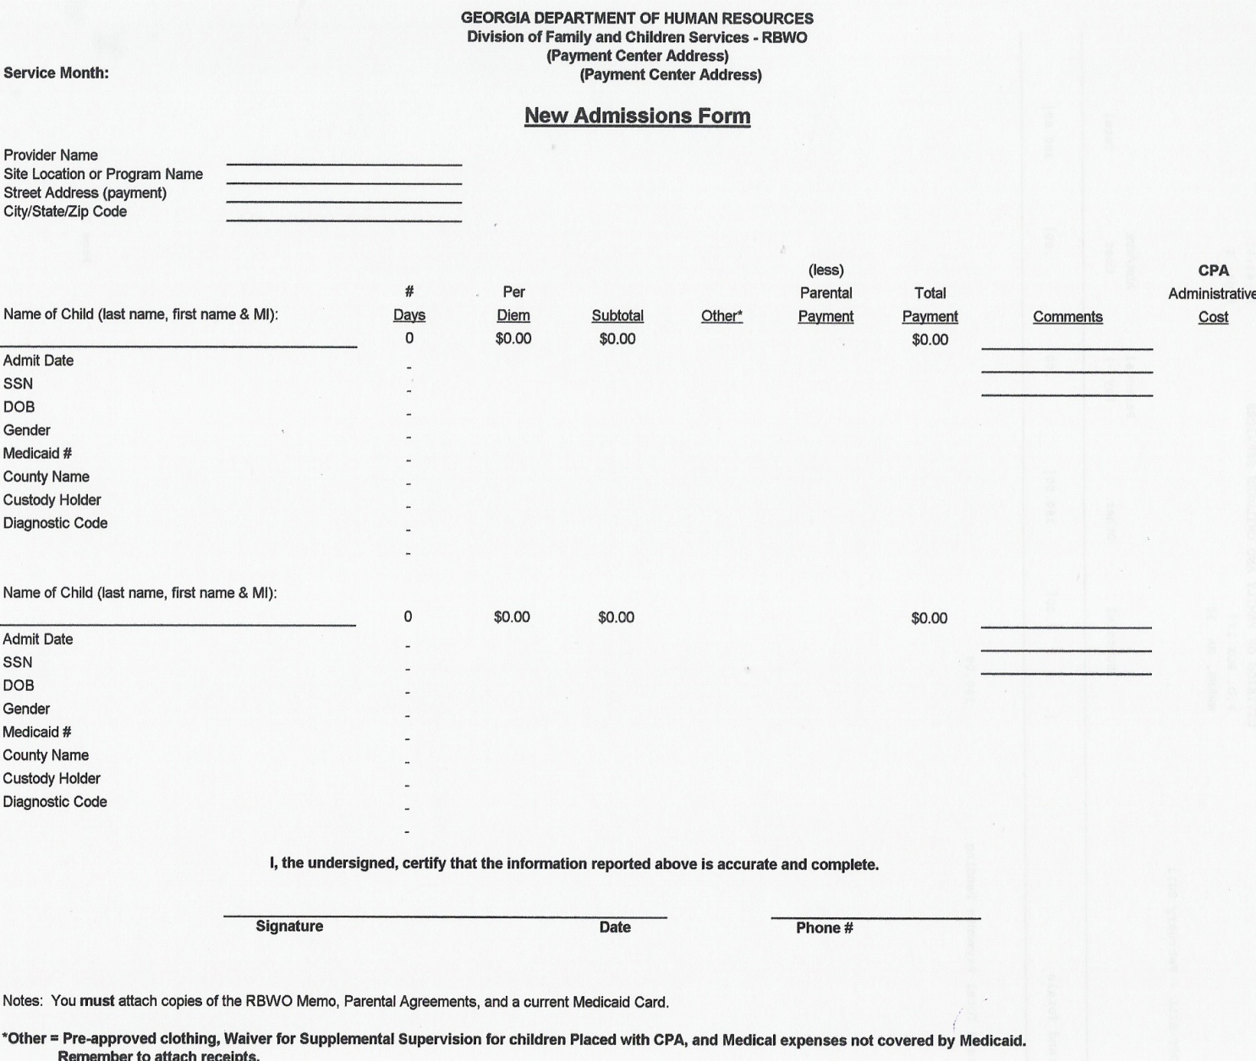
New Admit
Form

Slide 16
Contracts and Rate Schedules/Annexes
Provider rates are set and monitored by the DFCS Fiscal and Administration unit. Current rates are based on the state approved RBWO rate structure.
A Rate Schedule Annex is included in the providers RBWO Contract for each DFCS fiscal year.
Each rate schedule has a Vendor ID number, Resource ID number, site location, mailing address, effective date, rate amount, and capacity (applicable to only CCI rate schedules)
Please Note: Per the Scope of Services section in the provider contracts: To accept children only within their approved program designations on their Rate Schedule, Annex titled Payment Provisions, and contractual capacity. The contractor further agrees that all per diems will be paid in accordance with contracted program designations and associated per diems. The contractor further agrees to ensure that per diem payments to foster parents match the amount indicated on the Rate Schedule.

Slide 17
Waiver Letters
Individual Waiver Letters for youth may be approved on an individual basis by the Care Coordination Treatment Unit (formally PRO) through the Universal Application Process for youth that meet specific needs which require a supplement that is above he standard state per diem rates. For more information on the Application Process please see Appendix D of the RBWO minimum standards
DFCS Case Managers should work with providers if there appears to be a need to obtain a waiver letter. The DFCS case manager will submit Universal Application Form to the Care Coordination Treatment Unit within the first 30 days of the child entering placement.
Waivers should not be used as the source document for paying standard per diem rate or for paying standard rates to foster parents.

Slide 18
Waiver Letters Continued
DFCS case managers are responsible for entering RBWO Waiver information into GA Shines, and uploading the letter into the External Documents section of GA Shines.
Providers can access the GA Shines vendor portal to check if the youth’s Waiver Letter has been updated correctly into GA Shines.
In addition to giving Waiver Letters directly to Regional Accounting staff for payment processing; Providers must also give the Waiver Letters to the DFCS case manager to ensure that the letter is entered and uploaded into GA Shines.

Slide 19
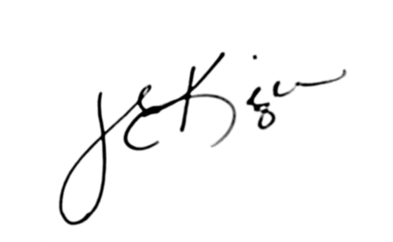
Waiver needed to pay above base rate
Please Note: effective on 2/1/15 means the payment is paid on that date, end date on 2/1/16 means it has ended and there is no payment made.

Slide 20
Respite Care
Respite for family foster care providers is a support service to allow foster parents “time away” from their parenting responsibilities. Only children in DFCS and RBWO CPA approved foster homes are eligible for this service.
Respite care is paid at the youth’s current per diem rate less the agency rate, up to ten (10) days per foster home per fiscal year.
The respite days may be taken individually or consecutively in a fiscal year. Respite care providers must meet DFCS established standards.
Respite is paid at the youth’s age/foster parent per diem rate and waiver amount only, Agency rate not included.
Respite placements must be approved by the custody county DFCS Case Manager with an email or memo (stating the home where the child is placed and dates) and entered in GA SHINES. Please attach this email or memo to your pre-bill when submitted for processing.
`

Slide 21
Concurrent Care/Bed Holds
For Bed Holds: Per Diem payments may be paid to a youth's provider (FFC or RBWO) during the youth's absence of up to 10 days in a calendar month. This provision requires the absence of the youth to be planned and purposeful for the following 3 reasons only : hospitalization, runaway, or incarceration status.
For Concurrent Placements: Per Diem payments may be paid to a youth's provider (FFC or RBWO) during the youth's absence of up to 10 days in a calendar month. This provision requires the absence of the youth to be planned and purposeful for the following reasons: when visiting with a parent/relative; visits to another facility for possible moves or evaluations and foster parents are attending required training that involves overnight stays.
Concurrent placements must be approved by the custody county DFCS Case Manager with an email or memo (stating the home where the child is placed and dates) and entered in GA SHINES. Please attach this memo to your pre-bill when submitted for processing.
If a youth is away at college and is still in DFCS custody; then a concurrent placement must be entered and approved by the DFCS Case Manager each time the child visits the CCI/CPA placement.
Per diem payments will only be made to the provider caring for the child.

Slide 22
RBWO Payment Processing
Your Payment Center staff will take your Pre-Bill when received and verify that each placement listed on your Pre-Bill has created an invoice in SHINES and will validate it for processing, and will add any miscellaneous (clothing, medical) charges at that time.
For invoices to systematically generate in GA SHINES, the DFCS case managers would need to ensure that all placement and payment of care data has been entered and approved by the last working day of the month for their children. Therefore, if an invoice is not in the GA SHINES system, this requires additional research with the county (not Regional Accounting) in order to have the system updated so that a manual invoice can be processed.

Slide 23
RBWO Payment Processing Continued
If there are no issues with the invoice through the GA SHINES nightly validation process, then the system will move them to Approval Status where it will be approved by a Regional Accounting Supervisor. If the invoice rejects, the Payment Center staff will research and work with the DFCS case managers to resolve for processing.
If the invoices do not reject in the nightly interface to SMILE, then the payment center staff will process the invoices that have come over to SMILE and those will be processed for direct deposit that will post 3 days from that date into your account.

Slide 24
RBWO Payment Processing Continued
If your correct email address is set up in our Statewide Database, you will receive an email the day before the funds are to post to your bank account.
In order to obtain your Post Bill to compare against the original Pre-Bill, you will need to set up your vendor(s) on the SMILE website
https://smileonline.us/smile/wa/r/AppLogin.

Slide 25
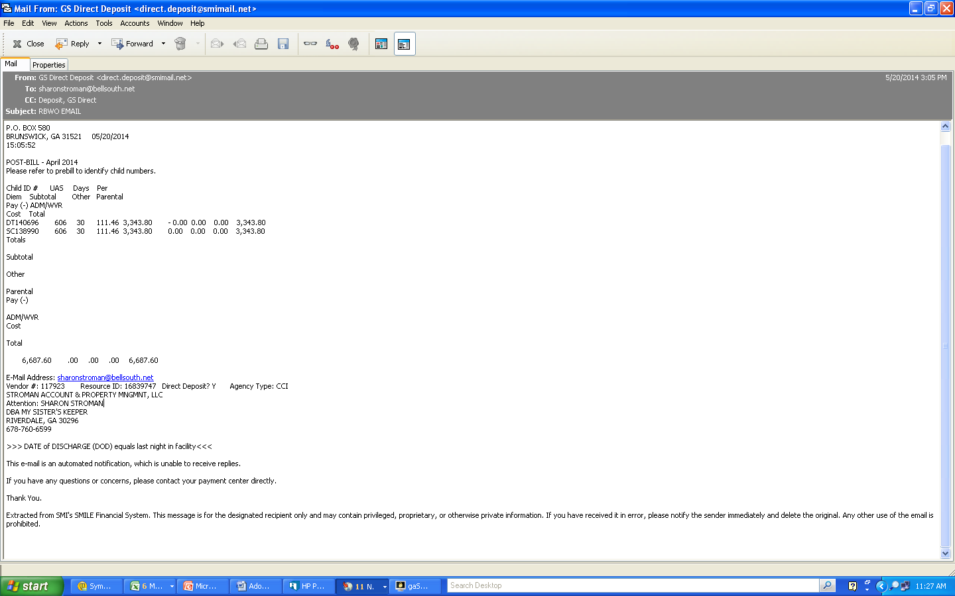
Email for Direct Deposit

Slide 26
Example of
SMI Website
Backup for payments

Slide 27
Standard Operating Procedures for Outstanding Payments
If all the information from the pre-bill is correct, the RBWO/Fiscal Payment Center will process the invoice within 5 (five) business days of receipt.
If payment for a specific child has not been received in 30 days after the billing month the provider must contact the DFCS Case Manager via email. If they do not receive a response within 24-48 hours, they should escalate the request to the case managers Supervisor or Field Program Specialist(FPS).
If payment for a specific child has not been received in 45 days after the billing month the provider must contact the County Director via email of the county that has custody of the child.
If payment for a specific child has not been received in 60 days after the billing month the provider must contact Region Director and District Director via email who is over the county that has custody of the child.
  PLEASE NOTE: Regional Accounting can not process any placement for payment that has not been entered and/or approved in the GA SHINES system. Therefore, you should not reach out to them first about outstanding payments. Please follow the SOP procedures above.

Slide 28
Standard Operating Procedures for Outstanding Payments continued
If payment for a specific child has not been received after 60 days of the billing month the provider must then fill out the RBWO Outstanding Payment Report and remit it via email to your RBWO Payment Center, Cathy Phillips and Karen Hardy.

Slide 29
Items that may be reimbursed by the child’s county of custody
Items listed below are submitted to the custody county by the provider for reimbursement on Foster Care Invoice Form 526 (not on the pre-bill)
Safety Enrichment $500 maximum per child per DFCS fiscal year
Requires DFCS CM approval
Promotes the well-being of children in foster care by providing them with extra-curricular activities that are available through a licensed community center, licensed childcare center, licensed family day care center, or programs through the Red Cross, YMCA, Girls and Boys Club, schools, colleges, churches, etc.
Examples include: Summer camps and Sports camps, Swimming, gymnastics, karate or other sports related lessons, Music, dance, art lessons

Slide 30
Items that may be reimbursed by the child’s county of custody (continued)
Miscellaneous expenses
Some counties may pay for the following expenses, but are on a case by case basis and may require prior approval before being billed to the custody county on a foster care invoice
Clothing not qualified to be initial or annual
Haircuts
Allowances
School supplies or activities
State ID – 18-year-old
Property Destruction approved on case by case basis
Diapers, Wipes, Formula

Slide 31
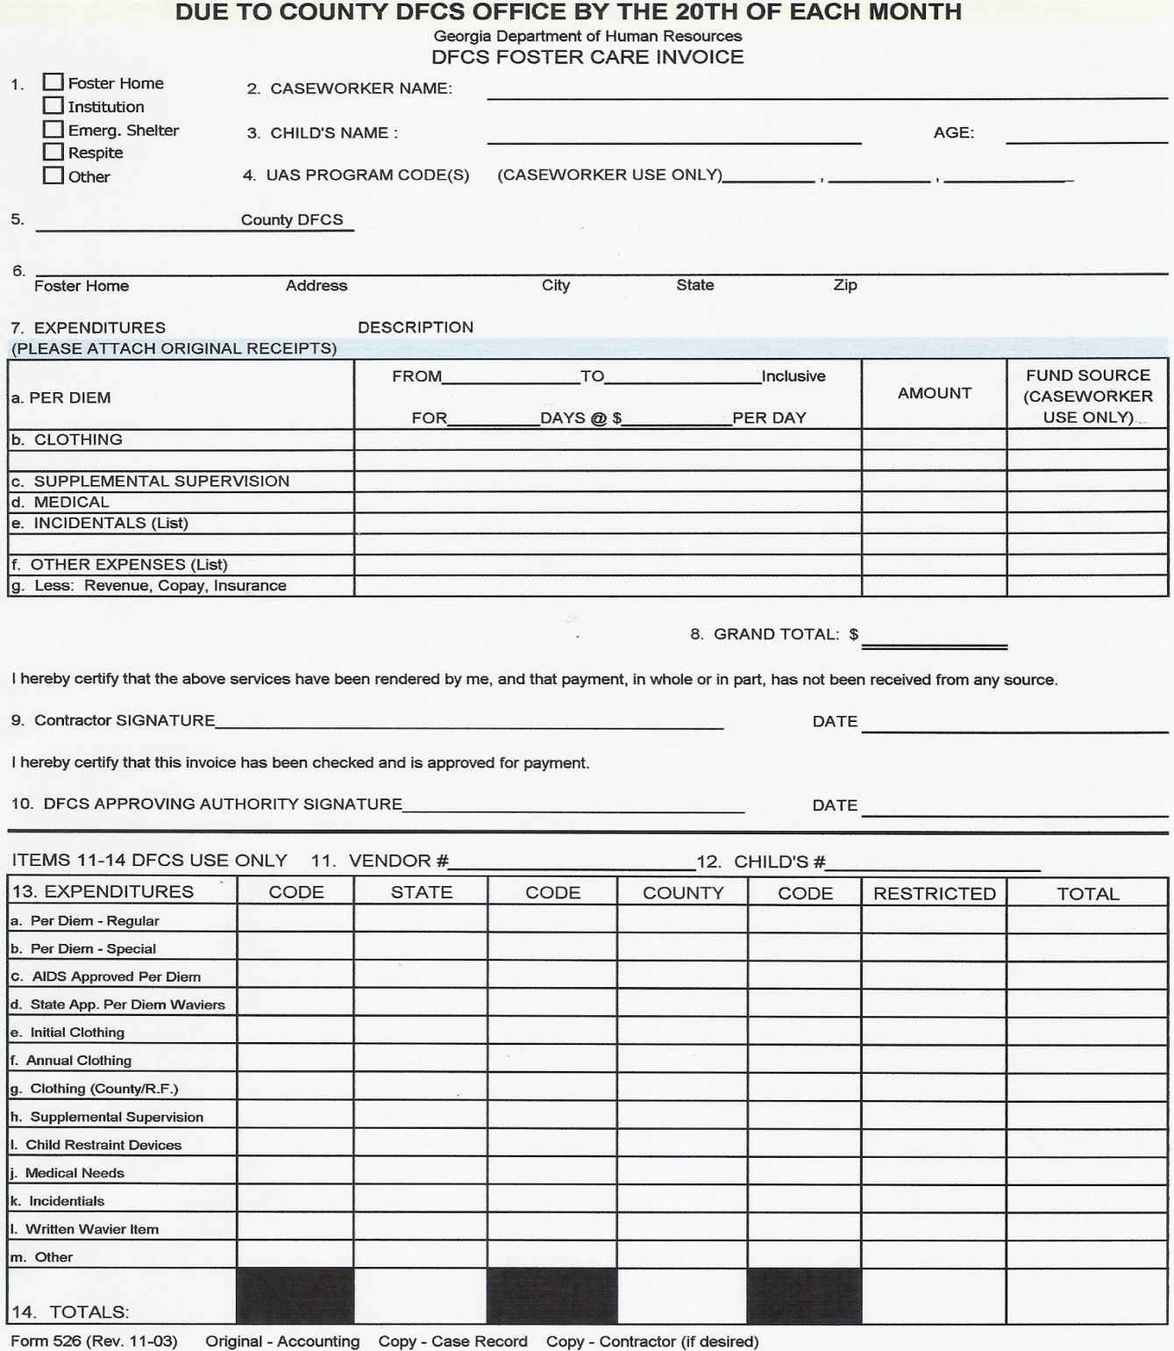
County Foster Care Invoice

Slide 32
Items that are Not billable
Items listed below are non billable items on either the pre-bill or Foster Care Invoice and are incurred costs by the CCI or CPA agency.
Foster Home Renovations/Accommodations (i.e. generators, access ramps)
Live Scan Fingerprinting for staff
Live scan for anyone living in the home over 18 years old
Bathroom accommodations (i.e. widening door, expanding shower, wheelchair accessible, medical necessary accommodations)

Slide 33
Miscellaneous DFCS Policies
Head in the bed rule is:
“We only pay the placement where the child sleeps for the entire night.”
No county expenses are paid from RBWO those must be sent to the custody county on the foster care invoice to be reimbursed. These should be approved by the county before expensed. See invoice in hand out.
Expenses such as birth certificates and airline tickets through Travel, Inc will be paid from GIA on the regional accounting books.

Slide 34
Miscellaneous DFCS Policies (continued)
Payment correction-approved waivers- Waivers should not be “retro-dated” as this causes problems with the payment process.
New waivers should be requested well in advance before the expiration of existing waivers as to not cause payment processing delays.
Funeral Cost are paid thru RBWO. The invoice from vendor, W-9 and e-verify form are needed to pay.

Slide 35
Miscellaneous DFCS Policies (continued)
Medical payments can be paid if approved, if for some reason Medicaid does not pay for the expense, such as medications(prescriptions), supplies, equipment, medical, dental, vision, therapy services. The invoice from vendor, W-9, e-verify form to pay and approval from county are needed for payment.
Unusual Medical/Dental expenses above $5000.00 must be approved by the Regional Director, such as braces, specialized medical equipment/beds, etc. Individual invoices are required, we do not pay the vendor up front before services are rendered.

Slide 36
Renita Jeffries, Fiscal Program Director rbwofiscal.services@dhs.ga.gov
Cathy Phillips, RBWO Manager
Cathy.Phillips@dhs.ga.gov
Karen Hardy, FFS Unit Manager
Karen.Hardy@dhs.ga.gov
Additional resources: http://ffs.dhs.ga.gov/ffs/index.php
COSTAR fiscal services website https://smileonline.us/smile/wa/r/AppLogin
SMI payment website

