Slide 1
Tom C. Rawlings
Director

Slide 2
Interstate Compact On The Placement of Children

Slide 3
ICPC Administrators ICPC Unit Director Niesha.Robinson@dhs.ga.gov 404-550-4264
Program Assistant File Room Clerk
Rebecca.Mason@dhs.ga.gov Wendell.Murray@dhs.ga.gov
404-623-2919 678-739-7695
Shauna.Hutchins@dhs.ga.gov Shuan.Leonard@dhs.ga.gov
B-C A-H-I-J
770-303-6950 470-322-0685
Connie.Daniel@dhs.ga.gov Margarita.Dyer@dhs.ga.gov
K-L-M-N-O Q-R-S-T
404-430-6572 404-615-9497
Yetiva.Haynes@dhs.ga.gov Michelle.Williams3@dhs.ga.gov
D-E-F-G-P U-V-W-X-Y-Z
404-989-2565 404-987-5001

Slide 4
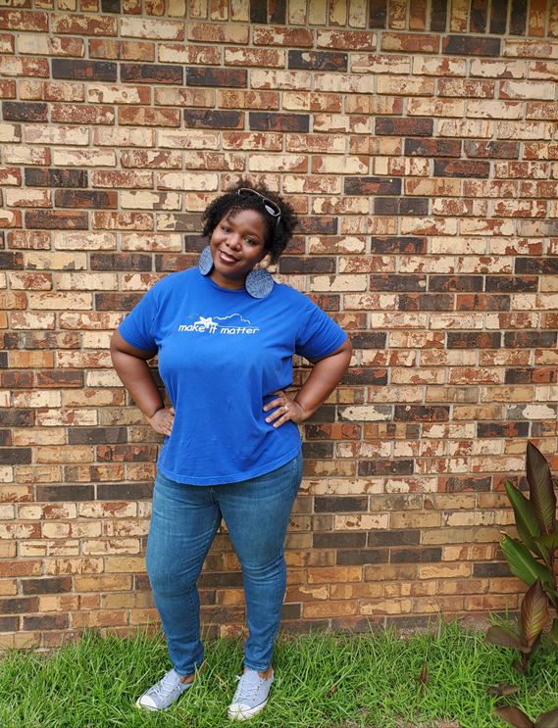

Slide 5
History Of ICPC
Social Services staff met informally to address issues surrounding and problems facing children placed across state lines for the purpose of adoption and foster care
Written in the 1950s- legal binding agreement
Compact is a uniformed law enacted by all 50 states, the District of Columbia and US Virgin Islands
Georgia enacted the compact in March 1977

Slide 6
ICPC Articles (O.C.G.A 39-4-4)
Article 1 – Purpose and Policy
Article 2 – Definitions
Article 3 – Conditions for Placement
Article 4 – Penalty for Illegal Placement
Article 5 – Retention of Jurisdiction
Article 6 – Institutional Care of Delinquent Children
Article 7 – Compact Administrator
Article 8 – Limitations
Article 9 – Enactment and Withdrawal
Article 10 – Construction and Severability

Slide 7
ICPC Regulations
Reg 1: Conversion of Interstate Placement into Interstate Placement: Relocation of Family Units
Reg 2: Public Court Jurisdiction Cases: Placement for Public Adoption or Foster Care in Family Settings and/or with Parents/Relatives
Reg 3: Definition and Placement Categories: Applicability and Exemptions
Reg 4: Residential Placement
Reg 5: Central State Compact Office
Reg 6: Permission to Place Child: Time Limitations, Reapplication
Reg 7: Expedited Placement Decision
Reg 8: Change of Placement Purpose
Reg 9: Definition of a Visit
Reg 10: Guardians
Reg 11: Responsibility of States to Supervise Children
Reg 12: Private/Independent Adoptions

Slide 8
ICPC Authority/Guidance
O.C.G.A. 39-4-1 through 39-4-10 (39-4-4 has the articles)
ICPC Articles
https://aphsa.org/AAICPC/text_icpc.aspx?WebsiteKey=1c52ac76-f593-4bbc-8980-1820609f983a
ICPC Regulations can be found here:
https://aphsa.org/AAICPC/ICPC_Regulations.aspx?WebsiteKey=1c52ac76-f593-4bbc-8980-1820609f983a
ICPC State Pages
http://icpcstatepages.org/
DFCS Policies 15.0 through 15.8 can be found here: http://odis.dhs.ga.gov/ChooseCategory.aspx?cid=1029 (select MAN 3000 and scroll down to Chapter 15)

Slide 9
Compact Applies to the following Situations:
Placements with parents and/or relatives when a custodial parent/relative is not placing the child on their own accord
Placements into foster care, including foster home, group homes, residential facilities, and institutions
Placements of adjudicated delinquents in institutions in other states

Slide 10
ICPC and CPA partnership
A current or prospective foster parent is identified in GA to care for the foster child who’s in the sending state’s (any state other than GA, District of Columbia and the Virgin Islands) custody
A contract is developed between the sending state and the Child Placing Agency (CPA)
The contract will entail the request(s) of the sending state which should include the completion of a home study, requested timeframe of completion (60 days), supervision(6 months), etc. from the CPA
The sending state’s ICPC unit will provide the contract to GA ICPC
The home study must be child-specific

Slide 11
Regulation 1
When a family who has been approved by the department and/or agency and has a child placed into their home needs to relocate to another state.
Applicable when supervision is ongoing; it is not necessary for a temporary relocation of (90) days or less.
Supervision should begin within the first 5 business days of receiving the request and is ongoing throughout the evaluation process and following approval.
Provisional approval should be provided after the first contact within (5) business days of receipt.

Slide 12
Regulation 2
Public Court Jurisdiction Cases, Foster Care Placements, Adoptive Placements and Placements with Parents/Relatives
For home evaluation requests with families approved with a private agency we need a signed contract between the agency and the county prior to accepting the request.
Processed within 60 calendar days after the receiving states local county has received the request.
A decision may be postponed to meet certain requirements (i.e. for the resource to be licensed as a foster/adoptive home), but the reason for the delay and anticipated date for a decision should be provided to the receiving state.

Slide 13
SAFE Home Study
Application
Visits with prospective foster family
Questionnaire I and II
Harvesting Sheet
Interview worksheet
Desk Guide Ratings
Psychosocial Inventory
Mitigation
Final Home Study Report

Slide 14
Verifications
IMPACT certification
Driver’s license/insurance or transportation plan
Marriages, Divorce and Death
Smoke Alarms
Pet Inoculations
Firearms (no longer need specific statement)
Gas Heaters
Unvented fuel-fired heathers
Swimming Pools
Environmental Inspection (water)
CPS Clearance
Safety Screenings
Sex Offender Registry
Department of Corrections
Boards of Pardons and Parole
Criminal Records
Confirmation Statement

Slide 15
Verifications cont’d
References
Desired placement
Approval letter
Proof of Citizenship or Legal Alien Status
Form 36 (medical report and TB test results)
Form 44 (financial statement)
Form 29 (Safety Assessment Form)
Form 5459 (ROI)
HIPAA form (outline the expectation that caregivers maintain confidentiality of information obtained regarding children and their families)
Proof of Income
Proof of Residence
Other Pre-Service Training

Slide 16
Safe Home Study Update/ Re-Evaluation
Required Materials include:
Safe Update Inventory
Harvesting Sheet
Safe Update Questionnaire
Safe Update Report
Proof of Income (Financial Statement)
Safety Screenings

Slide 17
Regulation 6 Home Study Approval
ICPC approved home study valid for 6 months from the date the receiving compact administrator signs the 100A

Slide 18
Regulation 11
Following placement, supervision of a child by the receiving state must include face-to-face visits at least once each month
The receiving state provides the sending state with a supervision report at least once every 90 days. Supervision reports should include:
- Date and location of contacts;
Summary of current circumstances, including a statement regarding the child’s safety and well-being;
Education, health and mental health updates;
Assessment of the placement/caretakers;
Description of any unmet needs;
Recommendation regarding continuation of the placement or finalizing a permanency option

Slide 19
Regulation 11 continued…
Two monthly collaterals
Quarterly report required or RBWO monthly report in addition to your GA SHINES Log of Contacts.

Slide 20
How can we help?

Slide 21
Questions
ICPC@dhs.ga.gov

