Slide 2
AGENDA
Welcome
PBP Summary
Common Errors
RPPS
Policy Violation Assessment
PBP FY17
Recruitment & Retention Plan
Wrap Up

Slide 3
PBP Summary Scores
140 CCI SCORE SUMMARY
During Q2, 99% earned a grade of A-C as compared to Q1 97%.
34% earned more than 100 points; scores ranged from 100.02 to 110.00 points.
1% scored below the threshold with grades of D or F.
No providers earned a grade of D.
1 provider earned an F.
1 provider was not graded because of no placements or staff during the quarter.

Slide 4
Common Errors
Tiffany Cutliff, Monitoring Manager (Green Team)
Admissions
Discharges/Placement Moves
Underage Placements
Michelle Williams, Monitoring Supervisor (Green Team)
Academic Supports
Purposeful Documentation
Shakaria Glass, Monitoring Supervisor (Red Team)
Maintaining GA+SCORE
Individualized Skills Plan
Family Contact
Karsten Hartman, Monitoring Manager (Red Team)
RPPS Reminders
Significant Events
Automated Emails

Slide 5
Admissions
4.1 Providers must only accept referrals for children with program designations for which they have been approved unless a waiver has been granted by OPM.
RBWO Contract
CCI Capacity Approval

Slide 6
Discharges/Placement Moves
Discharges
Whenever a youth leaves one placement to go to another.
A discharge can occur within the same program.
Whenever a youth is moved from one site to another, it is considered a discharge.
A discharge summary is required at each discharge.
RBWO Minimum Standard 5.9-A Discharge Summary must be provided to the DFCS case manager at the time of notification of placement move/disruption but no later than 24 hours from the provider.

Slide 7
Underage Placements
When is a waiver required?
Group Care or CCI Settings
a. No child younger than twelve (12) years of age (0-11) in the custody of Fulton or DeKalb County will be placed in a group care setting without the express written approval of the state DFCS Foster Care Services Director based upon his or her certification and specific finding that the individual child has needs which can be met by the particular group care setting and that the particular group setting is the least restrictive placement that can meet such needs.
b. For the other 157 counties, no child younger than 11 (0-10) will be placed in a group care setting without the express written approval of the DFCS Foster Care Services Director based upon his or her certification and specific finding that the individual child has needs which can be met by the particular group care setting and that the particular group setting is the least restrictive placement that can meet such needs. Regional Directors can approve placements for children age eleven (11).
c. No child under age twelve (12) that has been appropriately approved for a CCI placement will be placed will be placed in any group care setting that has a capacity in excess of twelve (12) children. This will not apply to a child who is under six (6) years of age (0-5) and who is also the son or daughter of another child placed in a group care setting.
*Note: The Regional Director has night and weekend approval authority until the next business day for waivers requiring the State Foster Care Services Director
Waivers must be signed by the approving authority
SHINES policy waiver printout is not sufficient

Slide 8
Academic Support
Definition - an educational activity, service or resource that assists the child with meeting learning standards, accelerates their learning process, and encourages and promotes the child’s overall academic success.
Applies to children who are enrolled in grades K-12 or a GED program.
Two (2) required per month, per child. Six (6) required per month, per child for incentive credit.
A description of each academic support must be properly dated and documented in the child’s case record.

Slide 9
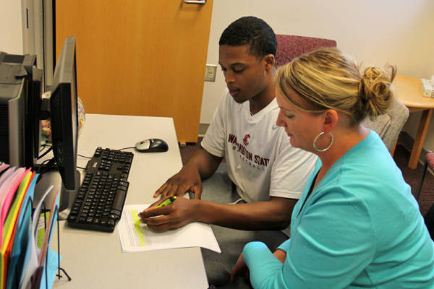
Academic Support Examples
Tutoring
Attendance at school meetings (IEP, PTA, conference, etc.)
Digital and online learning applications
Community enrichment activities
Summer programs that include learning activities
Homework Assistance

Slide 10
Every Child, Every Month (ECEM)
A purposeful, face-to-face monthly contact with the child placed.
Must take place in the child’s residence.
Conducted by the Human Service Professional (HSP), Life Coach or Case Support Worker (CSW).
Documented on the guided narrative in GA SHINES that addresses Safety, Permanency and Well-Being.
Must be documented within 72 hours of the visit in GA SHINES.
Applies during the child’s first full month in the placement.
A child is not required to receive an ECEM during partial months in care.
However, the provider receives credit if a child is in care for a partial month and the provider nevertheless conducts an ECEM during the month.

Slide 11
Every Child, Every Month (ECEM) cont’d…
Documentation must include the following:
a. Developmental, social, emotional progress and challenges
b. Progress on Individual Service Plan goals
c. Child’s involvement in the permanency case plan
d. Issues pertinent to safety, permanency and well-being
e. Any concerns or red flags
f. Any need for follow-up and next steps.

Slide 12
General Contact
A purposeful, face-to-face monthly contact with the child placed.
Does NOT need to occur in the residence.
Generally focuses mainly on safety and well-being.
Conducted during the first week of the child’s placement then once per month.
Conducted by the Human Service Professional (HSP), Life Coach, Case Support Worker (CSW) or Case Support Supervisor (CSS).
Must be documented on the standard narrative or guided narrative in GA SHINES.
Must be documented within 72 hours of the visit.
Cannot be conducted on the same day as the ECEM.

Slide 13
Maintaining GA+SCORE
Information in GA+SCORE should be kept up to date per the timeframes outlined in the RBWO Minimum Standards.
Provider Profile
Child/Staff Rosters

Slide 15
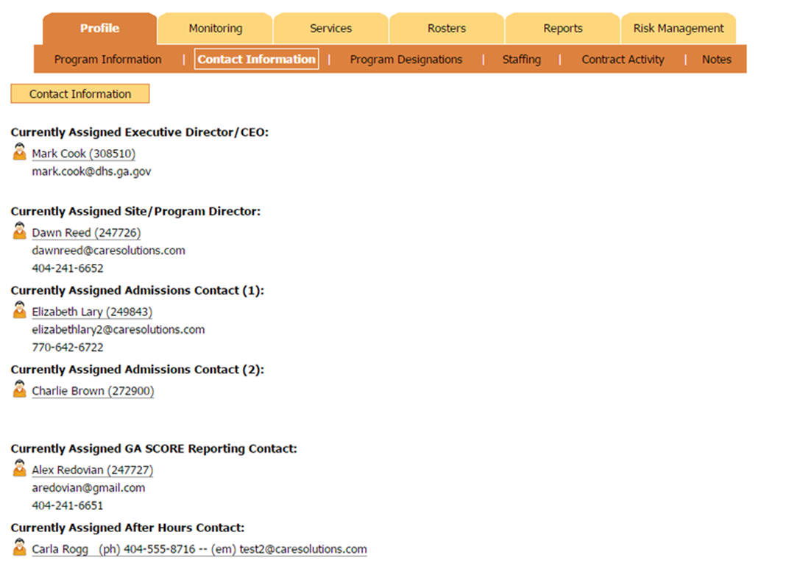

Slide 16
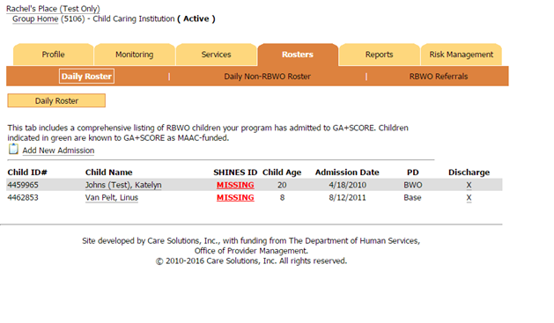
Child Roster
RBWO
Non-RBWO
RBWO Referrals

Slide 17
Individualized Skills Plan
RBWO Minimum Standard 10.0
Providers who care for youth ages 14 years and up will develop Individualized Skill Plans based upon the Casey Life Skills Assessment (CLSA). The individualized skill plan is a supportive component to the DFCS Written Transitional Living Plan (WTLP). The individualized skill plan must be updated every six months.

Slide 18
FAQ : Individualized Skills Plan
What is the Individualized Skills Plan? Is it the same as the service plan?
A: The Provider’s service plan for youth age 14 years and up that focuses on independent living skills. The skills plan can be a component of the youth’s Individual Service Plan (ISP) or a stand alone document.

Slide 19
FAQ : Individualized Skills Plan
What should be included in the plan?
A: The provider will use the results of the youth’s completed Casey Life Skills Assessment (CLSA) to develop goals, objectives, and interventions for the youth.

Slide 20
FAQ : Individualized Skills Plan
How often should a youth retake the Casey Life Skills Assessment (CLSA)?
A: Youth complete the CLSA at ages 14, 16 and 17 ½
years and annually for youth ages 18 to 21 years.

Slide 21
Family Contact
Provider’s role in permanency is to provide supportive services to assist DFCS in achieving permanency for children.
Family contact is a right, not a privilege.
Visits/phone contact CANNOT be canceled as a consequence for negative behavior.

Slide 22
Stronger Families for a Stronger Georgia

Slide 23
RPPS Reminders

Slide 24
Number One:
ALL providers are required to have a policy and to put these standards into practice. There are no exceptions.

Slide 25
Number Two:
RPPS decisions must first and foremost be “reasonable” and “prudent.”

Slide 26
Number Three:
When making RPPS decisions, it must be clear that the child is benefitting in efforts to create normalcy. RPPS is not intended to be an advantage for the agency/caregiver.

Slide 27
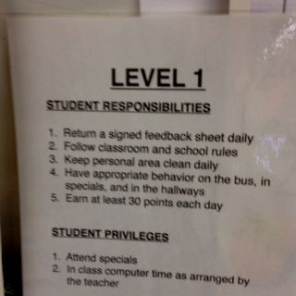
Number Four:
Individual agency practices and programs do not supersede Child Welfare Policy related to RPPS.

Slide 28
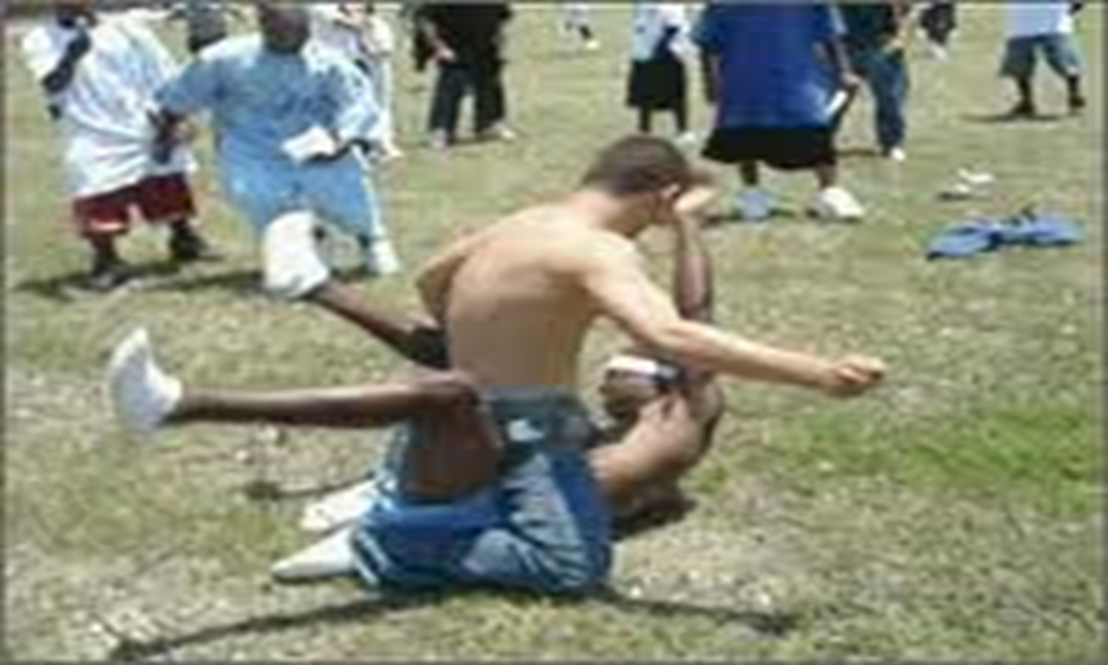
Significant Events Review

Slide 29
Providers must notify OPM whenever there is a Significant Event relating to the provider’s operation or to the care or protection of children in its care. Notification must be made as soon as possible but within one business day via GA+SCORE. Additionally, based on circumstances and the severity of situations, providers should use good judgment in determining which Significant Events should also be reported verbally to OPM.
STANDARD 1.12

Slide 30
REPORTABLE EVENT CATEGORIES (1 0f 2)
Automobile Accident
Child on Child- Sexual acting out
Child on Child- Physical confrontation
CPS Involvement
Death
Emergency Safety Intervention (10+) more than 10 times in one month for all children in the agency
Emergency Safety Intervention (3+) 3 or more times in one month on the same child
Emergency Safety Intervention (Injury)- any ESI resulting in injury
Environmental Safety/Physical Plant
Fire Department Involvement

Slide 31
REPORTABLE EVENT CATEGORIES (2 0f 2)
Good News
Impact from Natural Disaster, Fire, or Flood
Inappropriate Discipline/Corporal Punishment
Legal Action-Federal state or local litigation against agency or staff member
Media coverage
Medical Care, Emergency – Hospitalization, ER visit, injury requiring more than First Aid, serious injury
Medical Care, Emergency – Resulting from a medication administration error
Medical Care, Planned – Hospitalization, outpatient invasive procedure
Medication Refusal
Neglect
ORCC Investigation Initiated
Police Intervention (Assault, Community or school issue, Drugs, Other, Runaway, Theft)
Psychiatric Emergency (1013)
Staff to Child- Other confrontation
Staff to Child- Physical confrontation
Suicide/Homicide- Attempt
Suicide/Homicide- Threat
Temporary Closure of a Living Unit
Other

Slide 32
“Other”
Please note that the use of “other” should not be routine as a Significant Event reporting type.
In addition, under-reporting could significantly impact your agency’s Comprehensive Review score.

Slide 33
You may be contacted by OPM if: … your report was not clear about exactly what happened. … your report did not include critical information (immediate corrective actions, safety plan, location of children, action against staff member, etc.). … you used an inappropriate category.
And…???

Slide 34
Documentation Best Practices
Be thorough, but to the point
Avoid unnecessary information
Stick to the facts, don’t speculate
Use full names of DFCS children and involved staff members

Slide 35
GA+SCORE’s
Automatically Generated Emails

Slide 36
Please ensure that emails under the “Contact Information” tab are correct.
Alerts regarding all available reports (Comprehensive Reviews, Safety Reviews, PBP Verification Reviews), PIPs, CAPs, and PVAs are sent to the two email addresses listed under “Currently Assigned Executive Director/CEO” and “Currently Assigned Site/Program Director.”
The same person should not be listed under both of these categories.
If you are not receiving these alerts, it means that either your email address is not correct or there is no one listed at all.

Slide 37
Policy Violation Assessments
Points to Remember:
The PVA process is intended to allow you to share information you are already gathering through your internal quality improvement process.
The PVA template is recommended for use but is not required as long as the same basic information is covered via your own tool.
CPS and law-enforcement investigations take precedence over PVAs.

Slide 38
OPM PVA Responsibilities
OPM will notify agency of CPS alert and need for policy violation assessment (PVA) to be completed.
OPM will conduct “emergency” safety reviews when appropriate (based on circumstances and severity of incident)
OPM will review completed policy violation assessment within 10 days of receipt and inform provider of outcome.
OPM will provide technical support to providers as needed in the development of a CAP.
OPM will follow-up on incident/CAP during subsequent safety and comprehensive reviews.

Slide 39
Provider PVA Responsibilities
Provider will document incident in GA+SCORE (significant event) and initiate policy violation assessment within 24 hours of receiving notification from OPM.
Provider will make face-to-face contact with staff and any child impacted by the alleged policy violation within 24 hrs.
Provider will address any serious issues or concerns identified during the PVA immediately or as soon as practicable.
Provider will complete the PVA within 15 calendar days and forward the documented results to OPM via GA+SCORE.
Provider will develop a CAP (if needed) with input from DFCS SSCMs and implement within 72 hours (identify who, what, when, how, etc.).
Provider will notify OPM via GA+SCORE when the CAP is satisfactorily completed. If an admissions hold was in place, it will be removed pending completion of CPS investigation.

Slide 40
PBP FY17
Minimum Threshold increased to 85% from 70%.
For providers with the average quarterly score over the fiscal year was at least 85%, the every other year comprehensive review schedule will be applied. OPM will determine which year (of the two years) that the review will occur.
Maltreatment in care measure will be changed to all or none to support the Division’s stance on zero tolerance for maltreatment in care.

Slide 41
FY17 PBP Measures

Slide 42
2016 Caregiver Recruitment and Retention Plan
Placement Operations --- refers to our system of caregiver recruitment and retention --- including DFCS & CPA foster and adoptive caregivers, relatives, group homes; placement matching , placement stability and support & training of caregivers.

Slide 43
Goal: A Successful Placement Operations System
Best caregiver match, community location, in the least restrictive environment and the most appropriate placement type available at the right time and that lasts for the entire FC episode for any child/youth or sibling group needing placement.
Current Issues
Lack of the right resources
Lack of placement matching
Lack of placement stability
Use of Non-Contracted Providers
Young children in CCIs
State-funded PRTF / Crisis Beds
Hoteling (James.Kizer@dhs.ga.gov)
Low rate of relative placements
Children placed outside their community

Slide 44
2016 Statewide Recruitment and Retention Goals, Objectives and Interventions www.gascore.com click DFCS RD-U Teams

Slide 45
2015-2019 CFSP Diligent Goal 1 Ensure that children and youth are placed in the least restrictive and most appropriate placement.
Objective: Expand the number of foster and adoptive resources (in either the county, CPAs or CCIs) to ensure that each child needing foster care placement has at least two potential placements that reflect their need for the least restrictive and most appropriate environment by September 2019. Initial 5 Year Targets: Approve 2,500 Partnership Parents, 1,000 Resource Parents, 700 Adoptive Parents, and 300 Relative Foster Parents.
2016 Goal # 1: Each region to increase its total number of approved foster caregiver (foster and relative) resources by 20% and increase by at least twice the number of bed spaces as newly approved resources by 12/31/2016. See Appendix C for baseline goals by region.
2016 Goal # 2: Enlist the partnership of CPA providers to increase the number of their caregivers by 20% and at least twice the number of bed spaces as newly approved resources by 12/31/2016. See Appendix C for current CPA totals.
2016 Goal # 3: Enlist the partnership of CCI and CPA providers to develop at least 50 “no reject, no eject” acute MWO bed spaces by 12/31/2016.

Slide 46
QUESTIONS?

