Slide 1
Tom C. Rawlings
Director

Slide 2
The Office of Provider Management Resource Development CPA Partnership Meeting August 27 & 28, 2020

Slide 3
Initials…How long does it take to process?

Slide 4
Initials
Per OPM policy, RD has three (3) business days to process all initials. For example, if an initial was submitted to OPM on 6/23/2020 the initial is due to be approved in GA+SORE and SHINES by 6/26/2020.
On average, RD team indicated that with the implementation of SAFE it takes at least 2 hours for an average household (2 adults and 2 children under the age of 18) to process an initial assessment.

Slide 5
GA+SCORE INITIALS DATA
From Jan 1, 2019 to May 13, 2020 there were a total of 3,128 homes open in GA SCORE:
988 were withdrawn (very few being submitted to OPM);
1,434 of these homes are still in inquiry status (42 of these homes have been submitted at least once); and
696 were submitted and approved.
Note: An average of 182 days -- six months -- between the provider's self-reported inquiry date and the day the RD enters the home for approval for placements in SHINES.

Slide 6
Top 10 Reasons for Initial denials
Immunizations (Flu and Whooping cough)
Safety Screens
Lack of assessment
Incomplete or incorrect forms
Household and/or minor children not interviewed
SAFE not being utilized correctly
All forms not being uploaded
Dates are wrong in GA+SCORE and approval letter
Adult Children Questionnaire
Missing signatures (i.e. Director, foster parent and/or staff)

Slide 7
Initial home assessment data approval based on submission
271 homes approved on 1st submission
254 homes approved on 2nd submission
83 homes approved on 3rd submission
24 homes approved on 4th submission
8 homes approved on 5th submission
2 homes approved on 6th submission

Slide 8
Ex. Initial assessment with 5 submissions
OIG letter for both caregivers
Approval dates were incorrect with what is reported on the approval letter
No signature on Confidentiality statement or Caregiver Safety Agreement (form 29).
References were not uploaded (concerns with references only received from on one caregiver and not the other).
Adult children questionnaires were not uploaded

Slide 9
Re-Evaluations. How long does it take to process?

Slide 10
Re-Evaluations
Per OPM policy, RD has fourteen (14) days business days to process all re-evaluations. For example, if a re-evaluation was submitted to OPM on 6/23/2020 the re-evaluation is due to be approved in GA+SORE and SHINES by 7/15/2020 (excludes holidays).
On average, RD team indicated that with the implementation of SAFE it takes at least 1 hour for an average household (2 adults and 2 children under the age of 18) to process a re-evaluation assessment.

Slide 11
Top 10 Reasons for Re-Evaluations denials
Homes not converted into SAFE format
Immunizations outdated or not current
Missing signatures and forms
SAFE not being utilized correctly
Lack of assessment
Specialized waivers not in place
Lack of continued development training hours
CPR/FA expired
Approval period dates are incorrect
All minor children (including foster children) not being interviewed

Slide 12
Re-Evaluations data Approval based on submission
3,269 re-evaluations records that have a “Date Director Approval Re-Evaluation” between 1/1/2019-5/31/2020
Of 2,888 records that have been submitted, at least once (as of June 2020). 2,646 were eventually approved
NOTE: an average of 22 days elapsed between the day the provider created the re-eval record in GA+SCORE and the day it was approved by an RD.

Slide 13
Ex. Timeline Sixth submission denial
9/2019: Home was sent back to agency due to the assessment not being in SAFE conversion
11/2019: Conversion was done incorrectly. Wrong questionnaires were utilized. Approval dates were incorrect
12/2019:Conversion was done incorrectly as mentioned on 11/2019 with incorrect questionnaires
2/2020: Home was not submitted timely causing incorrect approval dates. Conversions was done incorrectly and included lack of assessment (caregivers health, adult children, immunizations, family strengths). Lack of 15 hours of training.
4/2020: Corrections were not addressed from 2/2020 notes.
5/2020: Lack of training hours, No CAP was completed. CPR/FA had expired. Continued concerns with following SAFE guidelines.

Slide 14
FOSTER HOMES STATUS
As of August 26, 2020, there are 2,987 foster homes:
Approval status – 2,252
On Hold – 116 (outstanding PVAs, CPS investigations, voluntary holds)
Unapproved status - 619

Slide 15
Today’s Agenda
9:10 – 9:40am | Data Overview | Shaun Johnson & Tammy Reed
9:40 – 10:10am | Foster Home Transfer Process Release of Information Form | Resource Developers & LaShaunda Daniel
10:10- 10:20am | BREAK
10:20- 10:50am | SAFE Matrix | Shelby Dorothy & Resource Developers
10:50- 11:20am | Progressive Compliance Plan | Deborah Spaulding
11:20 – 11:50am | Overdue Re-evaluations Tips & Compliance | Resource Developers & LaShaunda Daniel
11:50-12:00pm | BREAK
12:00-12:30pm | RD Safety & Quality Reminders | Resource Developers
12:30-1:00pm | Minimum Standards | Sara Beth Brown
1:00-1:30pm | Performance Based Placement | Shakaria Glass
1:30-2:00pm | Questions & Answers
Notes:
For those who may have not had an opportunity to review the agenda here’s a snapshot. Next, we will review OPM’s Foster Home Transfer process & the revised Release of Information form, Shelby Dorothy with the Consortium for Children will be going over the SAFE Matrix and form requirements, Deborah Spaulding will present on the Progressive Compliance Plan, we will then talk about Overdue re-evals and RD Safety and Quality reminders/ Sara Beth Brown will discuss the Minimum Standard changes and Shakaria Glass will do the same for PBP/ We will have a Q&A at the end; however, again you’re able to do so in the chat feature or by raising your hand. Shaun you can take it from here!

Slide 16
Transfers and Release of Information

Slide 17
Foster Home Transfer Protocol
Child Welfare Policy 14.24 Inter-County and Inter-Agency Partnership
Foster home transfer process

Slide 18
GA+SCORE Enhancement

Slide 19
SAFE MATRIX
GA SPECIFIC SAFETY CHECKLIST
SAFE Q1 (for all Applicants)
SAFE Q2 (for all Applicants and all adults living in the home)
SAFE HARVESTING SHEET
SAFE PSYCHOSOCIAL INVENTORY (PSI)
SAFE ADULT CHILD QUESTIONNAIRE (required for all adult children of applicant(s)/caregiver(s)) whether or not they live in the home or outside of the home.
GA SPECIFIC CHILD PLACEMENT PREFERENCE FORM (Must be completed by Assessor in the presence of the applicant(s)
SAFE UPDATE Questionnaire (for all applicants and all adults living in the home)
SAFE UPDATE PSYCHOSOCIAL INVENTORY (PSI)

Slide 20
Progressive Compliance Process
Deborah Spaulding, North Monitoring Manager

Slide 21
Why Is Progressive Compliance Needed?
A protocol is needed to address overall non-compliance with Minimum Standards, Child Welfare policy and other contractual obligations.
Formalized Process
Consistency

Slide 22
Phase One
Phase One focuses on providing identified needed resources and supports in addressing any form of non-compliance.
Step One:
Technical Assistance
Telephone Conference
Site Visits
Completed by all sections of OPM
This initiates Progressive Compliance Process
Step Two:
Quality Improvement Plan (QIP)
Documentation of step in GA+SCORE in provider’s OPM History file.

Slide 23
QUALITY IMPROVEMENT PLAN
A Quality Improvement Plan (QIP) is a detailed work plan intended to enhance an organization’s quality in a specific area.
Includes essential information about how your organization will design, implement, manage and assess quality.
Developed by the utilization of S.M.A.R.T. goals and should result in the reduction of the occurrence of further non-compliance in the specified area of concern.
QIP will be monitored and tracked for progress every 30 days until final completion.
Documented in provider’s OPM History file.

Slide 24
Phase Two
Assist providers with ensuring compliance with the Minimum Standards, the Division’s Child Welfare policies and contractual obligations through the utilization of corrective measures.
Decrease re-occurrence of previously identified non-compliance while partnering to provide the necessary support in ensuring meeting OPM expectations and requirements.

Slide 25
Phase Two
Telephone Conference
Office Conference
May be requested in lieu of a telephone conference dependent upon severity of concerns.
Changes to contract may be requested to address concerns.
Provider Capacity
Program Designations
Recommend Training
Admissions Suspension
Letter of Concern

Slide 26
Phase Two
PHASE TWO:
Corrective Action Plan (CAP)
This plan should be developed by the utilization of S.M.A.R.T. goals and should result in the reduction of occurrence of further non-compliance in the specified area of concern.
Duration of the CAP is up to six months.
Monitoring and supervision of the provider will be increased to ensure ongoing progress towards resolution.
CAP is monitored and tracked for progress by OPM every 30 days.

Slide 27
Phase Two
Involuntary Suspension
During a provider admission suspension, no new child or youth admissions can be made with the provider until the suspension is authorized for release.
If admissions of children and youth has been made at any time throughout the suspension, further action may be taken by OPM including or up to the removal of placements.
Involuntary Suspension
During a provider admission suspension, no new child or youth admissions can be made with the provider until the suspension is authorized for release.
If admissions of children and youth has been made at any time throughout the suspension, further action may be taken by OPM including or up to the removal of placements.

Slide 28
Phase Two
Contract Termination
OPM maintains the exclusive right to recommend and proceed with contract termination dependent upon the severity and/or nature of the policy violation infraction.
If placed on an involuntary admissions suspension for six months or more, OPM will consider contract termination if:
The ongoing suspension is due to continued failure to resolve or address identified non-compliance issues.
Lack of adherence to provider’s proposed CAP.

Slide 29
Phase Three
S.B.A.R. Completion
Summarization of the history of deficiencies including, but not limited to:
History of all technical assistance provided
Letter of Concerns
Summary of policy violations
PBP scores
Staffing concerns
Physical plant concerns
Past involuntary admission suspensions
SBAR staffed with the Permanency and Placement Director and legal team prior to contract termination finalization.

Slide 30
Suggestions
Feedback
Concerns regarding “Discipline” not reflecting partnership.
Process renamed to Progressive Compliance.
Majority of respondents (72%) identified that a progressive compliance process was needed.
Majority of respondents (80%) feel that a tiered approach will be effective.
Approximately 66% of respondents believe the progressive compliance process should be ongoing.
Questions regarding timeframe of overall process.

Slide 32
Overdue Re-Evaluations IMPACTS: Kenny A IV-E Funding Agency performance and/or expansion PERMANENCY

Slide 33
Re-Evaluation Tips:
Tracking system(s)
FP monthly contacts
Send paperwork in advance
Staying on top of DATES!
Accountability
Support

Slide 34
Family Re-Evaluation Outline
General Information
Safety
Medical Evaluation
Home and Community
Family Lifestyle & Interaction Patterns
Finances/Employment
Caregiver/household Input
-Interview all household members
-Interview all foster placements
-Document observations of children who are too young to be interviewed
General Parenting/ Caregiver Protective Capacity
Specialized Parenting
Support Systems/Substitute Caregivers
Placements during Re-evaluation Period
Updated Household Information
Continued Parent Development
Assessor’s Conclusion and Recommendations
Attestation Statement
Required Signatures

Slide 35
Family Re-Evaluation Forms
Caregiver Child Safety Agreement (Form 29)
Financial Statement (Form 44)
*CPS History Request Form
Caregiver Feedback Form
Caregiver Placement Preferences Form
Water Safety Assessment (if applicable)
Questionnaire 2 Update
Psychosocial Inventory Update (if home is already converted or written in SAFE)
Confidentiality and Privacy Standards
Supervisor Certification Form
Approval Letter

Slide 36
Safety and Quality Standard Reminders
Child Welfare Policy 14.1
Portable Heaters
Water safety assessment
Weapons, hazardous items, medications
Testing smoke and carbon monoxide detectors
Bedding
SAFE Mitigating (ratings of 3, 4, and 5’s)

Slide 37
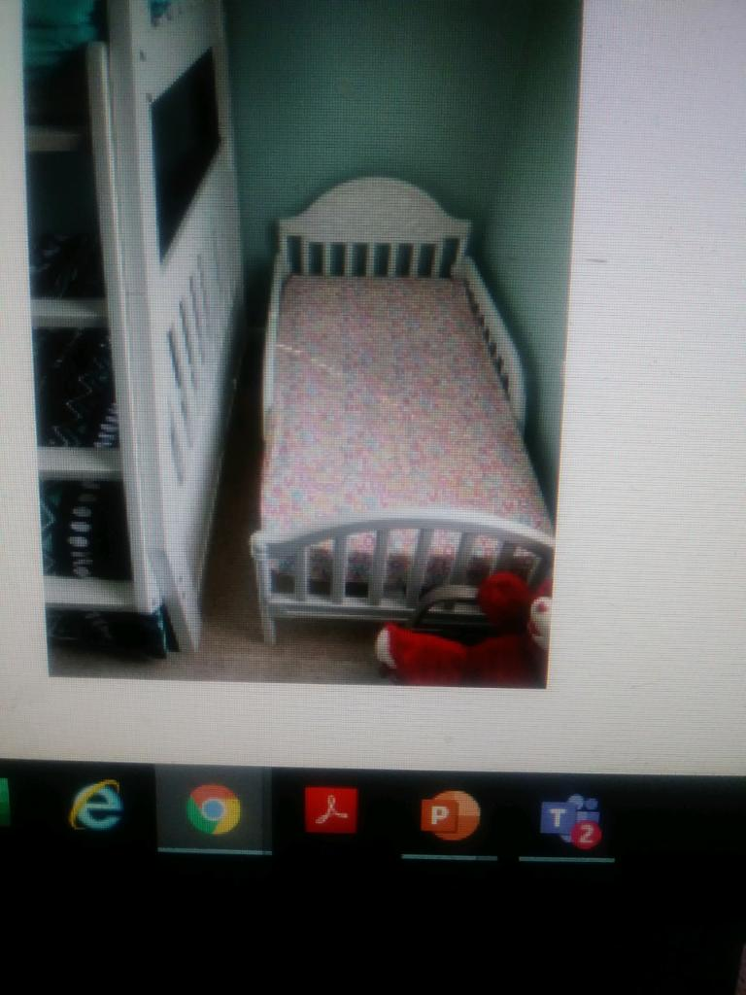
Does This Meet Safety & Quality Standard Guidelines?

Slide 38
Safety and Quality Standards Policy 14.1 Section D
Safety and Quality Standards Policy 14.1 Section D
Foster Home Sleeping Arrangements
Appropriate Sleeping standards including bedding

Slide 39
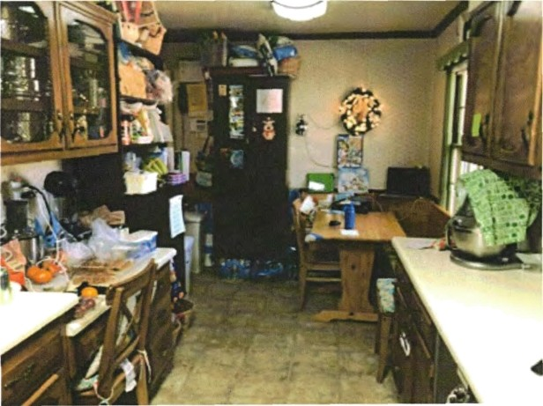
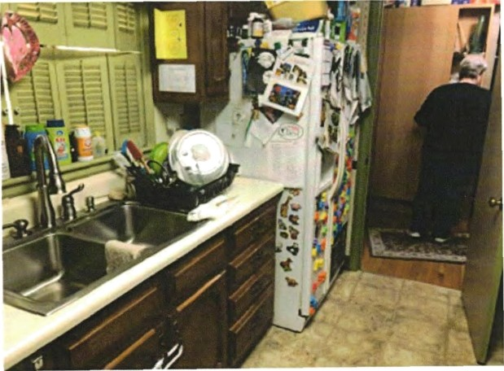
Does This Meet Safety & Quality Standards Guidelines?

Slide 40
Safety and Quality Standards Policy Section 14.1 b ii.
The home and all structures of the property must be properly maintained in a clean, safe, and sanitary condition and in a reasonable state of repair within community standard
Interior and exterior must be free from dangerous objects/conditions, and from hazardous materials
Proper trash and recycling disposal
The home must have conditions that prevent child’s access to all medications, poisonous materials and cleaning supplies

Slide 41
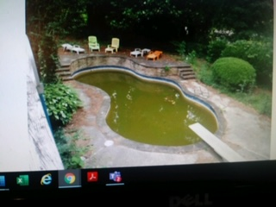
Does This Meet Safety & Quality Standard Guidelines?

Slide 42
Safety and Quality Standards Policy 14.1 Section 9
Swimming pools, hot tubs, and spas must meet all state and local safety requirements
Barriers
Lifesaving and flotation devices
Working pump and filtering system
Hot tubs (i.e. Jacuzzi) and spas must have safety covers that are locked when not in use
Notes:
Policy 14.1 Section 9
Swimming pools, hot tubs, and spas must meet all state and local safety requirements (see Practice Guidance: Water Safety).
a. Swimming pools must have a barrier on all sides.
b. Swimming pools must have their methods of access through the barrier equipped with a safety device, such as a bolt lock.
c. Swimming pools must be equipped with lifesaving and flotation devices (e.g. reaching poles and ring buoys). d. If swimming pools cannot be emptied after each use, the pools must have a working pump and filtering system. e. Hot tubs and spas must have safety covers that are locked when not in use.

Slide 43
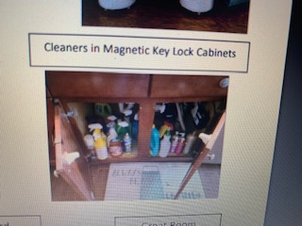
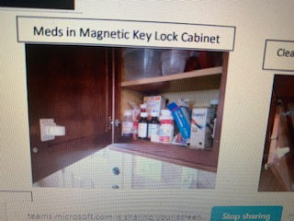
DOES THIS MEET SQS GUIDELINES?

Slide 44
Safety and Quality Standards Policy 14.1 Section 8
The home must have conditions that prevent a child’s access to all mediations, poisonous materials, cleaning supplies, and alcoholic beverages.
Cleaning supplies are kept locked in a cabinet inaccessible for smaller children
Medications are kept high and stored in a locked cabinet and/or box

Slide 45
Does This Meet Safety & Quality Standards Guidelines?

Slide 46
Safety and Quality Standards Policy 14.1- Section 9
Pool Safety Covers should meet American Society for Testing and Materials (ASTM)
Direct adult supervision of children around a body of water
Fence requirements
For an exterior wall of a home to be considered an adequate safety barrier to a pool/body of water, there must be an alarm on all exists from the home leading to the pool/body of water.
Notes:
Caregivers should provide direct adult supervision of children around a body of water (e.g. beach, lake, pool, etc.) at all times.
Fences used as a safety barrier must be at least four feet in height, surround all sides of the pool, and have a gate that locks. Fences must have no vertical or horizontal openings that are more than four inches wide and must be constructed in such a manner that a young child cannot climb through or under the fence.
In order for an exterior wall of a home to be considered an adequate safety barrier to a pool/body of water, there must be an alarm on all exits from the home leading to the pool/body of water. The alarm must meet the standard of 85 decibels.
9. Pool safety covers should meet American Society for Testing and Materials (ASTM) Standards and must be installed, used, and maintained in accordance with manufacturer’s specifications. Pool covers must be kept free of standing water and be completely removed when the pool is in use.
Discuss the caregivers plan regarding swimming and wading pools, ponds, lakes, trampolines, and any concern identified during the assessor’s observation of the home environment

Slide 47
OPM Resource Development Team!
Lashaunda Daniel, OPM Provider Relations Manager
lashaunda.daniel@dhs.ga.gov
Office (404) 657-0919
Andria Bolton
andria.bolton@dhs.ga.gov
Mobile- (404) 895-7135
Shanise Wooten
shanise.wooten1@dhs.ga.gov
Mobile (404) 548-6756
Tomeka Branscomb
tomeka.branscomb1@dhs.ga.gov
Mobile (404) 796-5053
Azure McCollough
azure.mccollough@dhs.ga.gov
Mobile (404) 357-3569
Amy Hill
amy.hill1@dhs.ga.gov
Mobile (478) 244-6379

Slide 49
FY2021
RBWO Minimum
Standards Updates

Slide 50
New RBWO Standard 1.18
Providers must develop a Quality Assurance Plan (QAP) targeted at ensuring all required background checks are completed and uploaded no more than 30 days prior to the employee’s hire or anniversary date. The QAP must include the provider’s method of tracking staff background checks due within the 30-day time period and indicate which individual(s) are responsible for oversight of the QAP. The QAP must be uploaded under the provider’s profile tab in GA+Score and updated annually.

Slide 51
New RBWO Standard 1.19
Providers must develop a water safety policy and procedure. When placing children in homes that have swimming pools, spas, or other large bodies of water nearby a water assessment must be completed. The age, special needs, and number of children in a home should guide decisions around placement in such homes. Water safety assessments must be completed annually. The water safety assessment can be found at www.gascore.com.
Note: Refer to the complete standard for water safety guidelines.

Slide 53
RBWO Standard 4.8 A 1.b
Providers must comply with the following placement conditions and requirements regarding each of the identified care settings:
1. For ALL foster youth in the legal custody of Fulton and/or DeKalb county:
b. No child will be in a placement that will result in more than three (3) children under the age of three (3) residing in a foster home including the children of the caregiver’s family.
Note: Updated to align with DHS policy 14.1.

Slide 54
New RBWO Standard 6.3
Providers must coordinate with DFCS to ensure parents or other identified permanency resources are invited to attend all youth’s medical and dental appointments, unless prohibited by court order or child safety concerns.
This Photo by Unknown Author is licensed under CC BY

Slide 56
New RBWO Standard 6.4 (Formerly 6.3)
Providers must follow the DHS guidelines for Psychotropic Medication Use in Children and Adolescents and they must have and follow their own medication management policy for all prescription and non-prescription medications which include the following:
(I.) Providers’ medication management policy must include children’s right to refuse medication and a procedure for documenting and addressing medication refusals.
(V.) Medication management policy should reflect that all medications must be stored in and dispensed from the original container, which should also include the prescribing physician's instructions.
Note: All other components of the standard remain the same.

Slide 58
New Standard 6.11 (Formerly 6.10)
Providers will ensure that appropriate educational services and academic supports are provided to youth who are required to be enrolled in K-12 or GED programs. Services shall include the following:
l. Documentation of at least two provider facilitated academic supports per month. Documentation should reflect how the educational activity, service, or resource assists the child with meeting learning standards, accelerates their learning process, and/or encourages and promotes the child’s overall academic success.
NOTE: All other components of the standard will remain the same.

Slide 59
RBWO Standard 6.22 (Formerly 6.21)
Providers must incorporate the principles of trauma informed knowledge into the daily living environments in CCIs and provide trauma informed training to CPA staff and caregivers.

Slide 60
RBWO Standard 10.1
Providers must ensure that youth complete the CLSA annually beginning at age 14 through 21 years of age. The CLSA should be completed within 15 days of the youth’s birthday or intake date based on the identified age requirements. The CLSA is required to develop the Individualized Skill Plan. Providers should review assessment findings with the youth in a strength-based conversation that actively engages them in the process of developing their goals. The Caregiver Assessment portion of the CLSA should be completed in conjunction with the youth’s assessment and included in the youth’s skills plan. When administering the CLSA, providers must use the appropriate code (which is based on the child’s custodial county region).
Note: This requirement can be satisfied at initial placement if a current CLSA has been provided from DFCS or the youth’s previous placement.

Slide 62
RBWO Standard 11.14
CPAs must ensure that the number of children placed in their foster homes complies with the following requirements:
a. The total number of foster children that may be cared for in a foster family
home must not exceed six except for the reasons listed below.
b. The number of foster children cared for in a foster family home may exceed six
for any of the following reasons:
1. To allow a parenting youth in foster care to remain with the child of the parenting youth.
2. To allow siblings to remain together.
3. To allow a child with an established meaningful relationship with the family to remain with the family.
4. To allow a family with special training or skills to provide care to a child who has a severe disability.
Note: For youth in the custody of Fulton or DeKalb county refer to Standard 4.8 1. a.

Slide 63
RBWO Standard 11.18
During the first 30 days of placement, providers must assess with the caregivers the necessity of safety gates, safety locks, outlet covers, securing sharps, medications, cleaning supplies or other items that may pose a hazard or danger based upon the individual child's needs. The outcome of the assessment must be documented in the child’s record.
Note: All other components of this standard remain the same.

Slide 64
RBWO Standard 13.3
Contractual changes such as site address, request for approved program designations, etc. should be made in writing to OPM using the vendor request form and may result in a site review or request for additional information. All vendor request forms should be sent to the Provider Relations Manager.
Note: All other components of this standard remain the same.

Slide 65
RBWO Standard 13.19
Providers must notify OPM in writing of any RCCL approved satellite offices in which records are kept. Notification must be sent to the provider’s assigned Monitoring Specialist and the Provider Relations Manager.
Note: All other components of this standard remain the same.

Slide 66
RBWO Standard 13.37
Individuals who serve in a quality assurance or compliance role must meet the minimum educational and experiential requirements of the Human Services Professional or Case Support Worker.
Note: Reference Staffing Standards for educational and experiential requirements.

Slide 67
RBWO Standard 46.0
The provider’s staff and/or caregiver will attend a pre-placement meeting to receive appropriate training for managing the care of the medically fragile child. If a pre-placement meeting is not possible, training is provided within 24 hours of placement to ensure that the caregiver is equipped to provide adequate care to the child.

Slide 68
1.9 6.6 12.6 23.11* 46.0
1.18* 6.11 13.3 24.0 CCI Staffing Standards
1.19* 6.22 13.10 24.3 ILP Staffing Standards*
2.12 8.1 13.19 25.1
3.0 8.5 13.33 25.3* * Denotes newly created Standard.
3.2 9.2 13.37 25.4* ** Denotes a Standard pending final
3.3 10.1 13.38 25.5 approval.
3.6 10.2 22.0 26.0**
4.1 11.14 22.4 32.3
4.8 11.15* 22.8* 37.0
4.15 11.18 23.2 37.2
6.3* 11.30 23.4 40.3 .
Note: This list should be used as a guide for FY21 updates and should not be considered an all-inclusive list.

Slide 70
Georgia Division of Family and Children Services
Office of Provider Management
PBP Measurements and FY21 Updates
Shakaria Glass, Monitoring Manager

Slide 71
Understand how to read and access PBP scorecard details.
Become familiar with FY21 updates to PBP Measures.

Slide 72
Performance-Based Placement
Performance‐based placement (PBP) is a system of data reporting and monitoring that generates quarterly scores for RBWO providers.

Slide 73
GA+SCORECARDS
Are issued on a quarterly basis.
Includes an overall score and corresponding grade as well as a detailed report of performance in each of the measurements.
Scorecard
Child Detail
Staff Detail
DFCS case workers use provider scores to make informed placement decisions.
OPM uses provider scores to assess quality of care and identify opportunities for technical assistance and training.

Slide 74
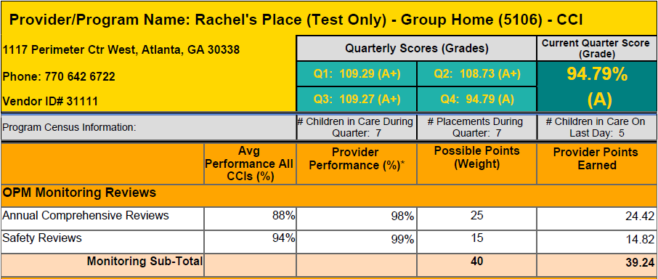
ACR weight will increase to 40 for FY21
SR weight will increase to 20 for
FY21
NEW weight =60

Slide 75
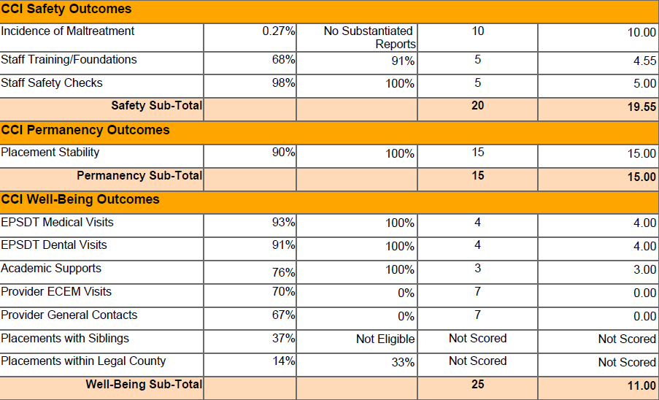
NO change
Self reported Placement Stability decrease to 10 in FY21
Self reported wellbeing weight will decrease to 20 points in FY21

Slide 76
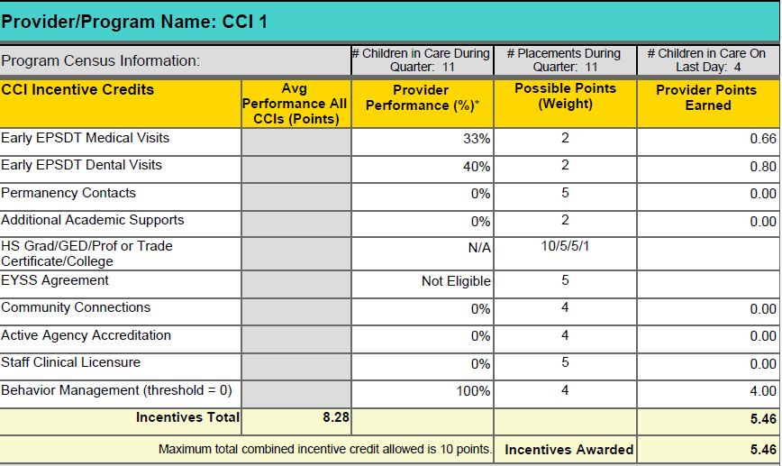
Providers can still earn up to 10 incentive points
CCI Behavior Management (use of ESI) Incentive Removed for FY21
Must score at least 70%
on most recent ACR.

Slide 77
Predicted Impact of Scoring Changes
To assess the effect on individual and aggregate scores, Care Solutions reran scorecards for 4 previous quarters using these new measures.
These changes had the greatest impact on scorecards with a large disparity between OPM’s assessment via monitoring reviews and the provider’s self-assessment.

Slide 78
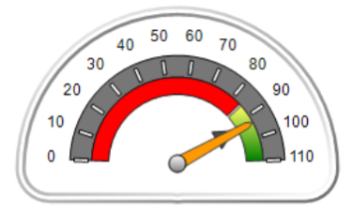
Data Highlights: CCIs
The lowest score for the last four quarters decreased from 52.9 to 44 and the highest score dropped from 110 to 108.5.
1/3 of scores increased or stayed the same; 2/3 decreased.
The mean and median scores are still in the A range.
Letter Grade | Original % | New %
A | 70.7 | 60.6
B | 20.0 | 25.8
C | 6.5 | 10.3
D | 2.1 | 2.5
F | 0.5 | 0.6

Slide 79
Data Highlights: CPAs
The lowest score for the last four quarters remained 33.5 and the highest score remained 108.
2/3 of scores increased or stayed the same; 1/3 decreased.
The mean and median scores are still in the A range.
Letter Grade | Original % | New %
A | 69.4 | 68.8
B | 18.1 | 17.1
C | 4.4 | 4.9
D | 2.8 | 4.4
F | 3.0 | 2.5

Slide 80
UNDERSTANDING THE CHILD DETAIL PAGE
A child specific breakdown of the RBWO provider self reported data for the quarter.
Names of children placed
Dates of admission and discharge
Required vs. Reported Data
Base and Incentive Measures
EPSDT Medical and Dental
Academic Supports
ECEM and General Contacts
REMEMBER: This data is all child specific.

Slide 82
UNDERSTANDING THE STAFF DETAIL PAGE
A RBWO Staff specific breakdown of self reported training and Safety Screening data for the quarter.
Name of staff and RBWO Role
Number of days worked in the quarter
Training required for current quarter (Y/N)
# of training hours completed during quarter
# of training hours completed during fiscal year
Foundations Registration and Completion
Safety Screenings completed (Y/N)
Licensure

Slide 83
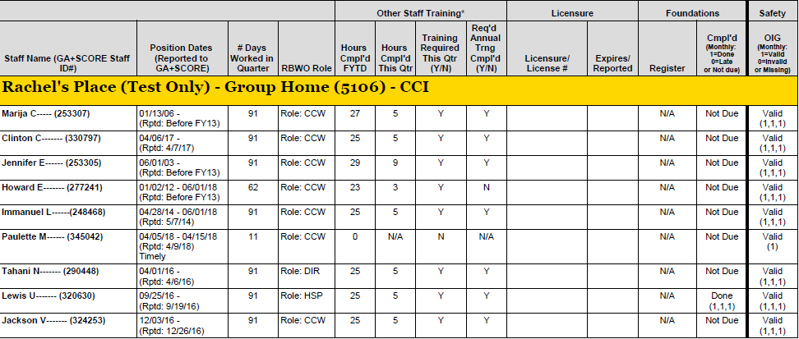

Slide 85
Access the PBP Measurements and Standards Guide at
www.gascore.com
Under Key Documents and Forms

