Slide 1

Consortium for Children
Consortium for Children, Copyright 2018

Slide 2


Be Proud, Georgia!
The SAFE team has been overly impressed with Georgia workers and supervisors for numerous reasons:
Your ongoing commitment to “Doing It Right and Doing It Well”
Partnership
Taking advantage of consultation with SAFE Specialists
Producing quality home studies
The attention and participation during SAFE trainings
Keep up the great work!

Slide 3

A Well Done Home Study Protects Both
Children and Applicants Alike

Slide 4

A SAFE Home Study is...
A placement document
An investigation
A psychosocial evaluation
A clear, detailed written report

Slide 5

Rules
Rule #1
SAFE must be used in its entirety or not at all
Rule #2
A SAFE home study should never be executed without the benefit of supervision or consultation
Rule #3
Applicants must be provided with a copy of the final SAFE Home Study Report. If this is not possible, they must be given the opportunity to read the final report

Slide 6

SAFE Information Gathering Tools:
Questionnaire I
Questionnaire II
Reference Letter

Slide 7
Introduction to Questionnaire I
Questionnaire I is completed by each Applicant and covers eight areas of family history and functioning:
  Personal History
  Parenting Practices
  Personal and Family Values
  Health
  Support System
  Work
  Family Relationships
  Marital/Partner Relationship

Slide 8

Time for Supervision
Prior to the first home study interview, practitioner will meet with the SAFE supervisor to review the Application, Questionnaires, and Harvesting Sheet.
Once you have met with your SAFE supervisor prepare your Interview Work Sheet.

Slide 9
Introduction to Questionnaire II
Questionnaire II contains the sensitive and critical questions that need to be covered in a home study:
      Problem issues/behaviors
      Personal alcohol consumption
      Personal legal/illegal drug usage
      Family substance abuse
      History of sexual, emotional or physical victimization
      Child abuse allegations/convictions
      Family violence and crime
      Family sexual perpetrators
      Domestic Violence
      Mental illness

Slide 10
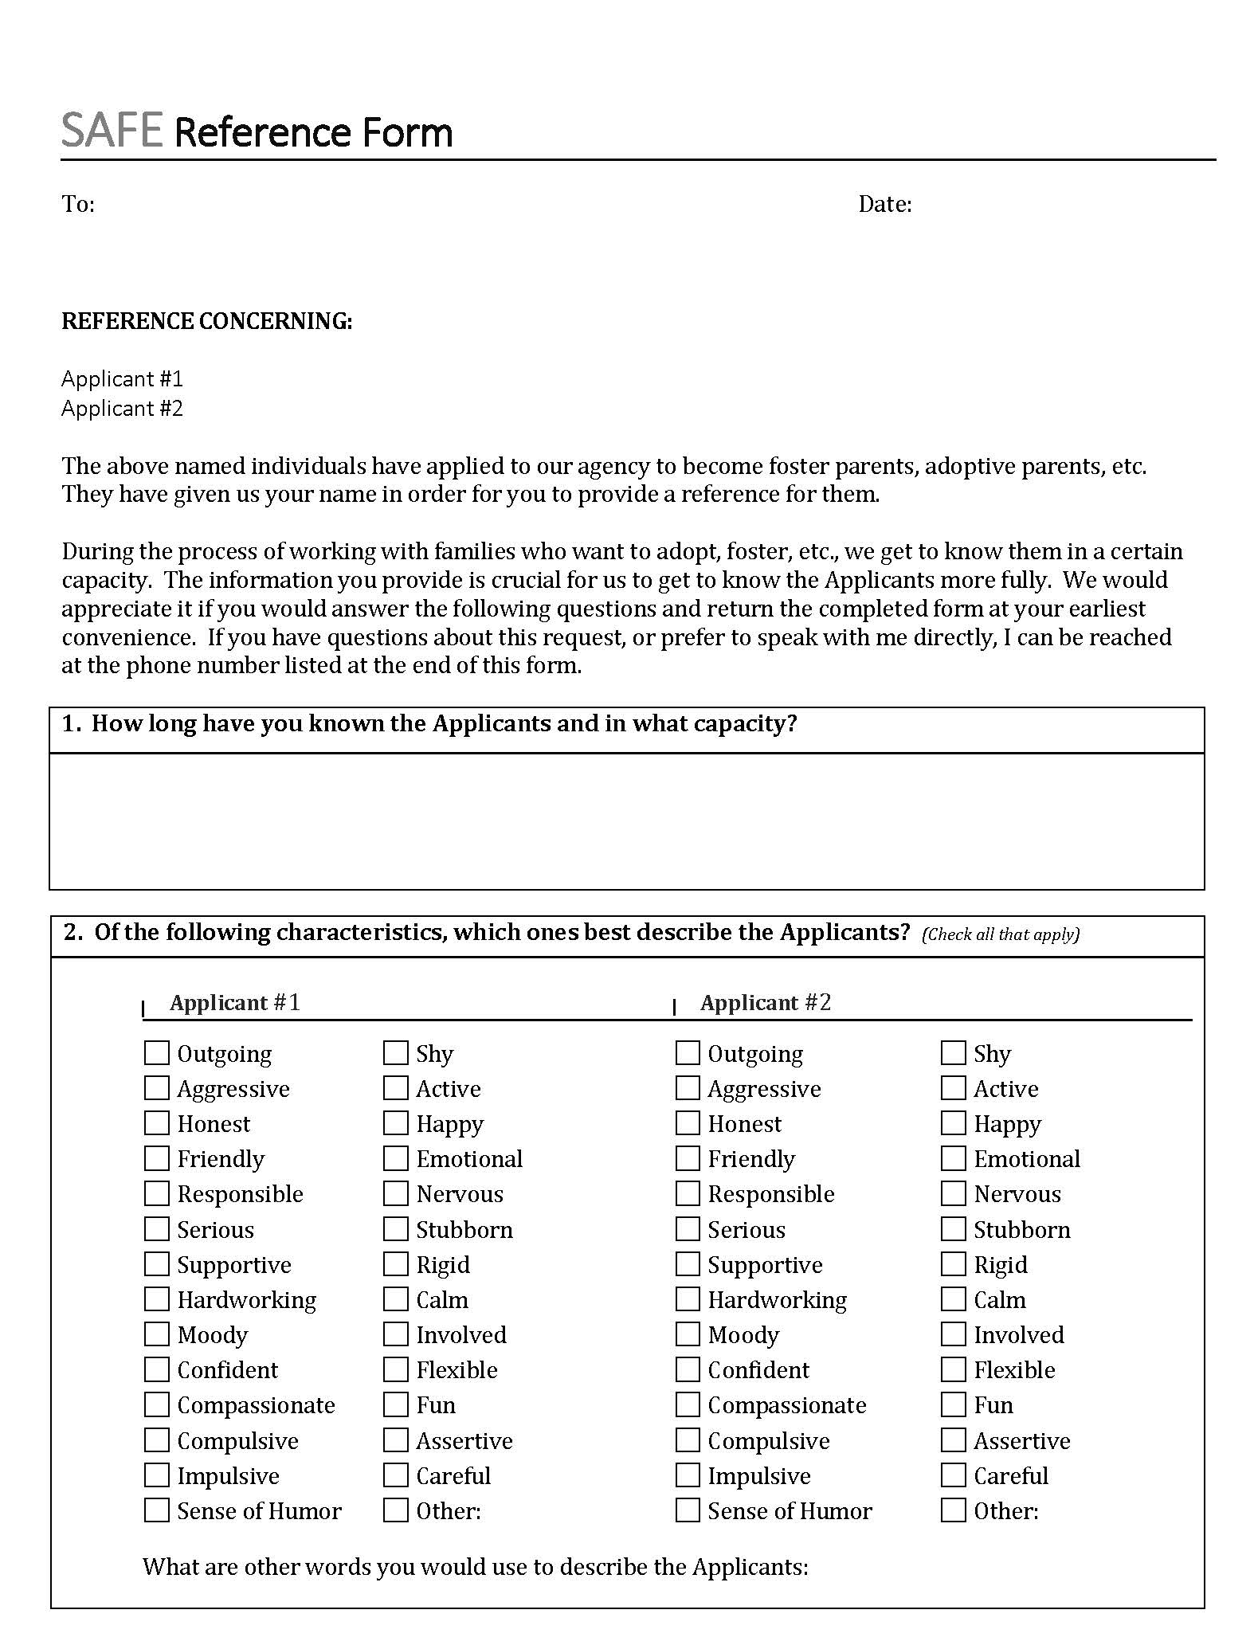
SAFE Reference Letter
The SAFE Reference Letter was developed to enable Home Study Practitioners to obtain additional information about Applicants for analysis and follow-up
The Reference Letter was designed to inhibit both the “halo” effect and the “pitchfork” effect

Slide 11
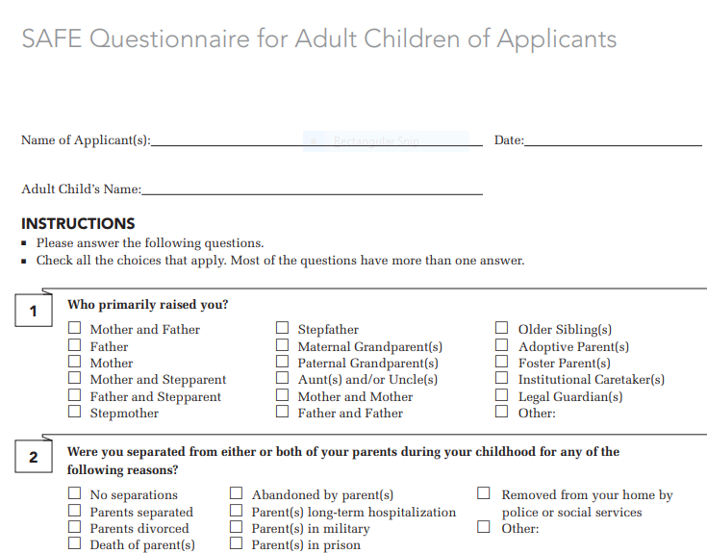

ADULT
CHILD
QUESTIONNAIRE
Notes:
Review that all children (minor or adult) should be interviewed either in person or via the phone, skype, facetime. Leave them to close to the end of the process as their info is useful to validate/corroborate info re: issue/behaviour or events heard from applicant(s)

Slide 12
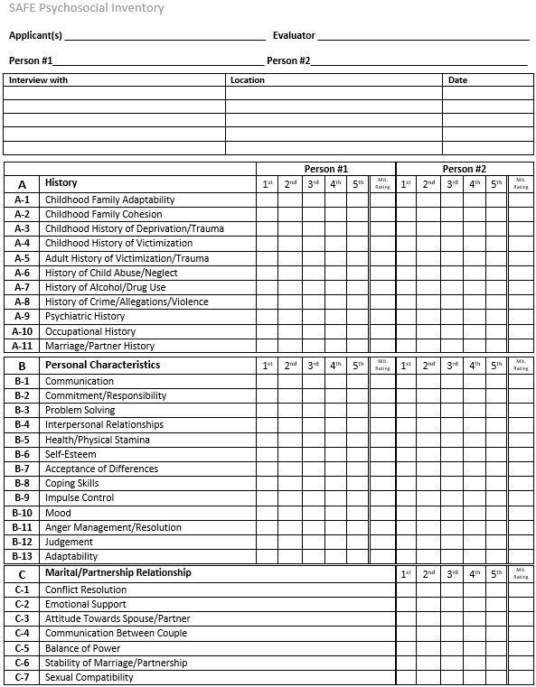
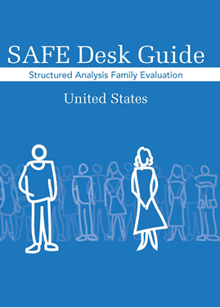
Psychosocial Evaluation
SAFE Structured Analysis Tools
The Psychosocial Inventory and the SAFE Desk Guide provide and support the Psychosocial Evaluation in the SAFE Home Study

Slide 13

The Psychosocial Inventory and SAFE Desk Guide
History
Personal Characteristics
Marital/Partner Relationship
Children/Others Residing or Frequently in Home
Extended Family Relationships
Physical/Social Environment
General Parenting
Specialized Parenting
Adoption/Foster Care Issues

Slide 14
The SAFE Desk Guide
The SAFE Desk Guide assists Home Study Practitioners in identifying and tracking the issues, behaviors, and events that will need to addressed in the SAFE Home Study Report

Slide 15
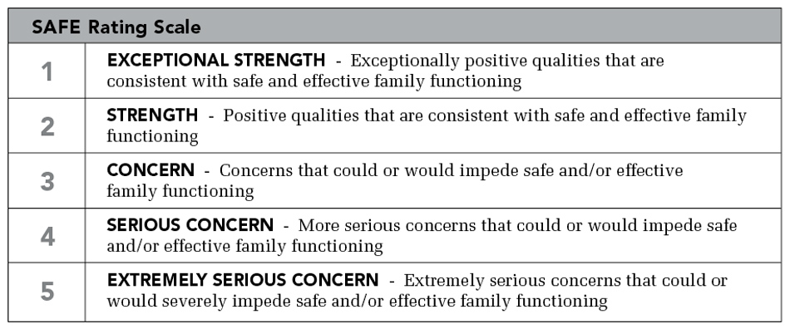
SAFE
Desk Guide
Rating Scale
The ratings indicate how serious an issue, behavior, or event COULD be according to research

Slide 16
Using the SAFE Psychosocial Inventory
The Psychosocial Inventory and SAFE Desk Guide are used after EVERY Home Study visit

Slide 17
Mitigation
Is applied to all final SAFE Desk Guide Ratings of 3, 4 and 5

Slide 18
Mitigation Process
The Mitigation process is when the Home Study Practitioner and their Supervisor evaluate the Applicant’s past and current issues/behaviors and events, and make an assessment about:
  The risk of their current functioning and ability
  to parent effectively
  who they can parent
  what services/resources they might require to be successful.

Slide 19

Mitigation
Requires
Evidence!
-a fact or series of facts that exist to support your desire to mitigate an issue, behavior, or event that is corroborated by outside sources (other family members, professionals, clinicians)

Slide 20
The Desk Guide is NOT used for Mitigation Ratings

Slide 21
M
I
T
I
G
A
T
I
O
N
A Mitigation Rating Uses the SAFE Severity Scale
Consortium for Children, Copyright 2018

Slide 22
The SAFE Mitigation Rating reflects practitioner’s analysis supported by evidence of the issue, behavior, or event which caused the final SAFE Desk Guide rating of 3, 4, or 5

Slide 23



You can Sustain, Reduce, or Erase a final SAFE Desk Guide Rating

Slide 24

Mitigation Reminders
Eventually every final SAFE Desk Guide Rating of 3, 4 or 5 will have to be addressed in the final SAFE home study report in terms of the Applicant’s current functioning or ability to parent
You do not have to erase or reduce every final SAFE Desk Guide Rating of 3, 4 or 5 to be able to approve an Applicant. You will have to write a rationalization in the final SAFE home study report as to how that factor will affect their current functioning and ability to parent
If you reduce or erase a final SAFE Desk Guide Rating you will have to prove your mitigation rating using sources OTHER THAN THE APPLICANT (evidence)
If you sustain a final SAFE Desk Guide Rating, you will have to discuss how that issue, behavior, or event affects the Applicant’s current functioning and ability to parent

Slide 25

There are Six Sections to a SAFE Home Study Report
Non-narrative reporting required by your agency or jurisdiction
Motivation, Profile, and Lifestyle of the Applicant
SAFE Psychosocial Evaluation
Conclusions and Placement Considerations
Signatures and Approvals
SAFE Psychosocial Inventory Results

Slide 26

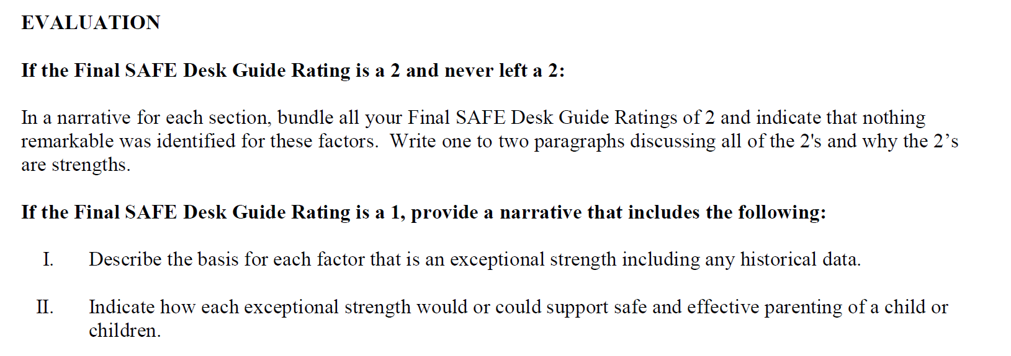

Slide 27
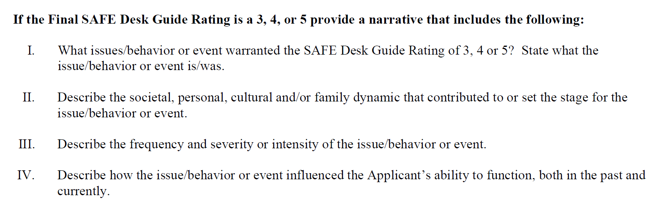

Slide 29
Home Study Report
Use behaviorally specific language
Write about it once
Write about it well
Be done with it!

Slide 30



Slide 31

Process for Converting a Non-SAFE Study to the SAFE Format

Slide 32
Required Materials for Converting a
non-SAFE Study to the SAFE Format:
SAFE Update Psychosocial Inventory
Harvesting Sheet
SAFE Questionnaire II
SAFE Update Report

Slide 33
Review the initial non-SAFE study and subsequent updates and documents. Identify issues, behaviors and events that "makes you curious" and need further clarification and understanding.
Use the SAFE Harvesting Sheet and record the things that "make you curious" from the original Home Study and supporting documents.

Slide 34
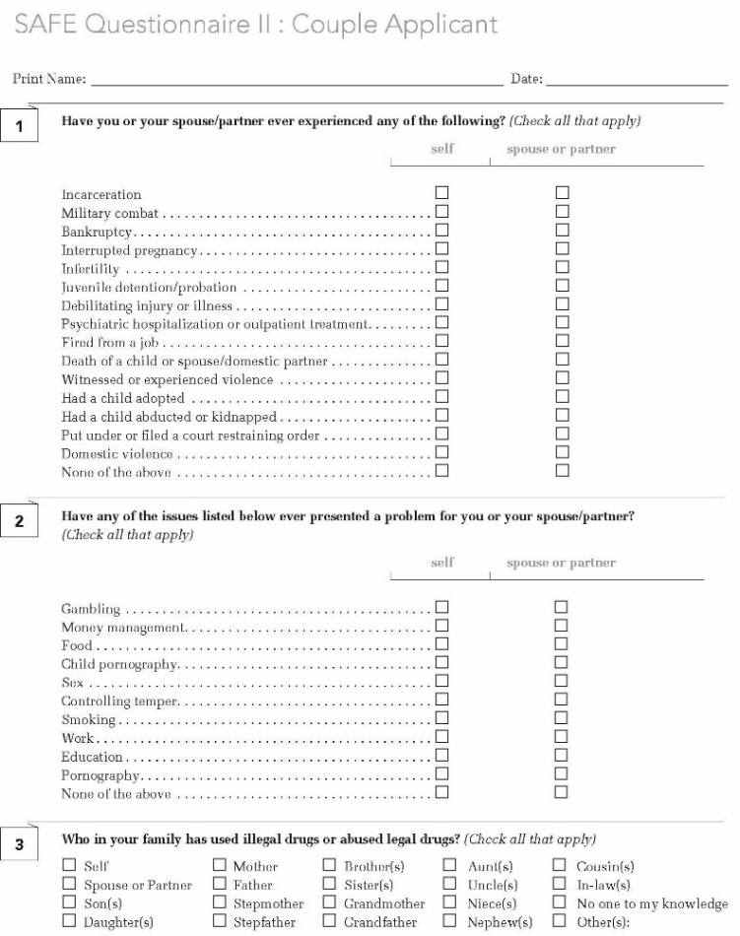
Administer SAFE Questionnaire II in the same manner you do for a SAFE Home Study (administer together and interview immediately after).

Slide 35
After the interviews, go through the SAFE Update Psychosocial Inventory and use the SAFE Desk Guide to assign Desk Guide ratings in Column A.*
*When converting a non-SAFE Home Study to the SAFE format, Column B is not used.

Slide 36
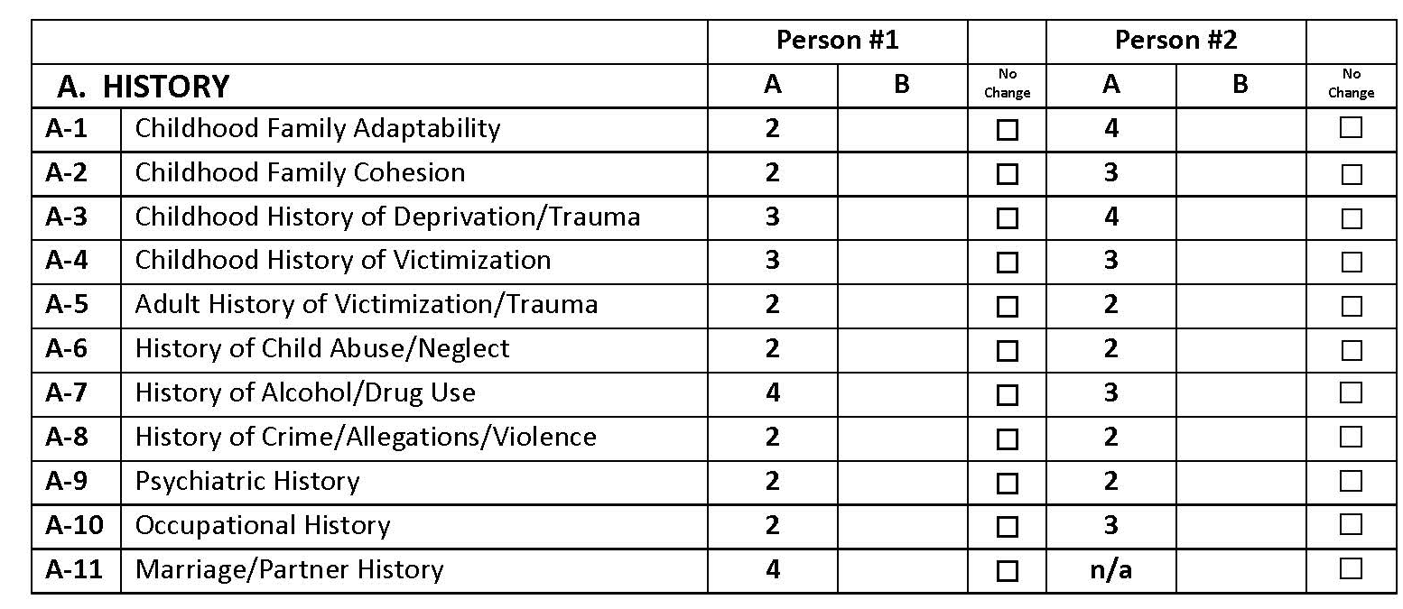

Slide 37
Review your SAFE Desk Guide ratings of 3, 4, and 5 and determine if the issues, behaviors, or events can be Sustained, Reduced or Erased (mitigated).

Slide 38
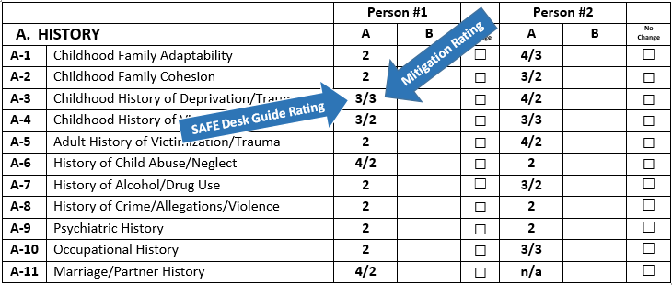
Place your Mitigation Rating into
the same column as the SAFE Desk Guide Rating.

Slide 39
Use the SAFE Update Report and follow the narration directions.
Reminder! The Update Report focuses on “what has changed” or “what is new” and does not require narration of anything covered in the original Home Study Report unless there has been an increase in severity (higher Desk Guide Rating), changed Mitigation Rating, or the issue, behavior, or event was not fully addressed in previous study.

Slide 40
Due to the fact that you are converting a non-SAFE Home Study , the Conversion will most likely require more narration than when you update a SAFE Home Study.
**You will have to fully narrate (using the SAFE Psychosocial Narration Instructions) any new issues you discover as well as those issues that you feel the original Home Study Practitioner missed, didn’t explore fully, or mitigate properly.

Slide 41
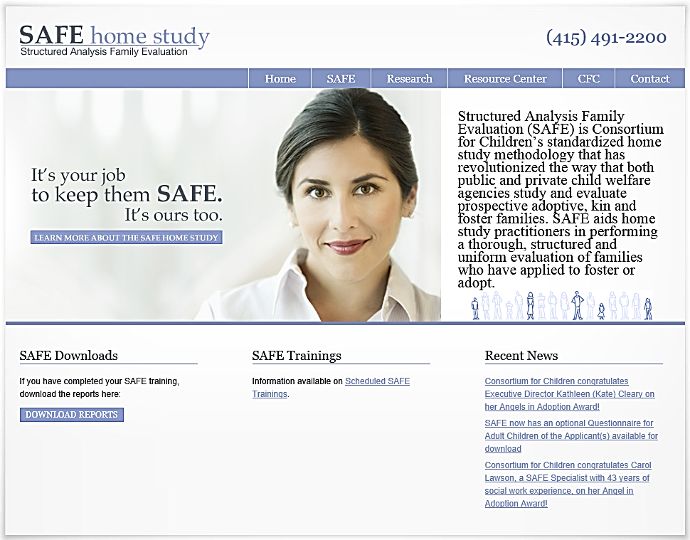

Slide 42
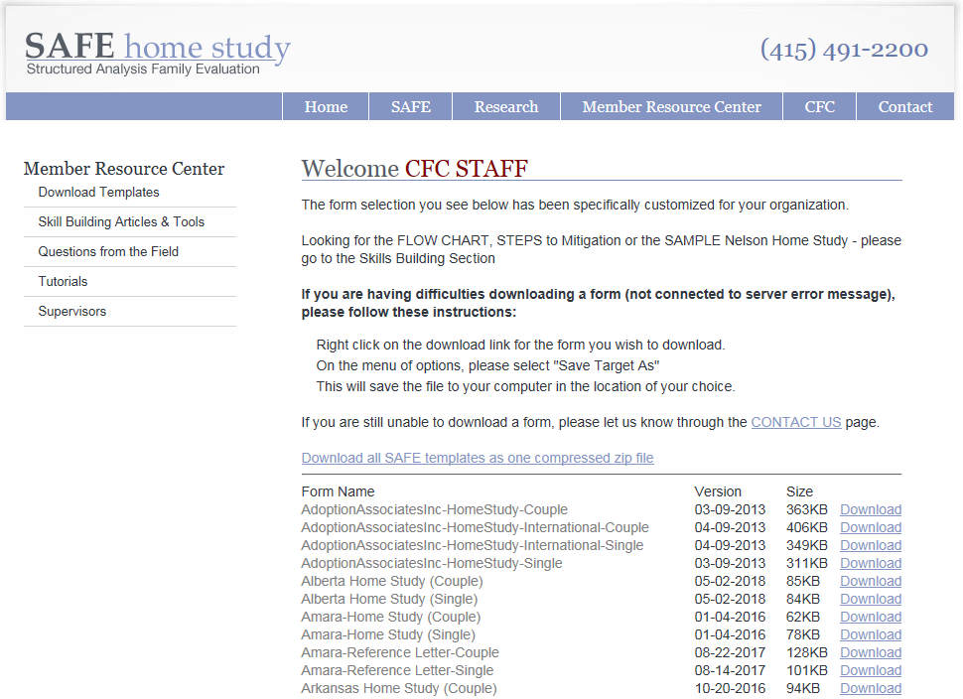

Slide 43
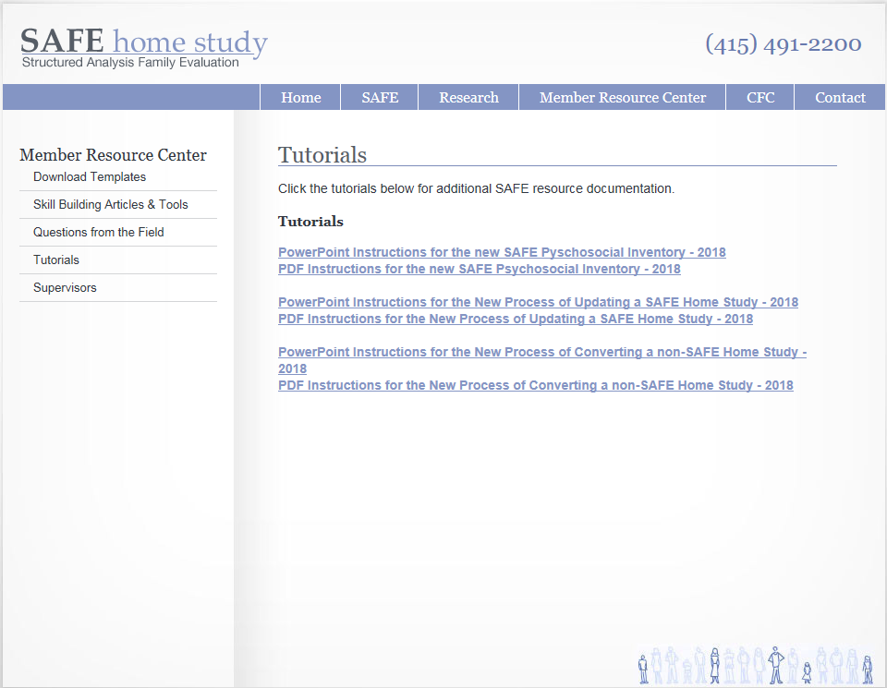

Slide 44
Continuing Support
The Consortium for Children also provides SAFE users with free 40-hour a week clinical and technical support.
You may call the Help Desk (415) 491-2200 or
E-mail us through the “contact us” tab on the SAFE web site.

Slide 45
When Do We Call SAFE?
SAFE Forms
SAFE Process
Mitigation
Narrative Writing

Slide 46
When Do We Call Georgia?
Georgia Policy and Practice
Georgia Requirements
Georgia Forms

Slide 47
Thank you for your commitment to keeping children and families safe!

