Slide 1
Tom C. Rawlings
Director

Slide 2
CPA Monthly Series: Continued Parent Development

Slide 3
Resource Development Team
Lashaunda Daniel, OPM Provider Relations Manager
Lashaunda.daniel@dhs.ga.gov
(404) 657-0919
Andria Bolton
Andria.bolton@dhs.ga.gov
(404) 895-7135
Shanise Wooten
Shanise.wooten1@dhs.ga.gov
(404) 548-6756
Azure McCollough
Azure.mccollough@dhs.ga.gov
(404) 357-3569
Tomeka Branscomb
Tomeka.branscomb1@dhs.ga.gov
(404) 796-5053
Amy Hill
Amy.hill1@dhs.ga.gov
(478) 244-6379

Slide 4
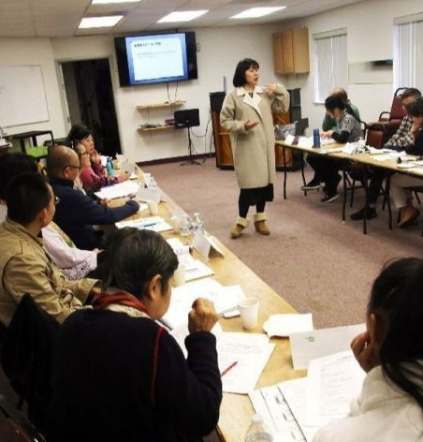
Continued Parent Development (CPD) Requirements (Policy 14.9)
Actively support each caregiver’s involvement in continuing education activities that enable them to develop competencies and skills
Ensure CPD is relevant to the characteristics of children being placed in the home
Verify that all approved foster caregivers obtain a minimum of 15 hours of CPD each calendar year (hours are prorated for caregivers approved after March 31st of the current calendar year)
Assign a policy violation and develop a corrective action plan (CAP) with caregivers who have not received the required hours of CPD by December 31st of the calendar year
Verify that caregivers maintain current certificate of CPR and First Aid throughout the approval period of their foster home.

Slide 5
Continued Parent Development (CPD) Requirements (Policy 14.9)
At least five (5) of the required hours must be obtained via in-person (one-on-one or group) interaction.
NOTE: There are special accommodations since COVID. Caregivers must have five (5) hours of training via zoom, teams, or any other virtual face-to-face training.
A maximum of three (3) hours of the annual training requirement can account for personal growth and development activities (e.g. counseling, support groups, stress management, nutrition).

Slide 6
Who requires training?
Scenario 1: Ms. Ingram has been fostering since 2017. Currently her household members include herself and her live-in boyfriend, Jacob Jones. Mr. Jones has been living in the home since 2016 and has completed IMPACT-FCP Training. Ms. Ingram indicated that on Mondays while she is at work , Mr. Jones is providing care for the children. She also stated that he provides on-going supervision.
Based on the scenario above, would you require Mr. Jones (live-in boyfriend) to participate on Continued Parent Development? And CPR/FA Training? Why and/or Why not?

Slide 7
Approval Date | Start of Training (60 days) | Hours Due by Dec 31st
January | March | 15 hours
February | April | 15 hours
March | May | 15 hours
April | June | 9 hours
May | July | 9 hours
June | August | 9 hours
July | September | 9 hours
August | October | 6 hours
September | November | 6 hours
October | December | 3 hours
November | January | 15 hours *
December | February | 15 hours *
*By December 31st of the following year of approval

Slide 8
Case Vignette 1:
Mr. David Spear was approved to foster with Caring and Love agency on April 15, 2020. Based on Mr. Spear’s approval period how many hours of training does Mr. Spear need by December 31, 2020?

Slide 9
Based on the Prorated chart in policy 14.9, Mr. Spear will need 9 hours by December 31, 2020.
Approval Date | Start of Training (60 days) | Hours Due by Dec 31st
January | March | 15 hours
February | April | 15 hours
March | May | 15 hours
April | June | 9 hours
May | July | 9 hours
June | August | 9 hours
July | September | 9 hours
August | October | 6 hours
September | November | 6 hours
October | December | 3 hours
November | January | 15 hours *
December | February | 15 hours *
*By December 31st of the following year of approval

Slide 10
Case Vignette 2:
Mr. and Mrs. Dolly are currently fostering three (3) children from DFCS. They are fostering through ABC Foster Care agency located in Atlanta, Georgia. They have been approved since January 21, 2020. Based on their approval period, how many hours of training will Mr. and Mrs. Dolly need each by December 31, 2020?

Slide 11
Based on the chart, Mr. and Mrs. Dolly will need 15 hours by December 31, 2020.
Approval Date | Start of Training (60 days) | Hours Due by Dec 31st
January | March | 15 hours
February | April | 15 hours
March | May | 15 hours
April | June | 9 hours
May | July | 9 hours
June | August | 9 hours
July | September | 9 hours
August | October | 6 hours
September | November | 6 hours
October | December | 3 hours
November | January | 15 hours *
December | February | 15 hours *
*By December 31st of the following year of approval

Slide 12
Case Vignette 3:
Ms. Sarah Williams is excited to start her fostering journey. She just received a letter with an approval date of November 3, 2020. When should Ms. Sarah begin her training? How many hours should she have? And by when should she have the required hours completed?

Slide 13
Based on the chart, Ms. Sarah should begin her training in January (which is 60 days from her approval date). She should also have 15 hours completed by December 31, 2021.
Remember: Approvals on November or December would mean that caregiver(s) should have 15 hours completed by the following year of approval
Approval Date | Start of Training (60 days) | Hours Due by Dec 31st
January | March | 15 hours
February | April | 15 hours
March | May | 15 hours
April | June | 9 hours
May | July | 9 hours
June | August | 9 hours
July | September | 9 hours
August | October | 6 hours
September | November | 6 hours
October | December | 3 hours
November | January | 15 hours *
December | February | 15 hours *
*By December 31st of the following year of approval

Slide 14
What should the case manager and/or Resource Developer do?
Inform caregivers of the CPD requirements, including ensuring CPD is relevant to the characteristics of children placed in the home.
Work with each caregiver during the initial family evaluation and re-evaluation process to identify their individual CPD needs.
Routinely consult with permanency CM regarding areas in which caregivers may benefit from CPD.
Discuss with caregivers any barriers to completion of the CPD requirement.
Verify that each caregiver’s CPR and FA certification is valid throughout the approval period

Slide 15
Specialized Parenting
Resource Developers and/or Assessors should make sure that caregivers are receiving training that is beneficial to the characteristics of the children placed in the caregivers' home.
Scenario 2: Mrs. Johnson has been fostering for one (1) year. She is approved to care for children ages 0-18. However, Mrs. Johnson has cared for a total of 15 children, all who have been over the age of 10 years of age. She is currently caring for a 17, 11, and 15-year-old sibling group. The children are diagnosed with ADHD, Depression and Anxiety. She expressed to you that the 17-year-old is now identifying as being LGBTQ. Mrs. Johnson has also expressed to you in several monthly contacts that she is having a hard time managing their behaviors but want to keep them in the home. She also expressed not knowing what to do with handling the 17-year old’s sexuality and independency. Mrs. Johnson submitted her training log to you last week.

Slide 16
Let’s have a conversation: Ms. Johnson’s Training Log

Slide 17
What are we looking for?....Assessing training hours during Re-Evaluations..

Slide 18
Practice Guidance
CPD may be provided by DFCS staff and licensed, certified, credentialed, or otherwise qualified professional. CM must consistently monitor each family’s participation in CPD throughout the year to avoid situations where families do not have adequate time to meet the minimum CPD requirement by the end of the year.
Families should be given a training certificate or some formal proof that they have successfully completed the training. Certificates should be kept in families file and entered in a training log.
Each DFCS County/Region Office and CPA Provider is responsible for making ongoing training activities available for their foster families.
CPD hours may not be obtained by reading books, articles, or other literature.

Slide 19
Approved options for obtaining CPD
Group training sessions sponsored by the local or state Adoption and Foster Parent Association of Georgia (AFPAG), DFCS or other credentialed party
Certain pre-approved classes or courses at local community agencies and institutions
Approved Conferences and mini-conferences related to foster parent issues
One-on-one training provided by a credentialed trainer, educator, therapist, or CCFA provider.
Live webinars or recorded webinars with a test component
Online training at the State and National FPA recommended website or other similar county-approved website (NOTE: A certificate and post-test must be provided)
Participation in CCFA Multi-Disciplinary Team Meetings (maximum of five (5) hours allowed per year)
Participation in individual session of IMPACT

Slide 20
Areas identified as being appropriate CPD
CPR/FA
Child Safety Issues
Caring for medically fragile children
Managing specific behaviors (bedwetting, hoarding, etc.)
Helping children learn appropriate behaviors
Helping children achieve permanency and independence
Gender-specific issues
Specific child development issues (toilet training toddlers)
Helping children develop self-esteem
Promoting cultural identity
Attachment disorder
Personality disorder
Parenting the gifted child
Parent the developmentally disabled child
Parenting the child who has been drug exposed
Parenting children with ADHD
Understanding and implementing agency polices

Slide 21
DOES IMPACT TRAINING COUNT AS CPD?
IMPACT training CAN count as CPD hours ONLY if the content (i.e. module) being presented benefits the foster parent and child. For example, if a foster parent needs a refresher on appropriate methods to managing behavior then the caregiver should sit in on the Behavioral Management module of IMPACT and can receive CPD hours.

Slide 22
Corrective Action Plan (CAP)…
A corrective action plan shall be used as a rehabilitative measure to address policy violations when appropriate.
According to Policy 14.22 lack of required continued development parenting is considered a low risk policy violation.
If caregiver(s) fail to complete the required DFCS policy of 15 hours of training a CAP must be given.

Slide 23
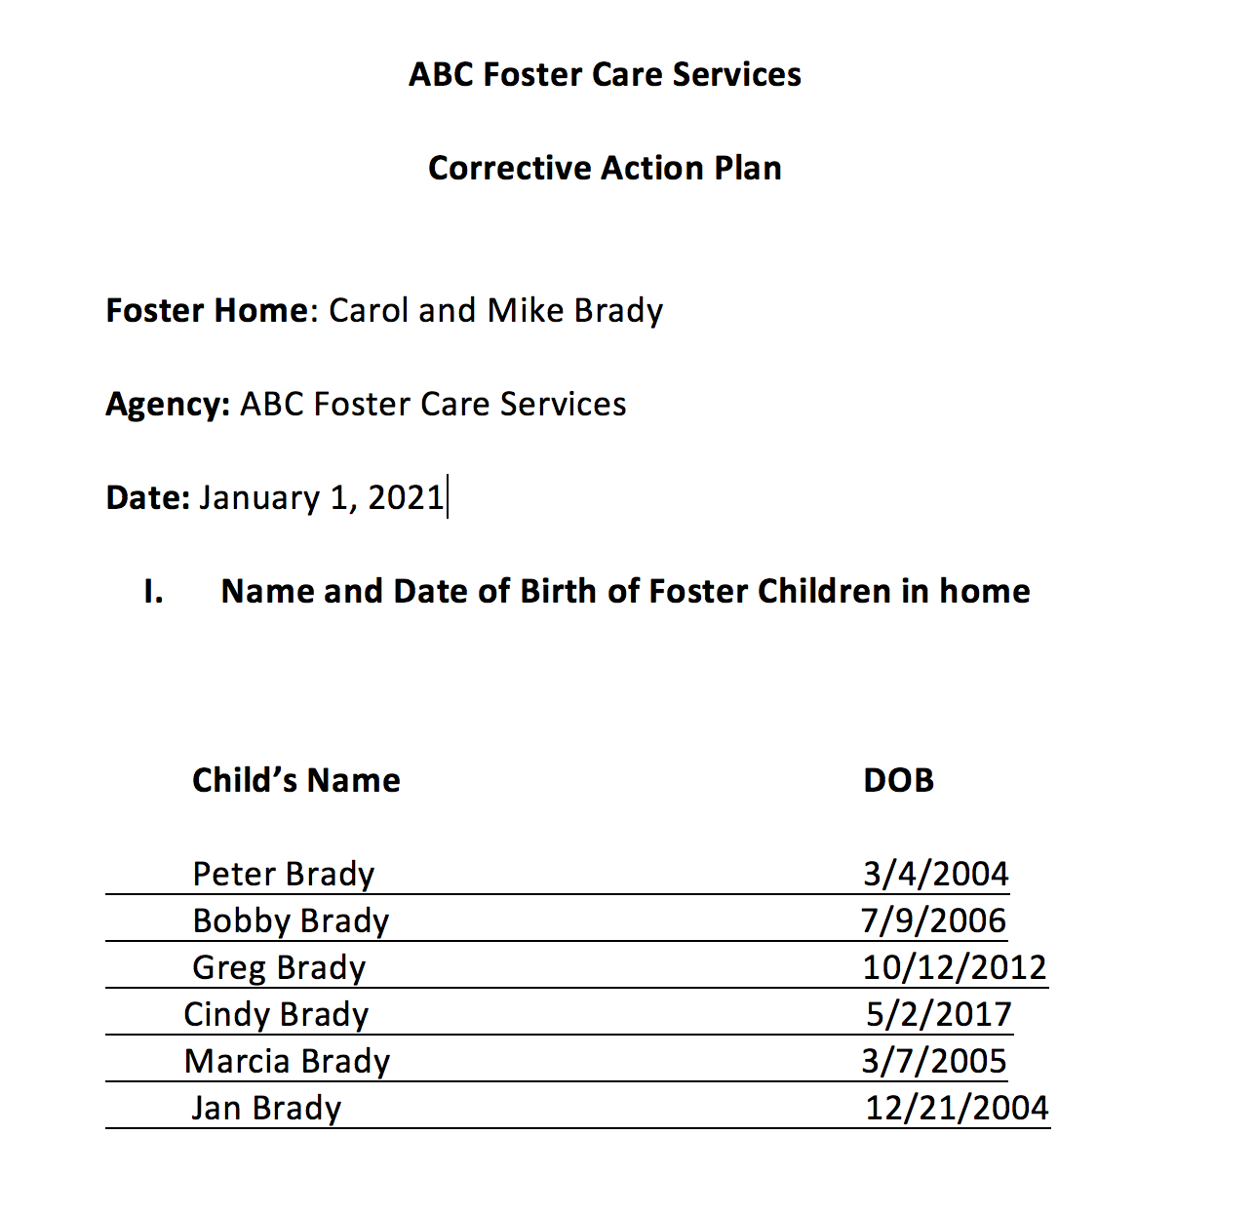

Slide 24
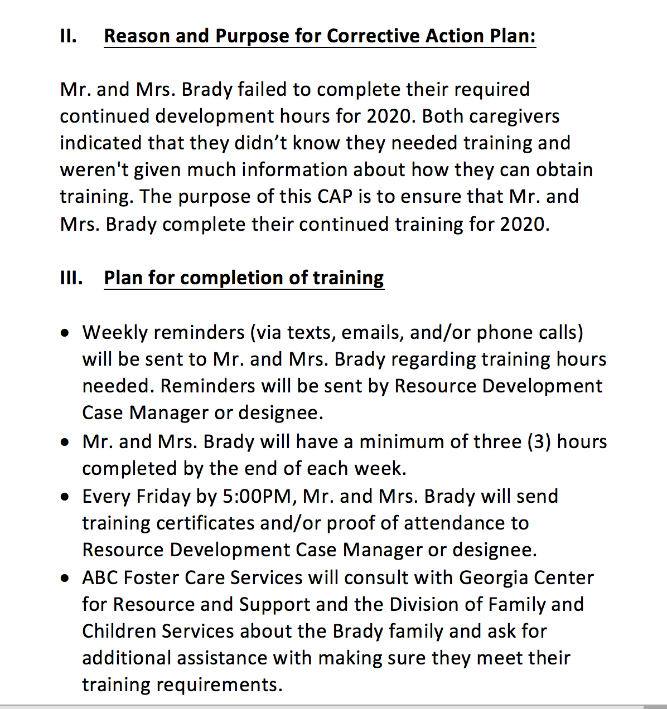

Slide 25
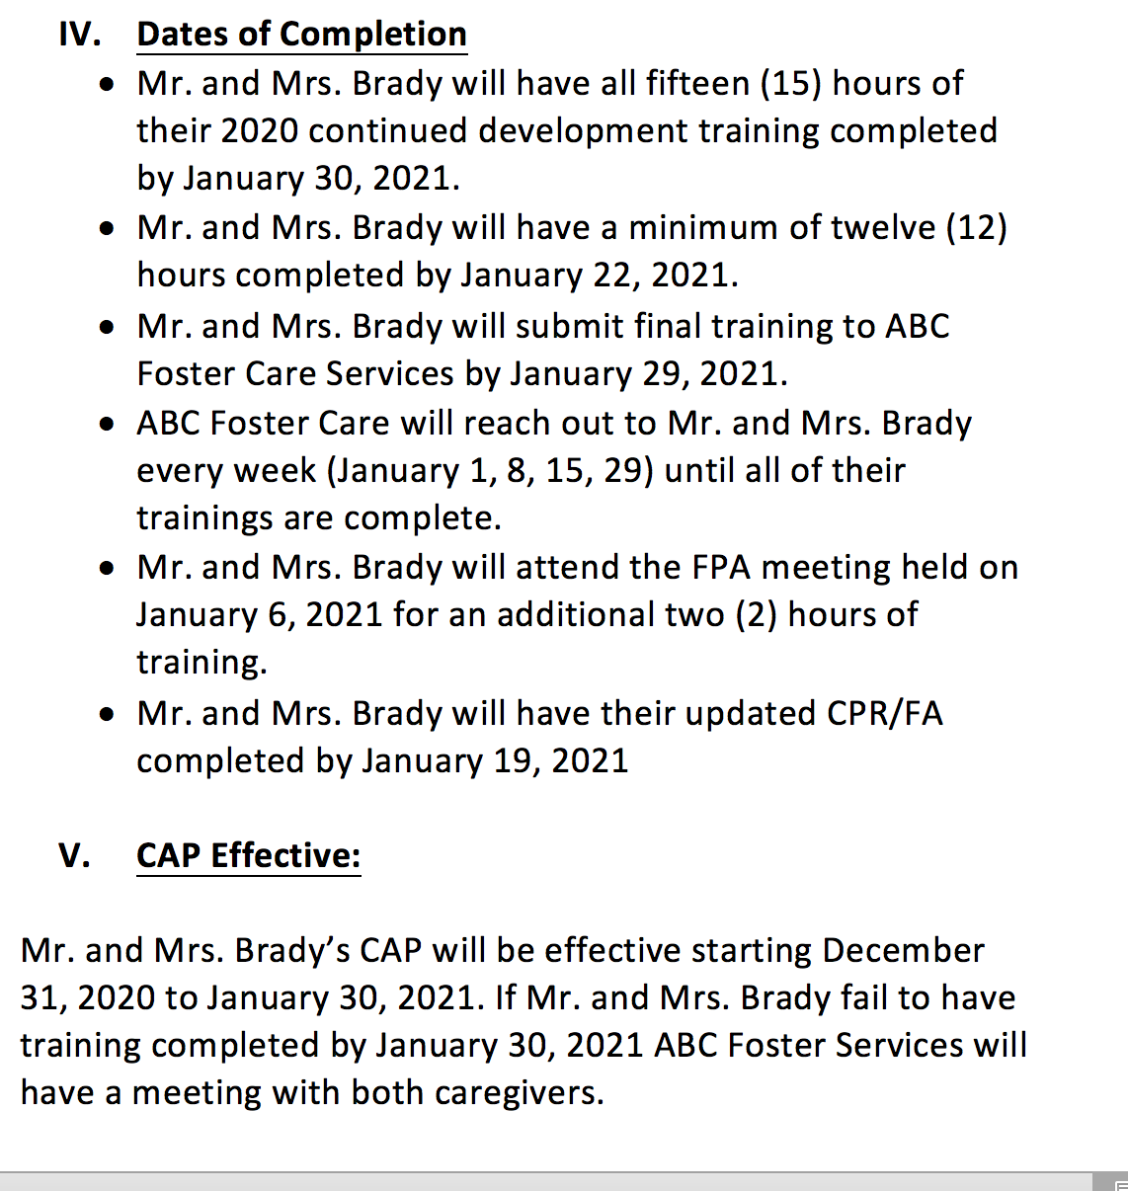

Slide 26
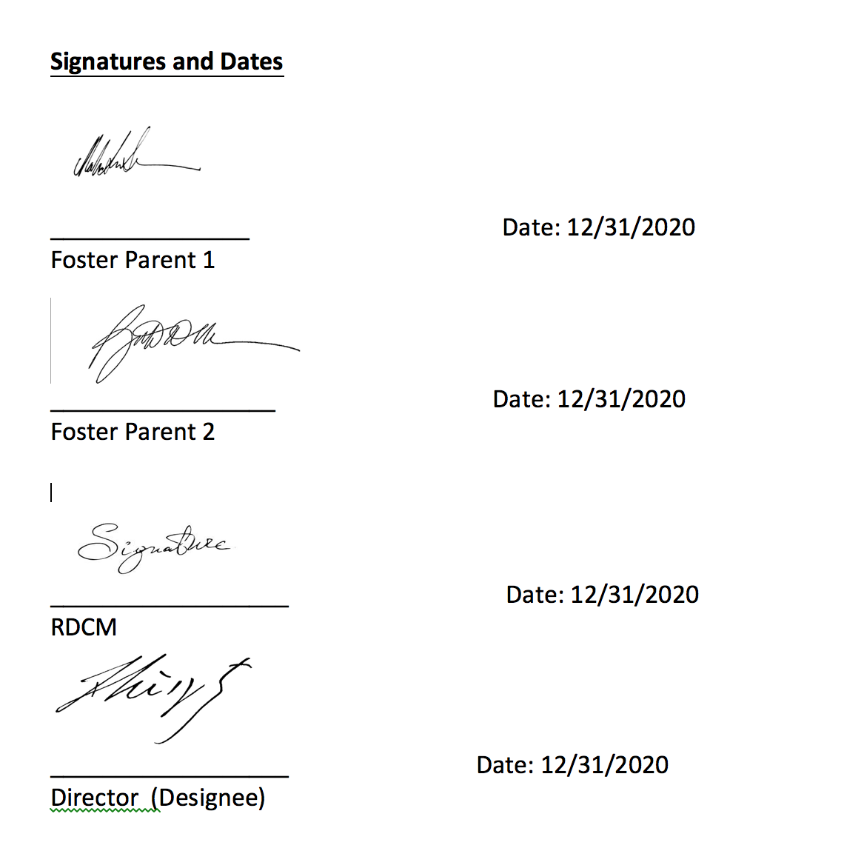

Slide 27
Training Resources
Georgia Center for Resources and Support
https://gacrs.org/home
Foster Georgia
http://fostergeorgia.com/on-going-training/
Local Foster Parent Association Meetings
Multi Agency Alliance for Children (MAAC)
https://www.maac4kids.org/
Foster Parent College ($)
https://www.fosterparentcollege.com/

Slide 28
Link to CPD and CAP/Policy Violation Policy
Continued Development Policy 14.9
Policy Violation Policy 14.22
https://odis.dhs.ga.gov/General

