Slide 1
Georgia Communicare
03/15/2024

Slide 2
Child Welfare
03/15/2024

Slide 3
Georgia Communicare Users
Georgia Communicare serves three primary user groups – Court Appointed Special Advocates (CASAs), foster parents, and parents.
Georgia Communicare equips the primary parties within a foster care case with secure communication and data management capabilities.
Each user group has different levels of permissions, allowing users to only access the information they are required to see.
DFCS Staff
Foster Parents
Parents
CASAs
Child Welfare
03/15/2024

Slide 4
Georgia Communicare Features
Georgia Communicare is a set of interconnected web portals specifically designed to support and enhance communication within child welfare programs.
Case data and documentation enhancements
Secure data and file sharing
Person-to-person chat
Appointment booking and
calendar management
Child Welfare
03/15/2024

Slide 5
Documents and Data for Foster Parents
Child Information
Demographics
Educational Records
School Records
Characteristics / Diagnoses
Prescribed Medication
Health Events
Education Detail
Individual Family Service Plan
Medical Records
Early and Periodic Screening, Diagnostic, and Treatment
Health and Medical Records
Individual Education Plan
Immunizations
Other Case Information
Ansell Casey forms
Dental Reports
Mental Health Records
Staff Contact Information
Foster Care Case Plan – Foster Parent Specific Version
Child Passport
Caregiver Passport
Georgia Communicare allows foster parents access to a wide range of case data and documentation.
Documentation is pulled directly from SHINES in real time, so as soon as a document is uploaded it is made available to users that have access to it.
Child Welfare
03/15/2024

Slide 6
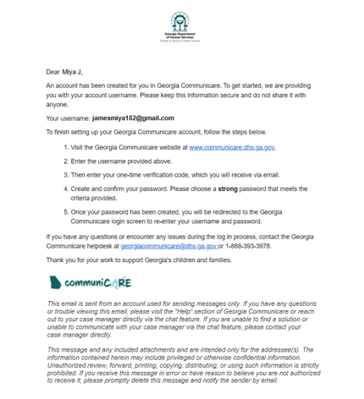
Statewide Rollout Timeline
Georgia Communicare is available statewide for all Foster parents. Users were onboarded geographically aligning to the legal county of the foster child in their care.
DADE
CATOOSA
MURRAY
FANNIN
UNION
TOWNS
RABUN
WALKER
WHITFIELD
GILMER
WHITE
CHATTOGA
GORDON
PICKENS
LUMPKIN
HABERSHAM
STEPHENS
Key dates for when each region was onboarded to Communicare
Regions 2 and 5 Completed on September 30, 2023
Regions 1, 3, and 4 Completed on January 19
Regions 13 and 14 Completed on February 16
Regions 6, 7, 8, 9, 10, 11, and 12 Completed on February 22
FLOYD
BARTOW
GORDON
DAWSON
GORDON
HALL
BANKS
FRANKLIN
HART
CHEROKEE
FORSYTH
JACKSON
MADISON
ELBERT
POLK
PAULDING
COBB
GWINNETT
BARROW
CLARKE
HARALSON
DeKALB
WALTON
OCONEE
OGLETHORPE
WILKES
LINCOLN
DOUGLAS
FULTON
ROCK- DALE
CARROLL
FAYETTE
CLAYTON
HENRY
NEWTON
MORGAN
GREENE
TALIAFERRO
McDUFFIE
COLUMBIA
HEARD
COWETA
JASPER
PUTNAM
WARREN
RICHMOND
SPALDING
BUTTS
HANCOCK
GLASCOCK
TROUP
MERIWETHER
PIKE
LAMAR
MONROE
JONES
BALDWIN
WASHINGTON
JEFFERSON
BURKE
UPSON
BIBB
WILKINSON
JENKINS
HARRIS
TALBOT
CRAWFORD
TWIGGS
JOHNSON
SCREVEN
Taylor
PEACH
T
EMANUEL
MUSCOGEE
HOUSTON
BLECKLEY
LAURENS
TREUTLEN
CHATTAHOOCHEE
MARION
MACON
CANDLER
BULLOCH
EFFINGHAM
STEWART
SCHLEY
DOOLY
PULASKI
DODGE
WHEELER
MONTGOMERY
TOOMBS
EVANS
WEBSTER
SUMTER
WILCOX
TATTNALL
BRYAN
CHATHAM
QUIT- MAN
TERRELL
CRISP
TELFAIR
JEFF
DAVIS
LIBERTY
RANDOLPH
LEE
TURNER
BEN
HILL
APPLING
LONG
CLAY
CALHOUN
DOUGHERTY
WORTH
IRWIN
COFFEE
BACON
WAYNE
McINTOSH
EARLY
BAKER
TIFT
PIERCE
MILLER
MITCHELL
COLQUITT
BERRIEN
ATKINSON
WARE
BRANTLEY
GLYNN
COOK
LANIER
SEMINOLE
DECATUR
GRADY
THOMAS
BROOKS
LOWNDES
CLINCH
CHARLTON
CAMDEN
ECHOLS
Child Welfare
03/15/2024

Slide 7
System Testimonial
"Georgia Communicare is an amazing tool for both foster and birth parents. I truly believe that Georgia Communicare is going to be the bridge that helps foster parents and birth parents communicate, as we navigate in support of reunification." - (Region 5 foster and adoptive parent)
Child Welfare
03/15/2024

Slide 8
Upcoming Features for Communicare
We are constantly evolving Communicare and expect to introduce new features and users in the future
CPA Staff – adding staff into the system to interact with parties to the case
Mobile Application for all users
Foster Parent onboarding and re-evaluation management for DFCS and CPA Foster parents
Child Welfare
03/15/2024

Slide 9
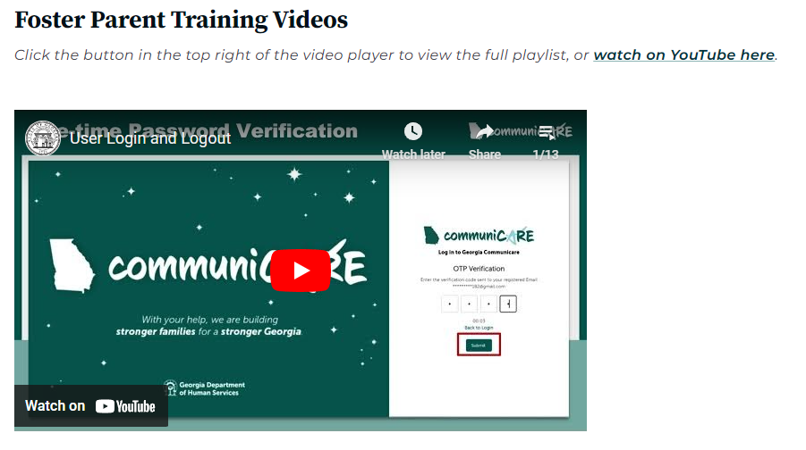
Available Resources for Georgia Communicare
Training videos for each user group are available within Georgia Communicare under the “Help” tab and on the DFCS website at dfcs.georgia.gov/services/georgia-communicare.
For support, contact the Georgia Communicare Helpdesk via phone or email.
Email: georgiacommunicare@dhs.ga.gov
Phone: 1-888-393-3978
Child Welfare
03/15/2024

