Slide 1
Tom C. Rawlings
Director

Slide 2
ILP Partnership Meeting August 25, 2020
AGENDA
9 – 9:10am | Wait period
9:10 – 9:20am | COVID Protocol | Dr. Shaun Johnson & Tammy Reed
9:20 – 10:00am | RBWO Minimum Standards | Beth Brown
10:00- 10:45am | Performance Based Placement | Shakaria Glass
10:45 - 11:00am | BREAK
11:00- 11:30pm | Progressive Compliance Process | Deborah Spaulding
11:30 – 12:30pm | ILP Redesign | Tiffany Cutliff
12:30-1:00pm | Questions & Answers | All
1:00-1:10pm | Announcements | Dr. Shaun Johnson

Slide 3
FY2021
RBWO Minimum
Standards Updates

Slide 4
New RBWO Standard 1.18
Providers must develop a Quality Assurance Plan (QAP) targeted at ensuring all required background checks are completed and uploaded no more than 30 days prior to the employee’s hire or anniversary date. The QAP must include the provider’s method of tracking staff background checks due within the 30-day time period and indicate which individual(s) are responsible for oversight of the QAP. The QAP must be uploaded under the provider’s profile tab in GA+SCORE updated annually.

Slide 5
New RBWO Standard 1.19
Providers must develop a water safety policy and procedure. When placing children in homes that have swimming pools, spas, or other large bodies of water nearby a water assessment must be completed. The age, special needs, and number of children in a home should guide decisions around placement in such homes. Water safety assessments must be completed annually. The water safety assessment can be found at www.gascore.com.
Note: Refer to the complete standard for water safety guidelines.

Slide 7
New RBWO Standard 6.3
Providers must coordinate with DFCS to ensure parents or other identified permanency resources are invited to attend all youth’s medical and dental appointments, unless prohibited by court order or child safety concerns.
This Photo by Unknown Author is licensed under CC BY

Slide 9
New RBWO Standard 6.4 (Formerly 6.3)
Providers must follow the DHS guidelines for Psychotropic Medication Use in Children and Adolescents and they must have and follow their own medication management policy for all prescription and non-prescription medications which include the following:
(I.) Providers’ medication management policy must include children’s right to refuse medication and a procedure for documenting and addressing medication refusals.
(V.) Medication management policy should reflect that all medications must be stored in and dispensed from the original container, which should also include the prescribing physician's instructions.
Note: All other components of the standard remain the same.

Slide 10
New Standard 6.11 (Formerly 6.10)
Providers will ensure that appropriate educational services and academic supports are provided to youth who are required to be enrolled in K-12 or GED programs. Services shall include the following:
l. Documentation of at least two provider facilitated academic supports per month. Documentation should reflect how the educational activity, service, or resource assists the child with meeting learning standards, accelerates their learning process, and/or encourages and promotes the child’s overall academic success.
NOTE: All other components of the standard will remain the same.

Slide 11
RBWO Standard 10.1
Providers must ensure that youth complete the CLSA annually beginning at age 14 through 21 years of age. The CLSA should be completed within 15 days of the youth’s birthday or intake date based on the identified age requirements. The CLSA is required to develop the Individualized Skill Plan. Providers should review assessment findings with the youth in a strength-based conversation that actively engages them in the process of developing their goals. The Caregiver Assessment portion of the CLSA should be completed in conjunction with the youth’s assessment and included in the youth’s skills plan. When administering the CLSA, providers must use the appropriate code (which is based on the child’s custodial county region).
Note: This requirement can be satisfied at initial placement if a current CLSA has been provided from DFCS or the youth’s previous placement.

Slide 13
RBWO Standard 13.3
Contractual changes such as site address, request for approved program designations, etc. should be made in writing to OPM using the vendor request form and may result in a site review or request for additional information. All vendor request forms should be sent to the Provider Relations Manager.
Note: All other components of this standard remain the same.

Slide 14
RBWO Standard 13.19
Providers must notify OPM in writing of any RCCL approved satellite offices in which records are kept. Notification must be sent to the provider’s assigned Monitoring Specialist and the Provider Relations Manager.
Note: All other components of this standard remain the same.

Slide 15
RBWO Standard 13.37
Individuals who serve in a quality assurance or compliance role must meet the minimum educational and experiential requirements of the Human Services Professional or Case Support Worker.
Note: Reference Staffing Standards for educational and experiential requirements.

Slide 16
RBWO Standard 22.0
ILP youth must have a documented assessment which supports their level of independence. The provider should assess the need to increase the frequency and type of supervision based on the young adult’s program designation at intake. The initial assessment determination should be documented in the youth’s 7-day ISP and updated at each ISP review.

Slide 17
RBWO Standard 22.4
All contacts must be documented in GA Shines within 72 hours of contact.
Note: All other components of this standard remain the same.

Slide 18
New RBWO Standard 22.8
Providers must have a policy to monitor youth who have identified substance use. The policy should address how the provider will support the youth within the program and outline how staff will be trained to identify indicators of substance use and abuse. Identified concerns should be documented in the youth’s ISP and updated as events dictate.

Slide 19
New RBWO Standard 23.11
The ILP must provide specialized parenting support services to pregnant or parenting youth. These supports must be included in the youth’s ILP ISP. Suggested content areas include: Healthy pregnancy—nutrition, emotional and medical support:
Adolescent development
Teaching youth parenting skills
Post-partum depression and related topics
Non-custodial parent engagement
Safe sleeping guidelines for infants
Motor vehicle/hot car safety
Conflict resolution
Sexuality and pregnancy of adolescents
Accessing community resources; and
Competency with culturally diverse populations

Slide 20
New RBWO Standard 25.4
Life Coaches must be trained by the provider in the following content areas within sixty (60) days of hire: Appropriate relationships with youth, Staff boundaries, Knowledge of adolescents and adolescent development, Development of engagement skills, Sexuality and pregnancy of adolescent females, Accessing community resources, Infant safe sleeping guidelines, Competency with culturally diverse populations, Conflict resolution and de-escalation, Motor vehicle “Hot Car” Safety (Reference DFCS Policy 10.1), Communicating with youth, Developmental stages, Trauma informed care, and Social media/internet safety.

Slide 21
Pending RBWO Standard 26.0
Youth in Single Occupancy Housing must be provided with a monthly allowance for hygiene products and receive a minimum monthly stipend of $300 for food.

Slide 24
Georgia Division of Family and Children Services
Office of Provider Management
ILP PBP Measurements and FY21 Updates
Shakaria Glass, South Monitoring Manager

Slide 25
Understand how to read and access PBP scorecard details.
Become familiar with FY21 updates to PBP Measures.

Slide 26
Performance-Based Placement
Performance‐based placement (PBP) is a system of data reporting and monitoring that generates quarterly scores for RBWO providers.

Slide 27
GA+SCORECARDS
Are issued on a quarterly basis.
Includes an overall score and corresponding grade as well as a detailed report of performance in each of the measurements.
Scorecard
Child Detail
Staff Detail
DFCS case workers use provider scores to make informed placement decisions.
OPM uses provider scores to assess quality of care and identify opportunities for technical assistance and training.

Slide 28
LET’S TAKE A LOOK

Slide 29
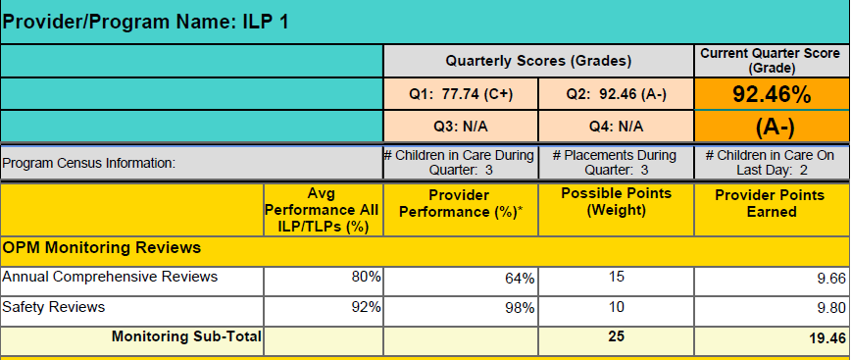
ACR weight will increase to 40 for FY21
NEW weight = 50

Slide 30
TLP & ILP Measurement Updates
Measure | Old Weight | New Weight
Incidence of Maltreatment | 3 | 3
Staff Training and Foundations | 5 | 5
Staff Safety Checks | 5 | 5
Placement Stability | 3 | 4
Academic Supports (now all youth) | 2 | 5
EPSDT Medical | 4 | 2
EPSDT Dental | 4 | 2
Provider Every Child Every Month Visit | 4 | 4
Academic/Career Development | 10 | 5
Independent Living Skills Provision | 15 | 5
Financial Independence | 5 | 5
WTLP /Life Coach | 15 | 5

Slide 31
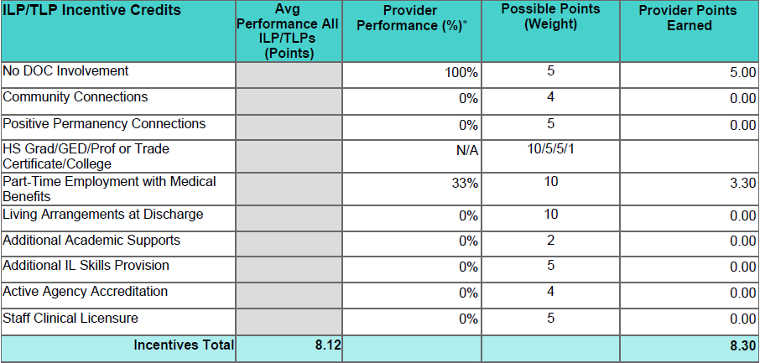
Providers can still earn up to 10 incentive points
Must score at least 70%
on most recent ACR.

Slide 32
Predicted Impact of Scoring Changes
To assess the effect on individual and aggregate scores, Care Solutions reran scorecards for 4 previous quarters using these new measures.
These changes had the greatest impact on scorecards with a large disparity between OPM’s assessment via monitoring reviews and the provider’s self-assessment.

Slide 33
Data Highlights: TLP & ILPs
The lowest score for the last four quarters remained 0 and the highest score remained 108.
85% of scores increased or stayed the same; 15% decreased.
The median score increased from a C to a B and the mean score remained in the B range.
Letter Grade | Original % | New %
A | 36.8 | 41.0
B | 15.0 | 18.8
C | 13.5 | 13.2
D | 10.2 | 9.0
F | 24.4 | 16.5

Slide 34
UNDERSTANDING THE CHILD DETAIL PAGE
A child specific breakdown of the RBWO provider self reported data for the quarter.
Names of youth placed
Dates of admission and discharge
Required vs. Reported Data
Base and Incentive Measures
EPSDT Medical and Dental
Academic Supports
ECEM and General Contacts
ILP Specialty Outcomes
REMEMBER: This data is all youth specific.

Slide 35
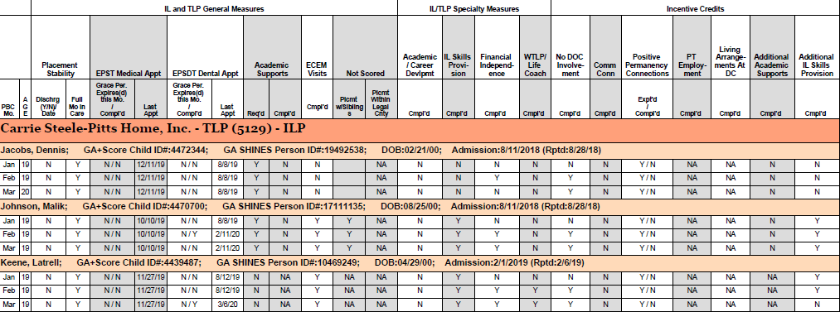
CHILD NAME: GA Score ID: SHINES ID:

Slide 36
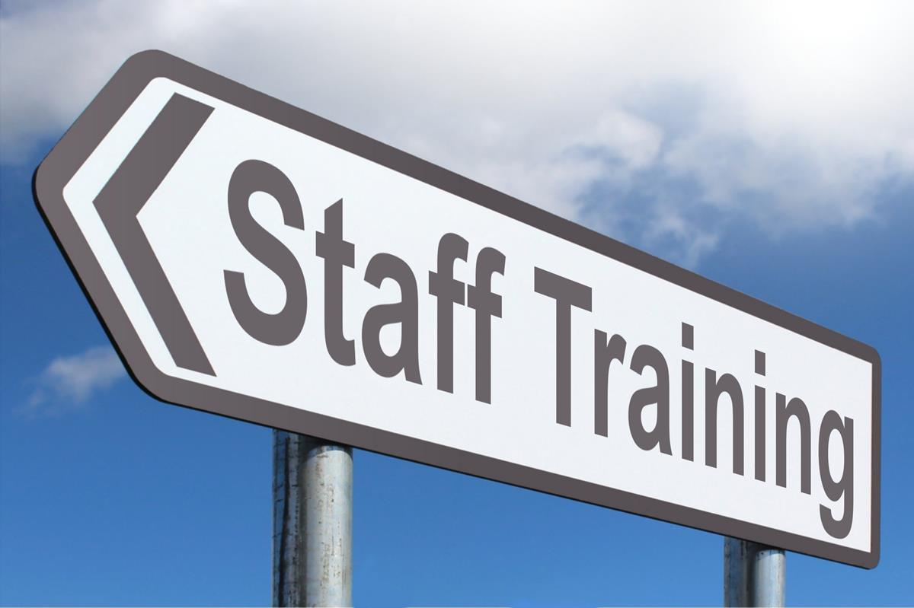
UNDERSTANDING THE STAFF DETAIL PAGE
A RBWO Staff specific breakdown of self reported training and Safety Screening data for the quarter.
Name of staff and RBWO Role
Number of days worked in the quarter
Training required for current quarter (Y/N)
# of training hours completed during quarter
# of training hours completed during fiscal year
Foundations Registration and Completion
Safety Screenings completed (Y/N)
Licensure

Slide 37
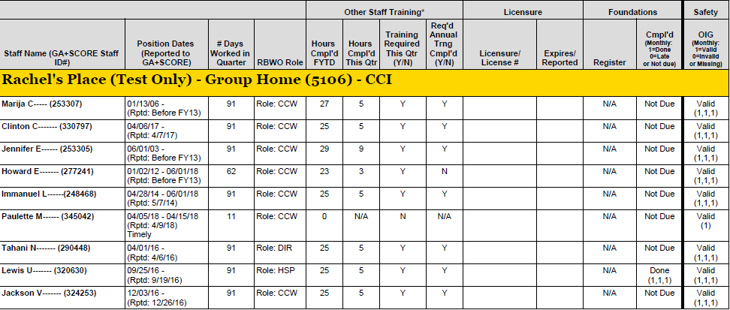
60 or more days

Slide 39
Access the PBP Measurements and Standards Guide at
www.gascore.com
Under Key Documents and Forms

Slide 41
Progressive Compliance Process
Deborah Spaulding, North Monitoring Manager

Slide 42
Why Is Progressive Compliance Needed?
A protocol is needed to address overall non-compliance with Minimum Standards, Child Welfare policy and other contractual obligations.
Formalized Process
Consistency

Slide 43
Phase One
Phase One focuses on providing identified needed resources and supports in addressing any form of non-compliance.
Step One:
Technical Assistance
Telephone Conference
Site Visits
Completed by all sections of OPM
This initiates Progressive Compliance Process
Step Two:
Quality Improvement Plan (QIP)
Documentation of step in GA+SCORE in provider’s OPM History file.

Slide 44
QUALITY IMPROVEMENT PLAN
A Quality Improvement Plan (QIP) is a detailed work plan intended to enhance an organization’s quality in a specific area.
Includes essential information about how your organization will design, implement, manage and assess quality.
Developed by the utilization of S.M.A.R.T. goals and should result in the reduction of the occurrence of further non-compliance in the specified area of concern.
QIP will be monitored and tracked for progress every 30 days until final completion.
Documented in provider’s OPM History file.

Slide 45
Phase Two
Assist providers with ensuring compliance with the Minimum Standards, the Division’s Child Welfare policies and contractual obligations through the utilization of corrective measures.
Decrease re-occurrence of previously identified non-compliance while partnering to provide the necessary support in ensuring meeting OPM expectations and requirements.

Slide 46
Phase Two
Telephone Conference
Office Conference
May be requested in lieu of a telephone conference dependent upon severity of concerns.
Changes to contract may be requested to address concerns.
Provider Capacity
Program Designations
Recommend Training
Admissions Suspension
Letter of Concern

Slide 47
Phase Two
PHASE TWO:
Corrective Action Plan (CAP)
This plan should be developed by the utilization of S.M.A.R.T. goals and should result in the reduction of occurrence of further non-compliance in the specified area of concern.
Duration of the CAP is up to six months.
Monitoring and supervision of the provider will be increased to ensure ongoing progress towards resolution.
CAP is monitored and tracked for progress by OPM every 30 days.

Slide 48
Phase Two
Involuntary Suspension
During a provider admission suspension, no new child or youth admissions can be made with the provider until the suspension is authorized for release.
If admissions of children and youth has been made at any time throughout the suspension, further action may be taken by OPM including or up to the removal of placements.
Involuntary Suspension
During a provider admission suspension, no new child or youth admissions can be made with the provider until the suspension is authorized for release.
If admissions of children and youth has been made at any time throughout the suspension, further action may be taken by OPM including or up to the removal of placements.

Slide 49
Phase Two
Contract Termination
OPM maintains the exclusive right to recommend and proceed with contract termination dependent upon the severity and/or nature of the policy violation infraction.
If placed on an involuntary admissions suspension for six months or more, OPM will consider contract termination if:
The ongoing suspension is due to continued failure to resolve or address identified non-compliance issues.
Lack of adherence to provider’s proposed CAP.

Slide 50
Phase Three
S.B.A.R. Completion
Summarization of the history of deficiencies including, but not limited to:
History of all technical assistance provided
Letter of Concerns
Summary of policy violations
PBP scores
Staffing concerns
Physical plant concerns
Past involuntary admission suspensions
SBAR staffed with the Permanency and Placement Director and legal team prior to contract termination finalization.

Slide 51
Suggestions
Feedback
Concerns regarding “Discipline” not reflecting partnership.
Process renamed to Progressive Compliance.
Majority of respondents (72%) identified that a progressive compliance process was needed.
Majority of respondents (80%) feel that a tiered approach will be effective.
Approximately 66% of respondents believe the progressive compliance process should be ongoing.
Questions regarding timeframe of overall process.

Slide 53
Independent Living Standards
Presented by: Tiffany Cutliff
Metro Monitoring Manager
Office of Provider Management
Notes:
Good morning everyone. I am Tiffany Cutliff, the Monitoring Manager for Metro team with the Office of Provider Management.

Slide 54
We’re Re-designing ILP…
Notes:
As you all know, at the end of 2018, OPM sent out a request to our provider community seeking volunteers to partner with the Division in formulating a workgroup with the purpose of redesigning the way Independent Living Programs operate in the state of Georgia. The workgroup consisted of 9 RBWO providers, MAAC, DFCS Policy Unit, GA RYSE Chafee program, DFCS Fiscal, and of course OPM. We began this workgroup around January of 2019 and held several workgroup meetings over the last year and a half. I would like to give a huge round of applause to everyone that dedicated countless hours of their time to come up with the information that I will be presenting to you today. This has not been an easy task, by far, but I think I can speak for the entire workgroup when I say that we hope the end result lends to much greater success for all of our young adults in foster care.
Before we begin, I urge you all to ask questions and provide feedback in the chat box. There will be members of the OPM team available to answer questions during the presentation. We will also provide an identified time for questions to be asked verbally at the end of the presentation.

Slide 55
Performance trends
Inconsistency across ILP’s
Increase in incidents
Improve Provider Performance
Improve Outcomes for our youth
Notes:
So, in case you are wondering why we are re-designing Independent Living in Georgia…..here are a few things that led us to the decision. Outside of the fact that ILP program standards have always been very broad for the most part, we noted that overall, there were inconsistencies in the way individual independent Living programs operated. We also noted that ILP provider performance scores were on a downward trend. Over the last three fiscal years, only 45 to 51% of ILP providers received passing Performance Based scores. In addition, an increase in incidents have been noted that raise significant concerns regarding youth being appropriate for Independent Living Placements with minimal supervision. Some of the identified trends involved youth non-compliance, criminal activities, gang involvement and other significant behavioral concerns. This drove the WHY behind re-designing Independent Living. With this re-design, we hope to improve provider performance and gain better outcomes for our youth.

Slide 56
New ILP Requirements
Age requirement
Must be 18
Underage waivers will no longer be provided
Education Requirement
Must have a high school diploma or GED prior to admission
Employment
To be eligible for extended foster care, youth must be employed at least 80 hours per month or attending a post-secondary school full time; or working part-time and attending school part-time
Pre-placement assessment required
ILP program will be Tiered
Tier 1
Tier 2
Tier 3
Scattered Site Placement Youth Readiness Assessment
Notes:
Beginning with the final approval and release of the FY 21 RBWO Standards, the new design and requirements for Independent Living will apply. Please note that the new Standards apply to new placements admitted after the release of the RBWO Standards. All prior placements will follow the current standards or will be re-assessed to determine an appropriate Tier.
Currently, the age requirement for ILP is 18, however, waivers have been granted for a younger person age 17 ½ to be approved to enter an ILP program. With the new design, a young person will have to be age 18 in order to enter an ILP program. Underage waivers will no longer be an option.
Another requirement is that A young person will now be required to have at least a high school diploma or GED in order to be admitted into an ILP program.
Here is another very important requirement as it relates to employment…in order to be and remain eligible for extended foster care, a young person MUST be employed at least 80 hours per month OR attending a post-secondary school on a full time basis OR they can be employed part-time while attending school part-time. Again, in order to maintain their eligibility for extended foster care, they have to meet one of these conditions.
We have developed a new pre-placement assessment that will be required for each young person. This pre-placement assessment will determine whether a young person should be approved or denied entry into an ILP program. We will go into more detail about the pre-placement assessment on the next few slides.
Lastly, ILP programs will now have a different structure. There will be three tiers. Each Tier is designed to…..

Slide 57
Pre-Placement Assessment
Scattered Site Placement Youth Readiness Assessment:
Must be completed before a young person can be considered for ILP admission
Can be completed as early as 6 months prior to a young person’s 18th birthday
Must be completed no later than 90 days prior to a young person’s 18th birthday
Completed by the Independent Living Specialist (ILS)
Must be signed by the young person, ILS, DFCS CM and County Director at a minimum
Youth will either be approved or denied ILP placement on or after 18th birthday
Notes:
So let’s talk more about the required pre-placement assessment.
The Scattered Site Placement Youth Readiness Assessment is the name of the newly required assessment.
Again, this must be completed before a young person can be considered for admission into an ILP program.

Slide 58
Pre-Placement Assessment Criteria
Self Development and Independent Functioning
Education
Household Management and Life Skills
Mental Health
Placement History
Employment
Expectant or Parenting Youth
Physical and Reproductive Health
Financial Literacy/Understanding Credit
Criminal History
Substance Abuse/Misuse
Notes:
The Scattered Site Placement Youth Readiness Assessment uses the following criteria:
Self- Development and Independent Functioning:
Can the youth appropriately advocate for themselves?
Can they take initiative in doing things for themselves (i.e., schedule their own appointments, etc.)?
Can the youth demonstrate appropriate non-threatening conflict resolution?
Education:
Is the youth participating or enrolled in a post-secondary education program (4yr, 2yr, trade program etc.)? If so, where and what are they studying? When is the expected date of completion?
Area for Additional Follow Up/Assessment:
If IQ is below 80 – the ILS must engage the Education Specialist and Care Coordination Treatment Unit to assess the youth’s capacity to function on their own in a scattered site setting
Household Management and Life Skills:
Does the youth know how to complete the following?
Complete basic household cleaning
Kitchen
Bathroom
Bedroom
Floors
Separate and wash their own laundry
Use a fire extinguisher
Identify smoke detectors and when it needs to be serviced
Shop for groceries?
Prepare Meals
Self-care
Mental Health:
List youth’s current and historical diagnosis – Last date of Evaluation
Does the youth understand their mental health diagnosis and what it means?
Does the youth understand their medication treatment regimen and adheres to it?
Does the youth know how to administer their medication themselves?
Placement History:
What is the youth’s current program designation?
If the youth has a current designation of Maximum Watchful Oversight (MWO) – list the behaviors the youth exhibited that warranted such designation.
Has the youth been hospitalized at a Crisis Stabilization Unit (CSU) with the last 90 days? If so, reason for hospitalization? How many times has the youth been hospitalized at a CSU within the last year?
Has the youth been placed at a PRTF within the last six months?
Has the youth been placed at a Psychiatric Residential Treatment Facility (PRTF) or experienced partial hospitalization within the last year? If so, reason for hospitalization?
Does the youth have history of elopement? If so, when was the last time the youth left, and what was the length of their absence?
Has the youth been declared a victim of sex trafficking?
Have they been assessed by GA Cares?
Has the young person participated in treatment? If, so date of completion?
Are there any current protective orders? If so, provide copy of existing orders.
Employment:
Has the youth been employed previously? If so, list prior employment and dates.
Has the youth participated in the employment program offered by GA CREW (formerly known as TeenWorks)?
Has the youth participated in job readiness training?
Does the youth have a State ID or Driver’s License?
Does the youth have necessary citizenship documents?
Birth certificate
Social Security Card
Expectant or Parenting Youth:
Is the youth currently pregnant or expecting? If so, when is the youth expected to give birth?
Is the child placed with the youth? If not, where is the child now?
Is the youth’s child in DFCS custody? If so, when was the child removed? What is the case plan type?
Is the youth engaged in the Teen Parent Connection Program with MAAC?
Has the youth participated in any parenting education programs?
Does the child have CAPS? If not, has the youth applied?
Physical and Reproductive Health:
When was the youth’s last physical examination?
Does the youth have any medical conditions that require ongoing treatment? If so, list the diagnosis and treatment regimen.
Does the youth know their treating physician(s)?
When was the youth’s last dental examination?
Does the youth know how to schedule their own appointments?
If the youth indicates yes, have the youth describe how they can execute this skill? (input scale)
Does the youth know their Amerigroup Care Coordinator?
Care Coordinator’s Name
Is the youth sexually active?
If so, does the youth utilize contraceptives? If so, what do they use now?
Financial Literacy / Understanding Credit:
Has the youth completed a financial literacy course or Individualized Development Account (IDA) Training? If so, when?
Does the youth have a checking or savings account?
If so, which bank?
Is the youth actively saving?
Describe the youth’s knowledge of budgeting and managing money.
Describe the youth’s knowledge around paying bills?
When did they retrieve their last credit report?
Criminal History:
Has the youth ever been convicted of the following types of offenses (if yes, indicate date of conviction and sentence):
Crimes against children
Drug Related Offenses
Sexual Offenses of any nature / or Sex Trafficking (as assailant not victim)
Crimes that are violent in nature (assault, robbery, domestic violence, etc.)
Has the youth been arrested for any offense within the last year?
If so, list charge and date of arrest
Does the youth have any pending hearings? If so, list the hearing date if scheduled/known.
Is the youth actively on probation? What are the conditions of their probation?
Substance Abuse/Misuse:
Does the youth have any history of substance use/misuse?
If so, list drug(s) of choice.
Date of last positive drug screen – for which substance
Has the youth ever received drug treatment? If so, when?
Other Considerations:
Required Signatures (Youth, ILS, DFCS CM & County Director at a minimum)
Providing the youth, a copy of the Assessment
Development of Action Plan for readiness tasks identified as a result of the assessment that the youth needs to complete
All action items identified must also be included in the youth’s Written Transition Living Plan and Placement Provider Service Plan
Do we wish to know who are the youth’s adult supporters, and whether they have a significant other?
Indicates areas that require additional information and development of an action plan.

Slide 59
Pre-Placement Assessment Minimum Standards
21.0 Before a young person can be considered for ILP admission, GA RYSE/Chafee must complete a Scattered Site Placement Youth Readiness Assessment.
21.1 Youth must be in foster care for at least six (6) months before being assessed. A first Assessment can be completed as early as six months prior to the youth's 18th birthday and must be completed no later than the Transitional Meeting that must occur 90 days prior to the youth’s 18th birthday.
21.2 Based on the results of this Assessment, the youth may be approved or denied for ILP placement on/after the youth’s 18th birthday.
21.3 If the youth is denied, they must wait 90 days before submitting a request for re-assessment; as part of the request, the youth must provide evidence of completion of readiness activities, goals, etc. identified in the previous denial.
21.4 If the young person is approved, the assessors may indicate specific strengths or needs discovered during the Assessment process. These items must be incorporated into the provider's ISP for the young person; see Standard 22: Admissions.
Notes:
Now most of this information I discussed on previous slides, but I wanted to reference the specific standards here. I think the only information that was not stated previously was from Standard 21.1 which states that a youth must be in foster care at least 6 months before being assessed for ILP.
Please also note Standard 21.3 that indicates that a youth must wait 90 days before submitting a request for re-assessment if they are denied. As part of the request, the youth must provide evidence of completion of readiness activities, goals etc. that were identified in the previous denial.
While we are here, l want to reiterate what Standard 21.4 states…which is that if a young person is approved, the strengths or needs discovered during the assessment process must be incorporated in the providers ISP for the young person. There is more about this in the Admissions section of the standards, which will discuss next.

Slide 60
ILP Admissions and Discharges Minimum Standards
Providers must admit only youth for whom the Scattered Site Placement Youth Readiness Assessment indicates that the youth is appropriate for the program. Based on the results of the assessment, the provider must concur that the young person is invested in and able to benefit from ILP and that the provider is able to meet any specific needs identified during the assessment.
22.0 The provider may not accept any young person who does not have a completed, signed, and approved Scattered Site Placement Youth Readiness Assessment.
22.1 The provider may not require any documentation other than the Assessment to determine whether a potential placement match exists.
22.2 All young people accepted into placement must be at least 18 years of age and have elected to participate in Extended Youth Support Services.
22.3 All young people accepted into placement must be employed at least 80 hours per month, or attending post-secondary school full-time (12 or more credit hours per term), or working part-time and enrolled part-time.
22.4 Providers must have defined admittance criteria, which includes a youth-completed application and interview.
22.5 Providers must determine whether youth will be accepted or denied admission within three business days of a completed application.
22.6 Youth admitted into an ILP must have an orientation to the program. Youth should be provided with a handbook or other literature describing the program. The contact information for the Office of the Child Advocate must be included in the handbook or orientation packet. (See appendix)
22.7 Youth admitted into an ILP must sign an acknowledgement of having participated in an orientation to the program and having received an explanation of their rights and responsibilities as a participant in the program.
22.8 ILP Youth must sign an acknowledgement that they may be discharged from the ILP if they willingly and knowingly participate in illegal or disruptive behavior or it is determined that they are unable or unwilling to benefit from the program. All youth discharged for violating ILP rules must be given a 60-day notice and assistance with transition. Providers must create a written transition plan. A family team meeting must occur to discuss the youth’s transition. The provider and the DFCS Case Manager will work collaboratively to identify placement options.
22.9 Providers must maintain an up-to-date roster on GA+SCORE.
Notes:
So, we will continue on and look at Standard 22, which speaks to ILP Admissions and Discharges.
I know all of you can read, however, I want to go over these in the event that the print is too small for some of you to see.
The heading states that Providers must admit only youth for whom the Scattered Site Placement Youth Readiness Assessment indicates that the youth is appropriate for the program. Based on the results of the assessment, the provider must concur that the young person is invested in and able to benefit from ILP and that the provider is able to meet any specific needs identified during the assessment.
22.0 The provider may not accept any young person who does not have a completed, signed, and approved Scattered Site Placement Youth Readiness Assessment.
22.1 The provider may not require any documentation other than the Assessment to determine whether a potential placement match exists.
22.2 All young people accepted into placement must be at least 18 years of age and have elected to participate in Extended Youth Support Services.
22.3 All young people accepted into placement must be employed at least 80 hours per month, or attending post-secondary school full-time (12 or more credit hours per term), or working part-time and enrolled part-time.
22.4 Providers must have defined admittance criteria, which includes a youth-completed application and interview.
22.5 Providers must determine whether youth will be accepted or denied admission within three business days of a completed application.
22.6 Youth admitted into an ILP must have an orientation to the program. Youth should be provided with a handbook or other literature describing the program. The contact information for the Office of the Child Advocate must be included in the handbook or orientation packet. (See appendix)
22.7 Youth admitted into an ILP must sign an acknowledgement of having participated in an orientation to the program and having received an explanation of their rights and responsibilities as a participant in the program.
22.8 ILP Youth must sign an acknowledgement that they may be discharged from the ILP if they willingly and knowingly participate in illegal or disruptive behavior or it is determined that they are unable or unwilling to benefit from the program. All youth discharged for violating ILP rules must be given a 60-day notice and assistance with transition. Providers must create a written transition plan. A family team meeting must occur to discuss the youth’s transition. The provider and the DFCS Case Manager will work collaboratively to identify placement options.
22.9 Providers must maintain an up-to-date roster on GA+SCORE.

Slide 61
ILP Tier Progression
The goal of an independent living placement is to prepare youth to become socially and financially independent from the foster care system. Providers have no more than 3 years, from the age of 18, to ensure that young adults are ready for independence at age 21; therefore, it is critical that the young person is able to successfully move from less to more independence in all areas – education, employment, housing, life skills, etc. – over the course of the placement. To this end, Independent Living Programs are broken into three (3) Tiers. Each young person that enters an Independent Living program must start in Tier 1 before moving to Tier 2 and finally to Tier 3. Each Tier has its own expectations and outcomes, and movement between tiers is based on assessments completed by the provider at least every 90 days. A brief overview of the tiers and progression follows.
Notes:
As I mentioned earlier, Independent Living Programs will now be broken up into Tiers.
The goal of an independent living placement is to prepare youth to become socially and financially independent from the foster care system. Providers have no more than 3 years, from the age of 18, to ensure that young adults are ready for independence at age 21; therefore, it is critical that the young person is able to successfully move from less to more independence in all areas – education, employment, housing, life skills, etc. – over the course of the placement. To this end, Independent Living Programs are broken into three (3) Tiers. Each young person that enters an Independent Living program must start in Tier 1 before moving to Tier 2 and finally to Tier 3. Each Tier has its own expectations and outcomes, and movement between tiers is based on assessments completed by the provider at least every 90 days. A brief overview of the tiers and progression follows.

Slide 62
Tier 1
Tier 1 is the entry point for a young person moving towards independence. This Tier requires a higher level of supervision as the provider assesses the young person’s abilities and needs. Tier 1 is designed to equip the young person with the basic skills related to education, employment, life and decision- making skills. It is expected that within 12 months of entering Tier 1, the young person should be ready to progress to Tier 2.
Notes:
Tier 1 is the entry point for a young person moving towards independence. This Tier requires a higher level of supervision as the provider assesses the young person’s abilities and needs. Tier 1 is designed to equip the young person with the basic skills related to education, employment, life and decision- making skills. It is expected that within 12 months of entering Tier 1, the young person should be ready to progress to Tier 2.

Slide 63
Tier 2
Tier 2 is ideally a 6-8-month process with 2 months extra if needed. Tier 2 involves a decreased level of supervision and is not appropriate for young people with a demonstrated involvement in criminal or unsafe behavior. At the halfway point within Tier 2, youth will present to a panel comprised of the provider, ILS, permanency pact individual(s), and any other connection pertinent to youth. This panel will be fact based on whether the youth is ready or on track for transitioning to Tier 3. The panel meeting will be scheduled and coordinated by the provider. This is also a place where additional assessments can be done if needed. Youth must be on an education AND/OR employment track while in the program. Youth must maintain and build upon skills of planning, purchasing, and preparing balanced meals. Youth must keep and maintain upkeep of their apartment.
Notes:
Tier 2 is ideally a 6-8-month process with 2 months extra if needed. Tier 2 involves a decreased level of supervision and is not appropriate for young people with a demonstrated involvement in criminal or unsafe behavior. At the halfway point within Tier 2, youth will present to a panel comprised of the provider, ILS, permanency pact individual(s), and any other connection pertinent to youth. This panel will be fact based on whether the youth is ready or on track for transitioning to Tier 3. The panel meeting will be scheduled and coordinated by the provider. This is also a place where additional assessments can be done if needed. Youth must be on an education AND/OR employment track while in the program. Youth must maintain and build upon skills of planning, purchasing, and preparing balanced meals. Youth must keep and maintain upkeep of their apartment.

Slide 64
Tier 3
Tier 3 is designed to prepare youth to become socially and financially independent from the foster care system. Tier 3 is most appropriate for youth age 19-20 years old who have received their High School Diploma or GED. Youth must be assessed by the assessment team to be demonstrating the skills needed to begin living independently with minimal care and supervision as they become responsible for their own care. The youth must be employed at least part time (20 hrs. /week). Youth are expected to have three months of savings in an IDA or savings account prior to moving into Tier 3. Youth should be able to shop, cook and prepare meals independently. Youth should attend all appointments and visits including ECEM, NYTD, medical, dental, and work unless it is an excused event. Additionally, youth are expected to pay 50% of their housing expenses.
Notes:
Tier 3 is designed to prepare youth to become socially and financially independent from the foster care system. Tier 3 is most appropriate for youth age 19-20 years old who have received their High School Diploma or GED. Youth must be assessed by the assessment team to be demonstrating the skills needed to begin living independently with minimal care and supervision as they become responsible for their own care. The youth must be employed at least part time (20 hrs. /week). Youth are expected to have three months of savings in an IDA or savings account prior to moving into Tier 3. Youth should be able to shop, cook and prepare meals independently. Youth should attend all appointments and visits including ECEM, NYTD, medical, dental, and work unless it is an excused event. Additionally, youth are expected to pay 50% of their housing expenses.

Slide 65
Notable Minimum Standards
General Administrative Requirements
23.0 The provider is responsible for ensuring that each young person in the program is meeting the minimum standards for their tier, that the young person is making regular progress towards higher tiers, and that no young person is promoted to a higher tier without completing the requirements of the lower tier.
23.1 All young people accepted into an ILP placement should enter the program in Tier 1, regardless of their age or placement history.
23.2 Each young person entering the ILP must have a staffing within the first 30 days of placement, which must include the youth, DFCS Case Manager, ILS and other supports. The purpose of the staffing is to review the results of the Assessment, program expectations, the WTLP and ILP ISP and to discuss the youth’s eligibility for services and funding.
23.3 Based on this staffing, the program and young person must agree to a progression plan for Tier 1. Action items identified in the Assessment must be included in the youth’s ISP along with the minimum standards for Tier 1 (described below) and the program's own expectations for the youth.
23.4 For the duration of the placement, the provider must complete ongoing assessments of each youth at least every 90 days to ensure the young person is making sufficient progress towards completing the current tier.
23.5 The young person must demonstrate that they have successfully completed the expected outcomes prior to being approved to move to the next tier.
23.6 When a young person enters a new tier (2 or 3), the provider and young person must agree to a progression plan for that tier. Action items identified in the Assessment must be included in the youth’s ISP along with the minimum standards for the tier (described below) and the program's own expectations for the youth.
23.7 If as a result of the ongoing assessment it is determined that a young person is not making the expected progress, the ILP Provider will work in conjunction with the DFCS CM and Independent Living Specialist (ILS) to develop an updated plan of progression.
23.8 A young person who is not making adequate progress may be removed from the program following the processed outlined in standard 22.8.
Notes:
So for the remaining ILP Standards, we combined some of the existing Standards with specific requirements that apply to the new ILP structure. As you review the standards, you will find general requirements that apply to all three tiers. You will also find specific standards that apply specifically to Tier 1, Tier 2 or Tier 3. Information specific to a certain Tier will be spelled out in the Standards so that it is easy to identify.
Standard 23.0 sets the tone. 23.0 The provider is responsible for ensuring that each young person in the program is meeting the minimum standards for their tier, that the young person is making regular progress towards higher tiers, and that no young person is promoted to a higher tier without completing the requirements of the lower tier.
23.1 All young people accepted into an ILP placement should enter the program in Tier 1, regardless of their age or placement history.
23.2 Each young person entering the ILP must have a staffing within the first 30 days of placement, which must include the youth, DFCS Case Manager, ILS and other supports. The purpose of the staffing is to review the results of the Assessment, program expectations, the WTLP and ILP ISP and to discuss the youth’s eligibility for services and funding.
23.3 Based on this staffing, the program and young person must agree to a progression plan for Tier 1. Action items identified in the Assessment must be included in the youth’s ISP along with the minimum standards for Tier 1 (described below) and the program's own expectations for the youth.
23.4 For the duration of the placement, the provider must complete ongoing assessments of each youth at least every 90 days to ensure the young person is making sufficient progress towards completing the current tier.
23.5 The young person must demonstrate that they have successfully completed the expected outcomes prior to being approved to move to the next tier.
23.6 When a young person enters a new tier (2 or 3), the provider and young person must agree to a progression plan for that tier. Action items identified in the Assessment must be included in the youth’s ISP along with the minimum standards for the tier (described below) and the program's own expectations for the youth.
23.7 If as a result of the ongoing assessment it is determined that a young person is not making the expected progress, the ILP Provider will work in conjunction with the DFCS CM and Independent Living Specialist (ILS) to develop an updated plan of progression.
23.8 A young person who is not making adequate progress may be removed from the program following the processed outlined in standards.

Slide 66
Education
23.11 Any young person not employed full-time (30 hours or more each week) must be attending post-secondary school. That young person may be attending post-secondary school full-time (12 or more credit hours per term) or working part-time and enrolled part-time.
23.12 If the young person is attending school (full- or part-time):
The young person must provide a copy of their course schedule, the syllabi for all courses, as well as mid-term and final grades.
The young person must notify the agency of any schedule changes within 5 days of the change. If the schedule change results in a reduction of course hours from full-time to part-time status, the young person will then need to seek part-time employment to maintain their eligibility.
The young person must maintain at least a C average or 2.0 GPA each term.
A young person attending school must attend tutoring and study hall per the discretion of the Life Coach.
Staff responsibility :
Obtain all required documents from young person to verify enrollment and monitor ongoing progress of the young person.
Assist with school enrollment and re-enrollment.
Collaborate with the GA RYSE Independent Living Specialist (ILS) to support the young person’s academic pursuits.

Slide 67
Employment
General
23.13 If the young person is not enrolled in school, is attending school part-time, or if the young person is in Tier 3 (regardless of enrollment), the young person must be employed. A young person attending school part-time must be employed at least part-time: 20 hours per week, no less than 80 hours per month. A young person not attending school must be employed full-time: 30 hours per week, no less than 120 hours per month. All youth entering Tier 3 must be employed at least part time, regardless of education status.
23.14 The young person, who must be employed per Standard 25.0, must obtain employment within 60 days of entering the program or within 60 days of losing prior employment. If unemployed, the young person must complete and have documented a minimum of 15 to 20 hours per week volunteering or searching for employment.
23.15 Providers must assist youth with maintaining their employment in order to remain eligible for placement in ILP. If youth is dismissed from employment or out of work for any reason, they will be given 60 days to find another job. The Life Coach must develop a plan to assist the youth with finding employment. Contacts during this time must increase to at least two (2) phone calls per week and two (2) face-to-face visits weekly to support the youth’s job search. If another job is not identified within the established time frame, a staffing must be held with the ILS, DFCS Case Manager and other supports to determine next steps.
Staff responsibility :
Every 30 days staff must follow up with the employer
Staff must complete a work plan for obtaining paystubs and deposits
If youth is unemployed, staff must confirm hours volunteered per week or hours used for searching for employment, and complete the extended foster care eligibility verification form
Staff must confirm direct deposit and savings deposit.
Tiers
23.16 A young person in Tier 1 who must be employed per 25.0 must maintain employment for at least three (3) months or more with one employer in order to transfer to Tier 2.
23.17 Any young person in Tier 2 must participate in one vocational life skills workshop per month (county of regional).
23.18 Any young person in Tier 2 must participate in a vocational program, such as dress for success, career plan, career assessments, resume building, Mock Interviewing.
23.19 All youth entering Tier 3 must be employed at least part time, regardless of education status.

Slide 68
Financial Independence: Savings
Youth are supported in developing financial independence skills.
23.20 Providers must support youth’s development and maintenance of a savings account (Individual Development Accounts (IDA) are preferred.). Staff must assist the young person in developing a saving/budgeting plan and addressing deficiencies in financial budget plan on a quarterly basis.
23.21 Youth must complete IDA training within 90 days of admission and open a savings account.
23.22 Once a checking/savings account is established, the young person must set up direct deposit . The young person must maintain a positive balance in their checking and savings accounts.
23.24 Providers must document youth's earnings (i.e., copies of pay stubs and bank statements).
23.25 All contributions put into savings with the provider must be signed and acknowledged by the youth each month. Providers must hold the youth’s contributions toward their expenses in a bank savings account and reimburse the full amount saved to the youth upon case closure. Providers must maintain documentation of the contributions and disbursements. Providers must have a separate account for youth contributions, which are not a part of the agency’s account. All banking fees must be incurred by the provider and any interest drawn from the account must be given to youth upon account closure.
Tiers
23.26 Minimum contributions per month are as follows:
For an unemployed youth in Tier 1 or 2, a minimum of $5 per month from their monthly stipend.
For an employed youth in Tier 1, 25-45% of their income per month.
For an employed youth in Tier 2, 50-75% of their income per month.
All youth in Tier 3 must be employed at least part time .
Note: Providers have the flexibility of creating an individualized financial contributions plan for youth who are not working but attending school full-time. The plan must be documented in the case record.
23.27 In Tier 2, the youth must complete a Mock Financial Plan (Budgeting).
23.28 In Tier 2 & 3, the young person must maintain both a Checking and a Savings Account.
23.29 In Tier 2 & 3, the young person will complete yearly taxes and credit checks for an accurate understanding of their financial status and needs
23.30 In Tier 3, Providers must assist the youth with understanding credit, checking their credit, and clearing up any discrepancies.

Slide 69
Financial Independence: Housing & Living Expenses
Providers must assist youth with securing and maintaining stable, affordable housing. Providers must develop a financial plan to help youth gradually take financial responsibility of their housing and other expenses.
General
23.31 Single occupancy housing is defined as a youth living alone or with a roommate of their choice and sharing the cost of living expenses. Single-occupancy housing is optional for young people in Tier 1 and mandatory for young people in Tiers 2 & 3.
23.32 Start-up cost for youth’s Single Occupancy housing will be provided in accordance with DFCS Child Welfare Policy 13.11. All start-up costs must be pre-approved by the Regional ILS. Start-up costs are limited to the following:
First month’s rent, security deposits, renter’s insurance, startup utility and telephone connection fees (NO cable or satellite television installation fees are allowable).
Basic furniture items (bed, chest of drawers, table and chairs)
Cooking and cleaning supplies
23.33 Providers may not use mobile homes as the housing unit for independent living placements.
23.34 Locks are required on each bedroom door for ILP youth sharing common living space, whether youth are in single occupancy housing with a roommate or in group care living. Note: ILP Youth should have their own bedroom.
23.35 Youth in Single Occupancy Housing must be provided with a monthly allowance for food and hygiene products. This allowance amount must be based on a documented assessment of the youth’s needs. Provider must assist youth with creating a shopping plan/schedule for the purchase of said items and food. All youth are eligible to apply for food stamps, however, food stamps are supplemental and the food allowance provided should be determined based on the amount of food stamps the youth receives to ensure an adequate food supply.
23.36 Providers must develop a financial plan to help youth gradually take financial responsibility of their housing and other expenses. All contributions put into savings with the provider must be signed and acknowledged by the youth each month. The recommended percentages below can be modified based on the youth’s needs/ability.

Slide 70
Financial Independence: Housing & Living Expenses (cont.)
Tiers
23.37 In Tier 1, single-occupancy housing is not required. Independent living placements may be offered through a variety of residential on-campus living arrangements where youth have the opportunity to practice independent living skills with decreasing degrees of care and supervision.
23.38 In Tier 1, the provider is responsible for 100% of housing related expenses (rent, utilities, food allowance) whether the youth is living on a campus or in single-occupancy housing. If the youth lives in single-occupancy housing, the lease must be in the provider’s name, unless approval is granted by OPM for the lease to be in youth’s name.
23.39 When a youth has been assessed to be appropriate for Tier 2 , providers must assist the youth in securing appropriate, single occupancy housing. The lease must be in the provider’s name, unless approval is granted by OPM for the lease to be in youth’s name. Utilities should be billed in the youth’s name as soon as practicable. Note: All youth in Tier 2 must be in single occupancy housing. A youth that is a parent of a child in the custody of DFCS must be approved by the Senior Manager-Placement Services prior to being placed in a single occupancy setting with their child(ren).
Youth in Tier 2 must contribute in the following manner:
1st–3rd month: 100% of housing expenses will be paid by the provider .
4th–7th months: 70% of rent and 100 % of all other expenses will be paid by the provider. Youth must pay 30% of rent to the provider with appropriate late fees assessed as applicable.
8th–12th month: 50% of rent and 70% of utilities will be paid by the provider. Youth must pay 50% of rent and 30% of the utilities to the provider with appropriate late fees assessed as applicable.
23.40 In Tier 3, the young person must live in appropriate, single occupancy housing, defined as a youth living alone or with a roommate of their choice and sharing the cost of living expenses. The single occupancy housing must be in the youth’s name as a primary or secondary renter to establish a rental history (the provider may need to be listed as a co-signer). Utilities should be billed in the youth’s name as soon as practicable.
1st–3rd month: 40% of rent and all other expenses will be paid by the provider and 60% by the youth .
4th–and on-going: 100% of rent and all other expenses will be paid by the youth.
Notes:
This slide continues the discussion around Housing and Living expenses

Slide 71
Standard 24
ILP Supervision and Independence
Youth should receive levels of supervision that fit their needs and be provided with appropriate independence to practice skills needed for successful independent living. Tier 1 requires the highest level of supervision, with decreased levels of supervision as the youth progresses to higher Tiers.
General
24.0 ILP youth must have a documented assessment which supports their level of independence.
24.1 ILP youth must have twenty-four (24) hour telephone access to the provider. The provider must have a key to the youth’s housing so as to have twenty-four (24) hour access.
24.2 Providers must develop a schedule for providing supervision based on a specific youth’s maturity, acquired skills, and abilities. The supervisory schedule will be developed in collaboration with the youth and DFCS Case Manager. Supervision must be designed so that the provider may observe that the youth is practicing healthy life skills and decision-making. Supervision schedule should not conflict with the youth’s class or work schedule.
24.3 Supervision of ILP youth includes at a minimum the following:
• safety, health, and overall well-being;
• ability to manage school and work responsibilities without daily supervision;
• ability to follow program and landlord rules;
• ability to use good judgment in daily activities; and
• overall progress toward established goals and desired outcomes.
24.4 The determined level of supervision must be incorporated into the ISP, which must be signed by the youth, DFCS Case Manager and Life Coach.
24.5 The youth’s level of independence should be re-assessed at least every three months or as often as circumstances or changes dictate. This reassessment should occur as dictated by the DFCS Case Manager, or Life Coach with consideration given to requests made by the youth.
24.6 The provider must have a policy surrounding youth, ages 18-21, who are missing for 48 hours or more. The policy should include the agency’s procedure for reporting the youth missing, steps taken to locate the youth, and debriefing procedures after the youth has been located. Debriefing should be held with the youth and DFCS. Documentation of the debriefing should be maintained in the youth’s record.
Tiers
24.7 The frequency of in-person supervision may vary due to many factors (e.g., Tier the young person is in, behavioral concerns, readiness for independence; living arrangements chosen; presence or availability of other adults; other factors unforeseen until after placement). The following in person supervisory schedule, at a minimum, shall be utilized during the first 4 weeks after a younger person enters a new Tier:
Tier 1
1st Week: Daily face-to-face supervision.
2nd through 4th Weeks: Three times a week face-to-face supervision and daily phone calls.
Tier 2
For the 1st 30 days there be two face to face visits per week with one of those visits occurring on the weekend.
Phone calls should be made at least three times a week, on days that a face to face visit does not occur.
Tier 3
For the 1st 30 days there should be at least one face to face visit per week and at least one phone call per week on a day that a face to face visit does not occur.
24.8 After the fourth week, face-to-face supervision must occur no less than once a week based upon a documented assessment by the provider. The full supervision plan should include telephone contacts and / or other forms of check-ins or contacts. In a one-month time period, at least 50% of the face-to-face visits should be unannounced. The frequency of in-person supervision should be greater in Tier 1, with a gradual decrease as the youth moves to Tier 2 and Tier 3.
24.9 In Tier 1, the young person must have a documented assessment which supports their level of supervision . The determined level of supervision must be incorporated into the ISP, which must be signed by the youth, DFCS Case Manager and Life Coach. The supervision level must be re-assessed by the DFCS CM or Life Coach at least every three months or as often as circumstances or changes dictate. Young person must be supervised under the same standards as general RBWO programs initially, however, young person is appropriate for decreasing levels of supervision based upon the program objectives, the young person’s maturity, behavior and other factors.
24.10 In Tier 3, the youth must begin to coordinate supervision meetings with the Life Coach, DFCS Case Manager and any adult the youth deemed as a support person. The Life Coach meetings must be designed so that the provider may observe that the youth is practicing healthy life skills, decision-making and mastering specific acquired skills, abilities, and youth’s maturity.
Notes:
From here on out, most of the ILP standards are the same as they have been previously. I have highlighted a few of the changes for you to take note of in regards to specific Tier requirements. I won’t read all of this, instead I will draw your attention to a few key points.

Slide 72
Standard 25
Independent Living Skill Building
ILPs must assist youth in making progress toward achieving the goals of the ILP ISP.
25.0 Providers must develop an ILP Individual Service Plan (ILP-ISP). The ILP-ISP must be based upon Scattered Site Placement Youth Readiness Assessment, the youth’s needs, desires, Casey Life Skills Assessment (CLSA) and future goals and objectives. All other standards for the ISP apply.
25.1 The ILP ISP must have defined goals and objectives with timeframes established. Case documentation should reflect progress and/or efforts toward meeting goals. The ILP ISP should be updated as needed during the required 90 day assessment noted in Standard 23.4 .
25.2 The ILP ISP incremental steps or goals must include the following:
• Development of Permanency Pacts or other agreements with caring adult connections;
• Living arrangements upon discharge from Extended Youth Support Services;
• Educational and/or vocational planning; and
• Any other goals or objectives which will assist the youth in being successful post discharge.
25.3 If the ILP is housed in a group home or other congregate care type facility, the ILP ISP must include a goal directed at the youth obtaining and maintaining single occupancy housing. Note: This applies only to ILP programs approved prior to FY 18.
25.4 Providers must submit a monthly summary of each youth’s progress to the assigned Independent Living Specialist (ILS) and the DFCS Case Manager by the 10th of the following month. The list of ILSs is located in Appendix G.
25.5 ILP youth must be engaged in learning and developing “soft” and “hard” independent living skills, daily living and self-care skills. Hard skills include teaching areas of development including, but not limited to banking, apartment hunting, job search, budgeting, tax preparation and educational planning. Soft skills include the teaching of areas including, but not limited to anger management, conflict resolution, goal-oriented behaviors, parenting skills, problem solving skills and interpersonal communication. Daily living skills should include instruction in nutrition, menu planning, grocery shopping, meal preparation, dining decorum, kitchen cleanup, food storage, home management, and home safety. Opportunities for youth to apply these skills would include developing menus, shopping for ingredients, preparing meals, cleaning the kitchen and dishes at the conclusion of the meals, and appropriately storing leftover food. Self-care skills should include instruction about topics such as hygiene, health, alcohol, drugs, tobacco, parenting skills, responsible sexual practices and other skills relevant to the youth. Opportunities for youth to apply these skills would include discussions as well as role playing and rehearsal of parenting and hygiene skills.
25.6 At a minimum, providers should document at least two efforts weekly that record the youth’s engagement in independent living skills development. Recommendation: Give examples of specific IL Skills. Such as laundry, food preparation, creating balanced meals .
25.7 Providers must coordinate educational services, facilitate career plan development, provide tutors, and help youth attain educational goals.
25.8 Providers must assist youth in developing a career plan. The plan should include the youth’s interests, strengths in school, visions for career and personal life, and opportunities for career and work experience.
25.9 Providers must connect youth with local industries and employment programs so that youth have the opportunity to explore career opportunities and develop a plan to achieve their career aspirations.
25.10 Providers must offer job search training in areas such as resume writing and interviewing.

Slide 73
Standard 26
Community Connections
26.0 Youth must complete permanency pact and complete at least one contact/activity per month
with the identified permanency contact.
26.1 In Tier 1, Youth must be supported in obtaining a state issued ID, permit or driver’s license.
26.2 In Tiers 1 & 2, youth must complete a quarterly life skills workshop on safety. (Examples: being aware of your environment, navigating public transportation, self defense)
26.3 Providers must regularly assess the transportation needs of the youth and their ability to
successfully transfer themselves to school and/or work.

Slide 74
Standard 27
Home Management/Personal Hygiene
27.0 In Tiers 1 and 2, youth must demonstrate their ability to manage the upkeep of their residence and pass all monthly inspections.
27.1 In Tiers 1 and 2, youth must demonstrate their ability to submit work orders.
27.2 Providers must complete inspections of each residence at least once a month, to include
monitoring cleanliness, maintenance concerns, carbon monoxide detectors, fire extinguishers,
food supply, and other safety concerns.

Slide 75
Standard 28
Life Coaching
Youth are supported in achieving personal goals through a Life Coach.
28.0 Youth in ILP programs must have a life coach. Life coaches must meet the same educational and experiential requirements of a Human Service Professional (HSP). Life coaching is a practice that helps people identify and achieve personal goals. Life coaches help clients set and reach goals using a variety of tools and techniques. Life Coaches model life skills (e.g., assertiveness, communication, conflict management, problem solving and decision making) and provide activities for youth to practice life skills and provide appropriate feedback to the youth.
Life Coaches are minimally responsible for the following activities:
• Assisting the youth in obtaining educational, vocational and employment opportunities;
• Providing transportation when necessary to achieve the goals of the ILP ISP;
• Assisting the youth in establishing and maintaining involvement in community/recreational activities;
• Assisting the youth in securing mental and medical health assistance when necessary; and
Monitoring youth savings and expenditures to ensure proper budgeting of income.
Note: Life Coaches serve as the HSP for ILP programs.
28.1 ILP Life Coaches must participate in a basic certification provided by the GA RYSE/IL Program Director. ILP Life Coaches must participate in a basic certification training provided by the state IL Program Manager. Training covers independent living policies, ACLSA and other requirements of the program.
28.2 ILP Life Coaches must attend at least one county/regional/state IL training, meeting or workshop quarterly. This requirement may also be met by meeting individually with the regional ILS (or DFCS Case Manager) to staff the youth.
28.3 Life Coaches must have a written plan for each youth and have at least weekly face-to-face sessions. The Life Coach plan may be a separate document or incorporated into the ILP ISP.
28.4 At a minimum, Life Coaches should document at least two efforts weekly that record the youth’s engagement in independent living skills development.
28.5 Provider will assign a Life Coach to each youth in the program. The ratio of Life Coaches to youth is no more than 1:15.
28.6 The Life Coach must be available to meet with DFCS and DJJ as requested.

Slide 76
Standard 28 (cont.)
Outcome Measures
Providers track outcomes of youth and overall program performance.
28.7 ILP providers must track outcomes for youth. Minimally, programs should compile on an annual basis the following:
• Demographics on youth served;
• Life skills programming and service delivery;
• Educational outcomes;
• Vocational outcomes;
• Youth involvement with DJJ or DOC;
• Housing, adult connection, employment, educational status of youth discharged and continuing in the program.
28.8 Providers must distribute reports for the contract year by July 30th annually (reports cover July 1- June 30). Reports should be provided to OPM, regional ILS and the GA RYSE/ILP Program Director.
Significant Event Reporting
28.9 Providers must contact the DFCS/DJJ Case Manager immediately when significant issues or incidents occur and the issue/incident is severe enough to risk a youth’s loss of the independent living placement (e.g., apartment) or the issue/incident creates a danger to the youth.
28.10 Providers must notify the Office of Provider Management whenever significant events occur relating to the safety or well-being of IL youth or relating to the IL program.
28.11 Providers must adhere to applicable general RBWO requirements.

