Slide 1
Tom C. Rawlings
Director

Slide 2
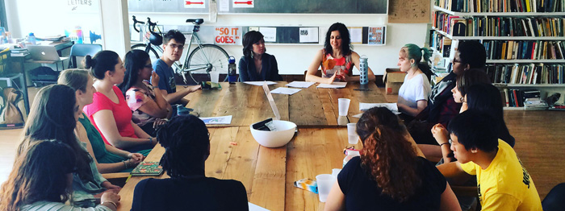
Regional Life Skills Workshops
Candis Jones, ILP Director

Slide 3
Our Why….
The goal of the GARYSE/The Chafee Program Living Life Skill workshops is to provide ILP eligible youth with various life skills to assist them in being self-sufficient when they decide to leave foster care at 18 or age out at 21.
Our window of opportunity is limited, and therefore introduction to, and participation in the life skills learning opportunities is paramount for our young people.

Slide 4
Lookback: 2018 Life Skills Workshops
Our collaborating partner responsible for workshop execution (MAAC) has provided an End Of Year (EOY) report.
Their charge was to influence the following areas:
Increasing youth attendance while reducing the number of “no-shows”.
Increasing the capacity at workshops.
Increase interactive and engaging workshops.

Slide 5
Youth Participation by Gender
Gender | # of Youth | % of Youth
Female | 829 | 51.7%
Male | 774 | 48.3%
Grand Total | 1603 | 100.0%

Slide 6
Youth Participation by Age
Age | # of Youth | % of Youth
15 | 77 | 4.8%
16 | 243 | 15.2%
17 | 356 | 22.2%
18 | 376 | 23.5%
19 | 315 | 19.7%
20 | 136 | 8.5%
21 | 66 | 4.1%
22 | 32 | 2.0%
23 | 2 | 0.1%
Grand Total | 1603 | 100.0%

Slide 7
Participation by Ethnicity
Ethnicity/Race | # of Youth | % of Youth
Asian or Pacific Islander | 4 | 0.2%
Black/African-American | 923 | 57.6%
Hispanic | 85 | 5.3%
Multi-Racial | 7 | 0.4%
Unable to Determine | 1 | 0.1%
White/Caucasian | 583 | 36.4%
Grand Total | 1603 | 100.0%

Slide 8
Workshops by Region
Regions | Oct-Dec17 | Jan-Sept 18 | Cancelled | Total Executed
1 | 6 | 14 | 2 | 18
2 | 6 | 14 | 3 | 17
3 | 6 | 14 | 2 | 18
4 | 5 | 14 | 3 | 16
5 | 6 | 14 | 3 | 17
6 | 6 | 14 | 0 | 14
7 | 6 | 14 | 0 | 14
8 | 3 | 12 | 0 | 12
9 | 6 | 14 | 0 | 14
10 | 6 | 14 | 2 | 18
11 | 6 | 14 | 2 | 18
12 | 6 | 14 | 3 | 17
13 | 7 | 18 | 1 | 24
14 | 6 | 24 | 1 | 29
Total | 81 | 208 | 22 | 246

Slide 9
Programmatic Data
 | Fiscal Year 2018 | Notes
Trainings Offered | 246 | There was at least one training in every region.
Youth Registered | 685 | Average number registered for a workshop per month.
Youth Trained | 506 | Youth approximately trained per month.
Youth Registered and “No show” | 3033 | An average of 337 youth per month. Possible duplication monthly.

Slide 10
What does this date show….
42.2% of the participants are under the age of 18
20% under the age of 17
Average of 506 young people trained per month
Average of 18 youth trained per Region
Average of less than 1 youth under the age of 16 trained per region per month

Slide 11
What strategies should we employ to increase the number of the youth under the age of 17 participating in Regional Workshops?
How can we target youth directly to increase participation?
How can we market the importance of Life Skills trainings with staff – and who are our greatest influencers?
What have we done before that worked well that we should employ?

Slide 12
Future Work Group Endeavors….
Youth Notification System
Life Skills Workshops Workgroup
College Tour Workgroup
Youth Transition Guide Workgroup
Transitional Living Conference

