Slide 1
Records Check Verification Process
Provider Training

Slide 2
Office of Inspector General

Slide 3
Records Check Application
The Federal Bureau of Investigation (FBI) requires that all agencies submit a Record Check Application on potential applicants prior to GBI and FBI processing an applicant’s fingerprints.
Provides authorization for submission of prints to appropriate authorities
Provides authorization for processing of background information by DHS
Office of Inspector General

Slide 4
The Process
Provider registers applicant for fingerprinting in GAPS, then completes and submits Records Check Verification Form via IDHS
DHS approves or denies the GAPS registration based on the Records Check Verification Form review
Upon approval, the applicant receives an email with fingerprinting instructions
Applicant visits GAPS print site Fieldprint and fingerprints are processed by GBI and FBI
Records released to DHS for processing
Office of Inspector General

Slide 5
Registration Verification
DHS will compare the information included in the GAPS/Fieldprint Registration to the information provided on the Records Check Verification Form.
Hiring Agencies will be contacted or GAPS/Fieldprint Registrations will be denied for the following reasons:
Name spelled different on either document.
DOB, POB, or SSN listed different on either document.
Sex or Race listed different on either document.
Reason Fingerprinted different on either document.
Requesting Agency GAP/GAC number left off or same as DHS
Office of Inspector General

Slide 6
Form Submission
Hiring Agency
Visit https://idhs.dhs.ga.gov
Click on the Records Check Application tab
Complete and submit Fingerprint Records Check Verification Form via IDHS after applicant is registered in GAPS.
Office of Inspector General

Slide 7
Application Details
Applicant Information - current information matching the Fieldprint Registration and a government-issued photo ID.
Name of Employer - provider’s business name
Reason Fingerprinted - reason for the background check. A dropdown menu will include the following listing of appropriate reason for fingerprinting (RFP).
DFCS – CPA Adoptions
DFCS/DHS – Foster Care Home Placement
DFCS/DHS – Foster Care Home Placement (5 year renewal)
DHS – Licensing Child Care Center (Director)
DHS – Licensing Child Care Center (Employee)
DHS – Licensing Child Care Center (Volunteer)
DHS – Licensing Child Welfare Agency (Owner)
DHS – Health Agencies/Contractors Providing Direct Child Care
DHS – Health Agencies/Contractors Providing Direct Elder Care = RCCL RFPs
DHS – Employment Contractors Providing Non-Direct Care
DHS - Volunteers Providing Direct Elder Care
DHS - Volunteers Providing Direct Child Care
= Contractor RFPs
Office of Inspector General

Slide 8
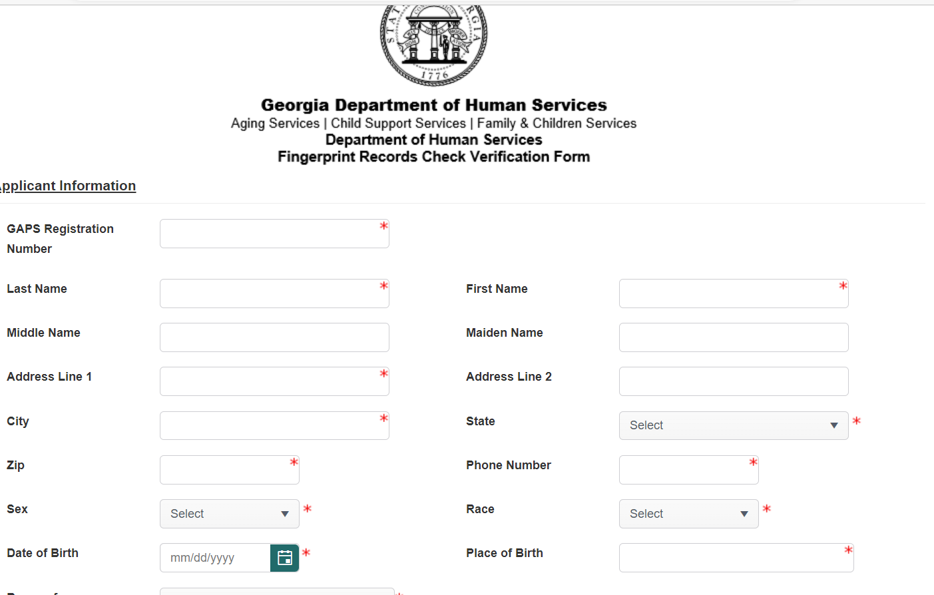
Starting April 29th , 2023, the GAPS Registration Number will no longer be a requirement on the IDHS Record Check form
Enter Correct Full Name
*
Office of Inspector General

Slide 9
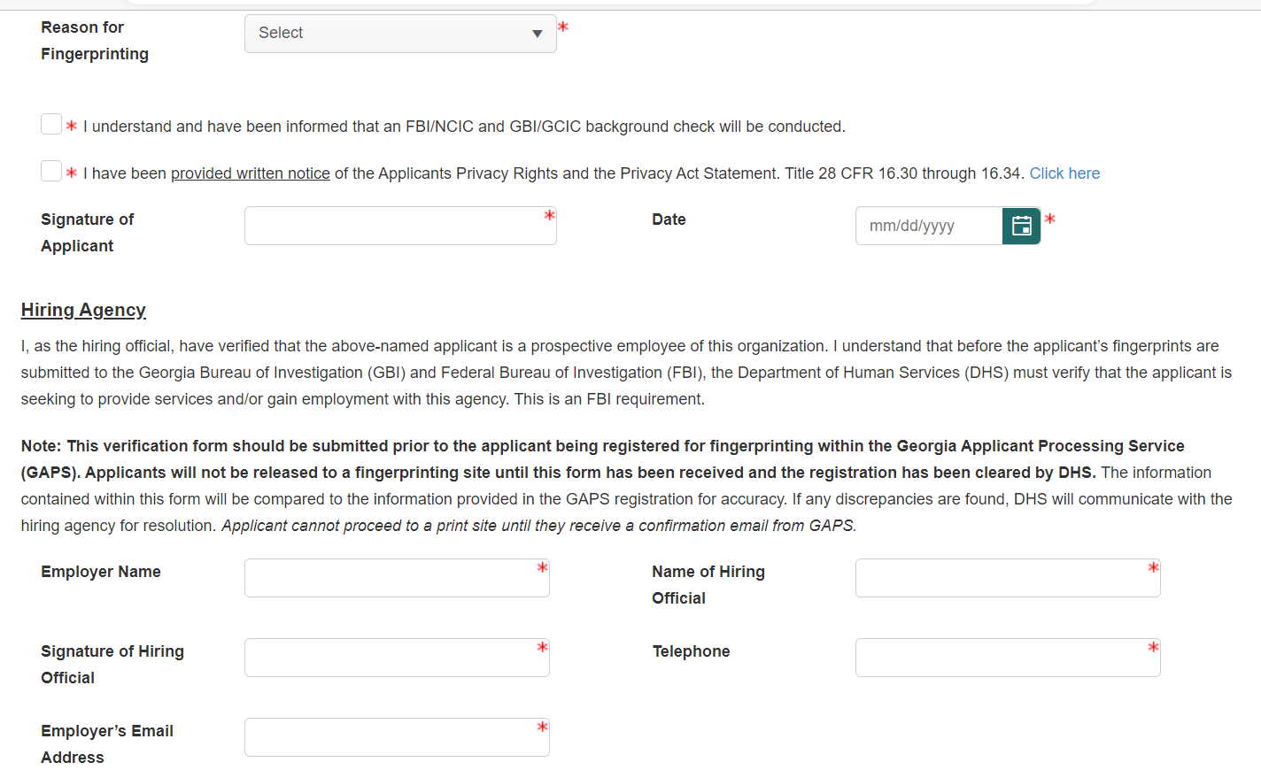
after
*
Office of Inspector General

Slide 10
Record Processing
Applicant’s background checks will be processed within 3 business days from when the Department of Human Services (DHS) receives the results from the state approved vendor.
A clearance determination letter will be accessible by the provider immediately upon being entered into IDHS. Email ASKOIGBIU@DHS.GA.GOV for instructions to access letters.
Applicant’s needing further evaluation will have a final determination uploaded no later than 15 business days from initial record review.
Office of Inspector General

Slide 11
Questions
Please forward all questions to ASKOIGBIU@dhs.ga.gov
Office of Inspector General

